Slide 1
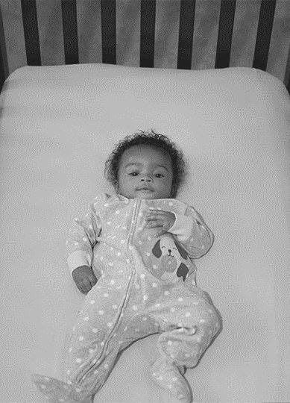

Addressing Disparities in Educating about Safe Infant Sleep :
Strategies for Helping Families
Adopt Safe Sleep Habits
Dr. Stacy D. Scott, Founder
Global Infant Safe Sleep Center

Slide 2

An Unimaginable Heartbreak
Every day, across the country, many families experience a death of an infant
Healthy babies should not die before their first birthday
Despite decades of trying to reduce the number of sudden unexpected infant deaths (SUID), they still persist
Most often in communities of color

Slide 3
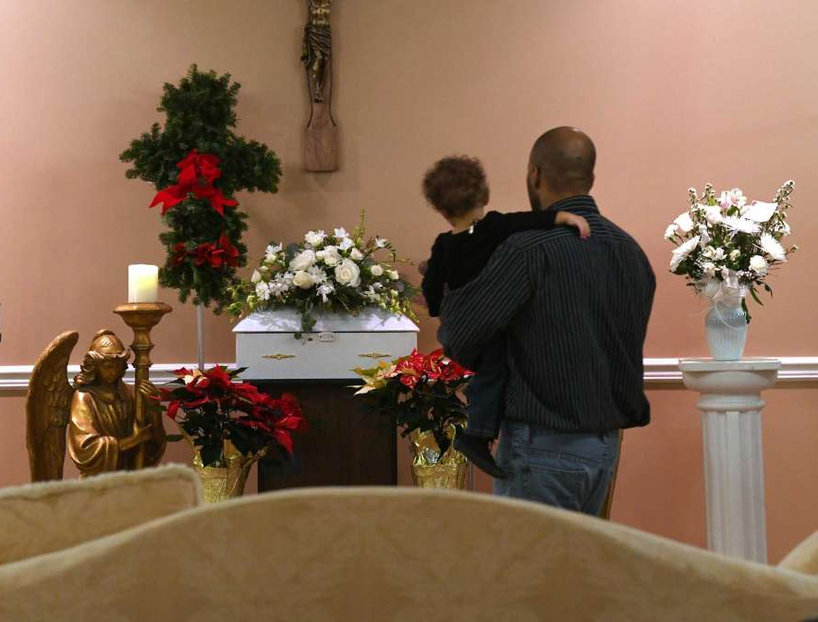
United States ranks 33rd among countries
United States Ranks 33rd among Countries
The infant mortality rate in the United States ranks 33rd among countries belonging to the Organization for Economic Cooperation and Development
There are persistent racial and ethnic disparities, with non-Hispanic black infants dying at a rate 2 to 3 times that of non-Hispanic white infants
↵Organization for Economic Cooperation and Development. Infant mortality rates. 2019. Available at: https://data.oecd.org/healthstat/infant-mortality-rates.htm. Accessed July 8, 2019
Mathews TJ, Driscoll A,Trends in Infant Mortality in the United States, 2005-2014. Washington, DC: National Center for Health Statistics; 2017
Google Scholar

Slide 4
Racial and ethnic differences in infant sleep practices
There are racial and ethnic differences in infant sleep practices that have important implications for racial and ethnic disparities for sleep-related infant deaths, including sudden infant death syndrome and accidental suffocation and strangulation in bed, which are the third leading cause of infant mortality in the United States.
Racial and Ethnic Difference
Hirai AH, Kortsmit K, Kaplan L, et al, Prevalence and factors associated with safe infant sleep practices. Pediatrics. 2019;144(5):e20191286 Abstract/FREE Full TextGoogle Scholar

Slide 5
Pregnancy Risk Assessment Monitoring System (PRAMS)
Researcher leveraged recently added questions to the Centers for Disease Control and Prevention’s Pregnancy Risk Assessment Monitoring System (PRAMS) to examine differences in sleep position, items in the sleep environment, bed-sharing, and room-sharing by race and ethnicity.
Hirai AH, Kortsmit K, Kaplan L, et al, Prevalence and factors associated with safe infant sleep practices. Pediatrics. 2019;144(5):e20191286 Abstract/FREE Full TextGoogle Scholar
Notes:
Forty-seven states currently partner with the Centers for Disease Control and Prevention to administer the PRAMS survey to a randomly selected subpopulation of women in their state who have recently delivered. PRAMS previously only included questions on the infant’s sleep position.

Slide 6
Pregnancy Assessment Monitoring System (PRAMS)
States began to include questions about bed-sharing and items in the sleep environment in 2009. In 2016, those questions, along with additional survey items about room-sharing and safe sleep anticipatory guidance from health care providers, were included for all participating states.
Pregnancy Risk Assessment Monitoring System (PRAMS)
Colvin, JD, Moon, RY., The Pediatrician’s Role in Eliminating Racial and Ethnic Disparities in Sleep-Related Infant Deaths Pediatrics Nov 2019, 144 (5) e20192310; DOI: 10.1542/peds.2019-2310

Slide 7
What They Found
One-third of non-Hispanic black infants were not usually placed on their back to sleep; 75% were not solely placed to sleep in a crib, bassinet, or portable crib; and two-thirds had soft objects in the sleep environment.
Many mothers reported that they never received the full range of safe sleep anticipatory guidance from their health care provider.
Approximately 15% of mothers reported never being told to place their infant in a crib, bassinet, or portable crib to sleep and remove all soft objects from the sleep environment; fewer than 50% were advised to room share without bed-sharing.
What They Found
Colvin, JD, Moon, RY., The Pediatrician’s Role in Eliminating Racial and Ethnic Disparities in Sleep-Related Infant Deaths Pediatrics Nov 2019, 144 (5) e20192310; DOI: 10.1542/peds.2019-2310

Slide 8
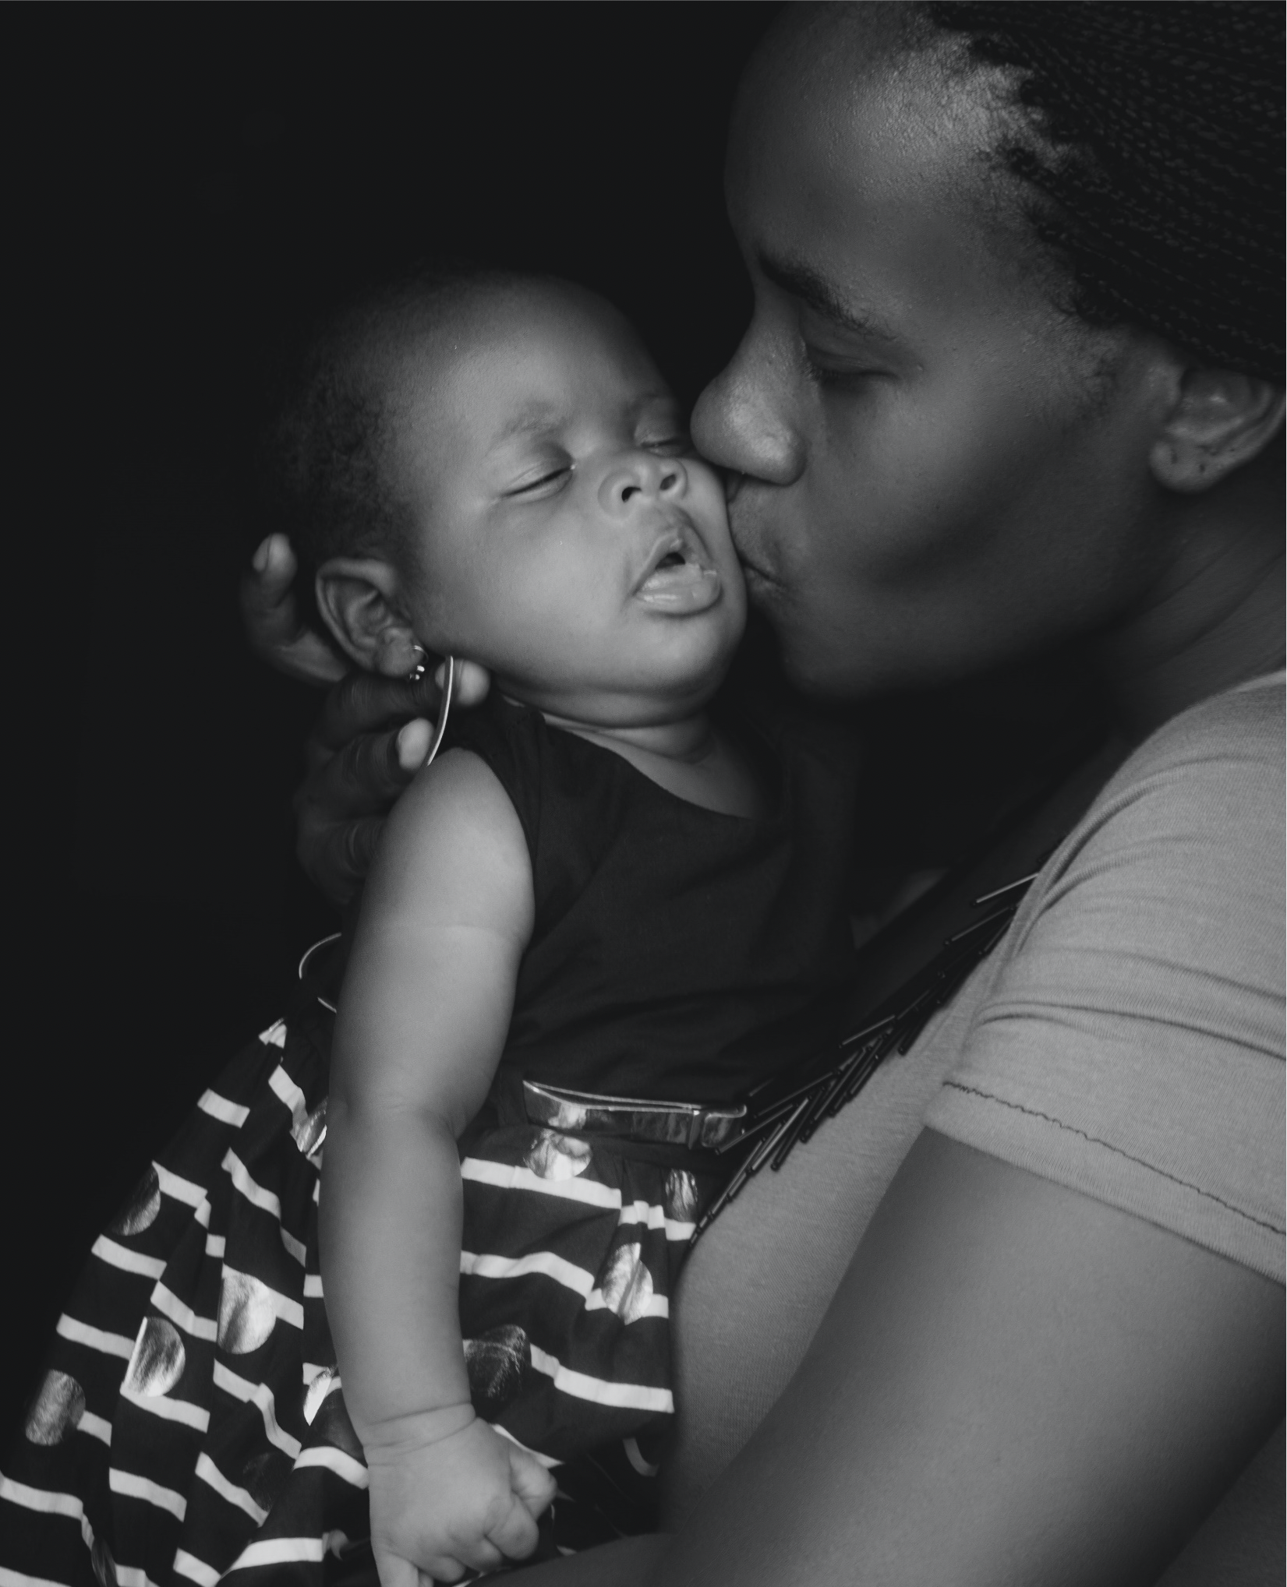
Opportunity to Educate
Even if this anticipatory guidance was given but not remembered by the mothers, these numbers should certainly alert the need to repeatedly discuss safe sleep.
There are multiple opportunities to discuss safe sleep in the newborn nursery and at the frequent well-child visits and weight checks in early infancy.
Colvin, JD, Moon, RY., The Pediatrician’s Role in Eliminating Racial and Ethnic Disparities in Sleep-Related Infant Deaths Pediatrics Nov 2019, 144 (5) e20192310; DOI: 10.1542/peds.2019-2310

Slide 9
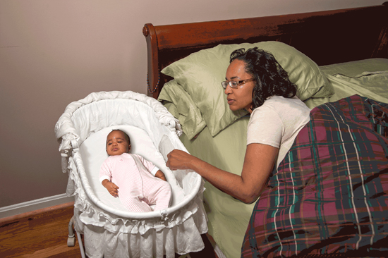
Opportunity to Educate
Parents listen to their health care providers’ advice on safe sleep for their infant.
Mothers who received safe sleep anticipatory guidance from their health care provider were 10% to 30% more likely to place their infant on their back for sleep; place their infant in a crib, bassinet, or portable playpen; room share without bed-sharing; and have no soft objects in the sleep environment.
Colvin, JD, Moon, RY., The Pediatrician’s Role in Eliminating Racial and Ethnic Disparities in Sleep-Related Infant Deaths Pediatrics Nov 2019, 144 (5) e20192310; DOI: 10.1542/peds.2019-2310
Notes:
xThis makes the provision of repeated safe sleep anticipatory guidance all the more important. The most effective guidance will also likely specifically address the primary drivers of parent behavior: perceptions of infant comfort and safety, the mistaken belief that their infant is not at risk, and misplaced confidence in parental vigilance to prevent a sleep-related death.^{4,5,8–12}
Unfortunately, when parents receive inconsistent advice from health care providers, they are more likely to disregard the guidance of all health care providers, instead relying on the advice of friends and family.^{7,11}
This is particularly important because sleep-deprived parents may make decisions about infant sleep position, location, and bedding simply on the basis of their desire for the infant to sleep longer.^{4,5,8–12}
Thus, consistent, evidence-based infant sleep recommendations from all health care providers will be important in eliminating disparities in sleep practices and sleep-related infant mortality.

Slide 10

Family Matters!!!
In previous research, it has been found that the influence of family and friends and the overall weight of social norms are incredibly important.
To overcome those influences, repeated, consistent messaging after the infant leaves the hospital and clinic will be needed.
Furthermore, racial and ethnic health disparities cannot be separated from socioeconomic health disparities in infant mortality.
Colvin, JD, Moon, RY., The Pediatrician’s Role in Eliminating Racial and Ethnic Disparities in Sleep-Related Infant Deaths Pediatrics Nov 2019, 144 (5) e20192310; DOI: 10.1542/peds.2019-2310
Notes:
However, although evidence-based guidance on infant safe sleep from health care providers is essential in eliminating these disparities, it likely will not be sufficient.

Slide 11
The Pediatrician’s Role in Eliminating Racial and Ethnic Disparities in Sleep-Related Infant Deaths
This article states that voices of pediatricians outside of the examination room, as well. The advocacy of pediatricians is essential to advance policies, such as paid parental leave and home visiting programs, to support families with infants so that parents and other child care providers get the support, respite, and consistent health messaging needed to eliminate racial and ethnic disparities in infant sleep-related deaths in the United States.
Colvin, JD, Moon, RY., The Pediatrician’s Role in Eliminating Racial and Ethnic Disparities in Sleep-Related Infant Deaths Pediatrics Nov 2019, 144 (5) e20192310; DOI: 10.1542/peds.2019-2310

Slide 12


Achieving Equity in Infant Survival
Statistics reflect an alarming lack of equity, yet they also illuminate a path of promising change.
If, collectively, we address these disparities, we can drastically reduce sleep-related infant deaths in the U.S.

Slide 13

What needs to done?
We know through evidence-based research what needs to be done; the question now is how can we do more to address disparities in sleep-related infant deaths? And how do we build on the successes that already exist?

Slide 14


Campaign to Conversation
Improving safe sleep practices means helping families understand the existing recommendations and why they matter. And helping them understand means having conversation built on mutual trust.

Slide 15


Ask Yourself?
Who am I empowering outside of my hospital or agency to have these conversations?”
How do we elevate their voices?
How do we facilitate trust?

Slide 16

Building Trust
These conversations can change outcomes, and having them means building trust by pausing to understand and empower those whose family’s health is at stake.
When we do this, we can help stop healthy babies from dying and help spare more families from hurting.

Slide 17


Trust
Trust isn’t something that just exists naturally, especially when working with underserved populations.
We have to understand that these conversations are fraught with underlying tension, which stems from historic trauma and implicit bias.

Slide 18

Trust
It won’t be easy to build that foundation of trust. But building it is what will make these conversations carry weight; it’s what will change perspectives and improve actions.
Building that trust will start with developing authentic relationships with the communities we seek to help.

Slide 19

We Must Be Sensitive
Socio-economic challenges:
  Racism
  Poverty
  Homelessness
  Unemployment
  Low education
  Lack of parenting skills
  Stress
  Mental health

Slide 20

Practice Sensitivity
We need to practice sensitivity while engaging with existing barriers. Many of these families face significant socioeconomic challenges that influence their willingness to adopt safe sleep practices.
Being sensitive to these challenges means focusing on more than their economic status.
It means trying to understand their unique experience, and the specific barriers they face.

Slide 21

Suspending our Biases
Practicing sensitivity also means suspending our biases about what the baby-caregiver dyad looks like.
Not all babies have or are cared for by mothers. In underserved communities, community members sometimes care for babies in lieu of an absent or unhealthy mother.
These caregivers, not to mention single fathers and same-sex male partners, may feel alienated from safe sleep messaging that does not consider their perspective.
Practicing inclusivity comes with any promise to practice sensitivity.

Slide 22


We Must Be Respectful
Convincing past generations, like grandparents, extended family or friends, may be difficult
Community health workers, home visitors, or doulas, trusted third parties play a critical role

Slide 23
Shifting Power
We need to shift the power, understanding that the most powerful way to promote a safe-sleep culture is through the mothers, fathers and members of underserved communities. Many of these mothers rely on the advice of family and fellow community members – those that share and understand their lived experience.

Slide 24
We Must Listen
Trusting the messenger is key to effectively extend the reach of safe sleep and breastfeeding messages. It requires more than delivering the message – one-way communications approach.

Slide 25
We Must Listen
– but also listening to caregivers.- through a two-way or interpersonal communication by focusing on the eyes of the person speaking, making eye contact, watching body language, responding appropriately with comments, questions, and paraphrasing, and summarizing to confirm main points and an accurate understanding

Slide 26
We Must Be Committed
The goal of public health: reduce the rate of infant deaths caused by SIDS and SUID.

Slide 27

We Must Work Together
We need new solutions, but those solutions will only be equitable, and they will only be trusted, if underrepresented people help build them.
We need to remember that it’s much harder to take something apart that has already been constructed.

Slide 28


Community Outreach
We do this best through community outreach that engages third parties already active within these communities.
Community health workers, home visitors and doulas all serve as trusted third parties who can connect with and inspire safe sleep community champions.
Tapping into those community voices from the outset is especially important as we seek to uncover what has not worked

Slide 29


Barriers to Conversations
Many mothers believe that their bed is the safest place for their baby.
These same mothers may live in communities where gun violence is common and burglary expected.
Other mothers may not be able to afford a separate bed for their baby. These are their experiences.
These are the barriers to productive safe sleep conversations that must be addressed.

Slide 30


When health professionals initiate conversations that stem from a sincere desire to understand these barriers, they come closer to achieving the authentic relationships needed for productive conversations.

Slide 31
Work to connect with parents and caregivers
Recognize your own implicit bias
Understand implicit bias of others
Be Honest
Be Sincere
Be Committed

Slide 32
Don’t Just Hear
LISTEN

Slide 33
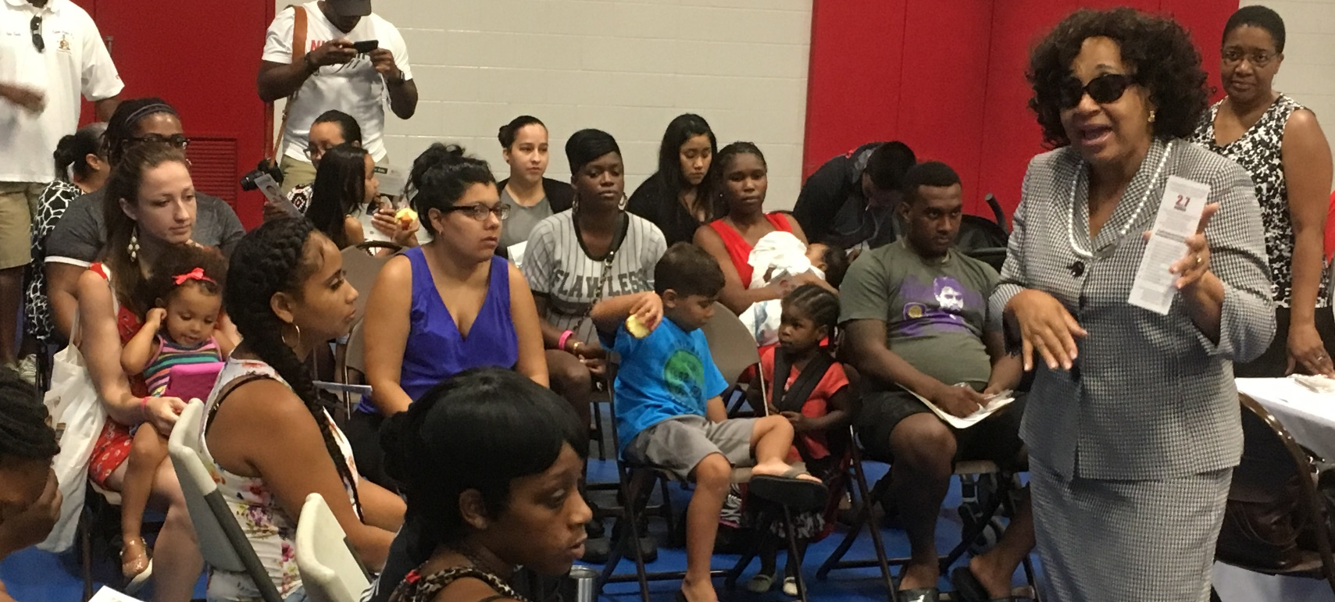
Authentic Community Engagement
Partnering with the community-based organizations to create change and improve health
Kappa Alpha Psi Fraternity, Incorporated – Former First Lady Silhouette Geraldine Battles

Slide 34
And never underestimate the power of the community
#savingourbabies

Slide 35
Thank You
Stacy Scott
Global Infant Safe Sleep Center
sscott@gisscenter.org

