Slide 1
Sleep-Related Death Data
Safe Sleep Collaborative Meeting
Erin Hodson, MPH, Epidemiologist

Slide 2
Safe Sleep Behaviors

Slide 3
AAP Recommended Safe Sleep Behaviors
Safe sleep practices recommended by the AAP include:
Placing the baby on his or her back at all sleep times – including naps and at night.
Using a firm sleep surface, such as a safety-approved mattress and crib.
Keeping soft objects and loose bedding out of the baby’s sleep area.
Sharing a room with baby, but not the same bed.

Slide 4
PRAMS Data
What is PRAMS?
Pregnancy Risk Assessment Monitoring System
Purpose: Collect state-specific population-based data on maternal attitudes and
experiences before, during and shortly after
pregnancy
The PRAMS sample is chosen from all women who had a live birth recently, so findings can be applied to the state’s entire population of women who have recently delivered a live-born infant
PRAMS provides data for state health officials to use to improve the health of mothers and infants.

Slide 5
Safe Sleep Practices by Race/Ethnicity Tennessee, 2017-2018
TN=80%
TN=58%
TN=82%
Data Source: Tennessee Pregnancy Risk Assessment Monitoring System (PRAMS), 2017–2018; Tennessee Department of Health, Office of Population Health Surveillance; Division of Population Health Assessment. Prepared May 2021 by Division of Family Health and Wellness.

Slide 6
Baby’s Usual Sleep Place by Race/Ethnicity Tennessee, 2017-2018
Data Source: Tennessee Pregnancy Risk Assessment Monitoring System (PRAMS), 2017–2018; Tennessee Department of Health, Office of Population Health Surveillance; Division of Population Health Assessment. Prepared May 2021 by Division of Family Health and Wellness.

Slide 7
How Baby Sleeps by Race/Ethnicity Tennessee, 2017-2018
TN=47%
Data Source: Tennessee Pregnancy Risk Assessment Monitoring System (PRAMS), 2017–2018; Tennessee Department of Health, Office of Population Health Surveillance; Division of Population Health Assessment. Prepared May 2021 by Division of Family Health and Wellness.

Slide 8
Safe Sleep Practices by Maternal Age Tennessee, 2017-2018
TN=80%
TN=58%
TN=82%
Data Source: Tennessee Pregnancy Risk Assessment Monitoring System (PRAMS), 2017–2018; Tennessee Department of Health, Office of Population Health Surveillance; Division of Population Health Assessment. Prepared May 2021 by Division of Family Health and Wellness.

Slide 9
Baby’s Usual Sleep Place by Maternal Age Tennessee, 2017-2018
Data Source: Tennessee Pregnancy Risk Assessment Monitoring System (PRAMS), 2017–2018; Tennessee Department of Health, Office of Population Health Surveillance; Division of Population Health Assessment. Prepared May 2021 by Division of Family Health and Wellness.

Slide 10
How Baby Sleeps by Maternal Age Tennessee, 2017-2018
Data Source: Tennessee Pregnancy Risk Assessment Monitoring System (PRAMS), 2017–2018; Tennessee Department of Health, Office of Population Health Surveillance; Division of Population Health Assessment. Prepared May 2021 by Division of Family Health and Wellness.

Slide 11
Did Medical Professional Tell You the Following? Tennessee Mothers by Race/Ethnicity, 2017-2018
TN=97%
TN=92%
TN=58%
TN=92%
Data Source: Tennessee Pregnancy Risk Assessment Monitoring System (PRAMS), 2017–2018; Tennessee Department of Health, Office of Population Health Surveillance; Division of Population Health Assessment. Prepared May 2021 by Division of Family Health and Wellness.

Slide 12
Did Medical Professional Tell You the Following? Tennessee Mothers by Age, 2017-2018
TN=97%
TN=92%
TN=57%
TN=92%
Data Source: Tennessee Pregnancy Risk Assessment Monitoring System (PRAMS), 2017–2018; Tennessee Department of Health, Office of Population Health Surveillance; Division of Population Health Assessment. Prepared May 2021 by Division of Family Health and Wellness.

Slide 13
Gap Between Recommended and Actual Behavior: Placing Baby to Sleep on Back
Data Source: Tennessee Pregnancy Risk Assessment Monitoring System (PRAMS), 2017–2018; Tennessee Department of Health, Office of Population Health Surveillance; Division of Population Health Assessment. Prepared May 2021 by Division of Family Health and Wellness.

Slide 14
Sleep-Related Infant Death

Slide 15
Overall and Sleep-Related Infant Deaths Tennessee, 2015-2019
Data Source: Tennessee Department of Health, Office of Vital Records & Statistics, Death Statistical System; Tennessee Department of Health, Division of Family Health and Wellness, Child Fatality Review Database. Prepared April 2019 by Division of Family Health and Wellness.

Slide 16
Racial Disparity in Sleep-Related Infant Death Tennessee, 2015-2019
Rate amongst Black infants nearly 4 times as high as rate amongst White infants
Data Source: Tennessee Department of Health, Division of Family Health and Wellness, Child Fatality Review Database. Prepared May 2021 by Division of Family Health and Wellness.

Slide 17
Infant Age at Time of Sleep-Related Death Tennessee, 2015-2019
Data Source: Tennessee Department of Health, Division of Family Health and Wellness, Child Fatality Review Database. Prepared April 2019 by Division of Family Health and Wellness.

Slide 18
Infant Age at Time of Sleep-Related Death Tennessee, 2015-2019
80% of sleep-related infant deaths occurred when infant was under 5 months of age
Data Source: Tennessee Department of Health, Division of Family Health and Wellness, Child Fatality Review Database. Prepared April 2019 by Division of Family Health and Wellness.

Slide 19
Rate of Sleep-Related Infant Death by Region Tennessee, 2015-2019
Data Source: Tennessee Department of Health, Division of Family Health and Wellness, Child Fatality Review Database. Prepared May 2021 by Division of Family Health and Wellness.

Slide 20
Where was baby placed to sleep? Tennessee, 2015-2019
Data Source: Tennessee Department of Health, Division of Family Health and Wellness, Child Fatality Review Database. Prepared May 2021 by Division of Family Health and Wellness.

Slide 21
Where was baby placed to sleep? Tennessee, 2015-2019
Data Source: Tennessee Department of Health, Division of Family Health and Wellness, Child Fatality Review Database. Prepared May 2021 by Division of Family Health and Wellness.

Slide 22
Contributing Factors in Sleep-Related Infant Deaths Tennessee, 2015-2019
Data Source: Tennessee Department of Health, Division of Family Health and Wellness, Child Fatality Review Database. Prepared May 2021 by Division of Family Health and Wellness.

Slide 23
Contributing Factors in Sleep-Related Infant Deaths Tennessee, 2015-2019
Data Source: Tennessee Department of Health, Division of Family Health and Wellness, Child Fatality Review Database. Prepared May 2021 by Division of Family Health and Wellness.

Slide 24
Contributing Factors in Sleep-Related Infant Deaths by Region, 2015-2019
Leading Contributing Factor
Unsafe bedding or toys in the sleeping area | Infant not sleeping in crib or bassinet
Davidson Shelby Knox Sullivan Northeast East Southeast South Central West Mid-Cumberland Upper Cumberland | Hamilton Madison
Data Source: Tennessee Department of Health, Division of Family Health and Wellness, Child Fatality Review Database. Prepared May 2021 by Division of Family Health and Wellness.

Slide 25
Safe Sleep Diaper Bag

Slide 26
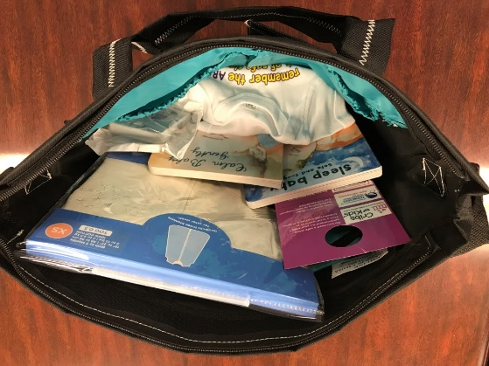
Safe Sleep Diaper Bag Data
Partnership with Community Health Access and Navigation in Tennessee (CHANT)
652 diaper bags distributed from January 2019-April 2021
Recipients were 34% Black, 60% White
Most common age group: 25-34 (42%)
Three-fourths (75%) received bag after their infant’s birth
68% were covered by TennCare, 15% had no health insurance

Slide 27
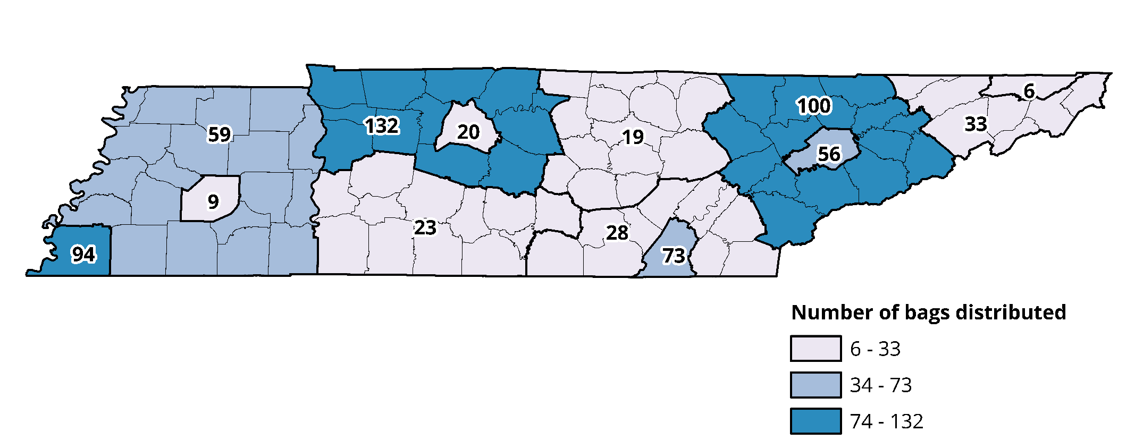
CHANT Recipients by Region

Slide 28
Data to Date
At follow-up visit…
Of those that changed their behavior, caregivers reported that they had started placing their baby…
Reported reading the books and written materials
Reported that the items in the bag had caused them to change the way the put their infant to sleep

Slide 29
Contact Information
Ibitola Asaolu, DrPH, MPH, Epidemiologist
ibitola.asaolu@tn.gov
615-253-0374
Erin Hodson, MPH, Epidemiologist
Erin.Hodson@tn.gov
615-253-2802

