Slide 1
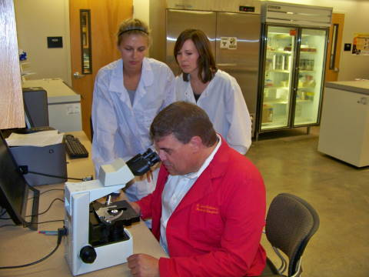
MYTHBLASTERS
TENNESSEE T.A.L.K.S.
TEACHING
ACTIVITIES THAT
LEAD TO
KNOWLEDGE AND
SAFETY
In collaboration with Tennessee Coordinated School Health (CSH)

Slide 2
You can get HIV from kissing someone who is HIV+.
The only way you
can contract an STD is by
having unsafe sex with more
than one person.
You can get HIV from mosquitoes.
MYTHBLASTERS
Here in America, HIV
knowledge is so prevalent
That 50% of people aged
18-64 get tested annually.
Drug use or abuse increases a person’s risk of HIV infection.
A person who is infected with an STD has a greater risk of
HIV infection.

Slide 3
You can get HIV from mosquitoes.
HIV can only live for a short time inside an insect
Biting insects do not inject the blood that is already inside them into a new host
BLASTED
MYTHBLASTERS
Notes:
Because HIV is spread through blood, people have worried that biting or bloodsucking insects might spread HIV. Several studies, however, show no evidence to support this -- even in areas with lots of mosquitoes and cases of HIV. When insects bite, they do not inject the blood of the person or animal they have last bitten. Also, HIV lives for only a short time inside an insect.

Slide 4
You can get HIV from kissing someone who is HIV+
Evidence shows that HIV is not spread through touch, tears, sweat, or saliva.
Unless both partners have large open sores in their mouths, or severely bleeding gums, there is no transmission risk from mouth-to-mouth kissing
HIV is spread through 4 bodily fluids: blood, semen, vaginal secretions, and breast milk.
BLASTED
MYTHBLASTERS
Notes:
To become infected with HIV you must get a sufficient quantity of the virus into your body. Saliva does contain HIV, but the virus is only present in very small quantities and as such cannot cause HIV infection.

Slide 5
The only way you can contract an STI is by having unsafe sex with more than one person.
All it takes is one time, with one person.
The more partners you have, the better your chance of getting an STD, but in the end (like getting pregnant), the magic number is One.
Abstinence is the only 100% effective method for the prevention of STIs and pregnancy.
BLASTED
MYTHBLASTERS

Slide 6
Drug use or abuse increases the risk of HIV infection.
Injection drug use is one of the primary ways HIV is spread.
Additionally, using any drug increases the likelihood of taking sexual risks.
Drug use also lowers immune functioning further increasing the risk of transmission.
FACT
MYTHBLASTERS

Slide 7
A person who is infected with an STD has a greater risk of HIV infection.
HIV can enter the bloodstream when blood or other body fluids come in contact with any open sore.
The lesions caused by STDs such as herpes or syphilis provide a possible entry point for the virus.
This puts the person at a much greater risk of HlV infection.
FACT
MYTHBLASTERS

Slide 8
Here in America, HIV knowledge is so prevalent that 50% of people aged 18-64 get tested annually.
According to recent data only 10% of adults report getting tested each year.
The CDC recommends getting tested 3 months after last possible exposure.
Regular testing is essential to prevent disease transmission.
BLASTED
MYTHBLASTERS

Slide 9
HIV/STI: The Reality
Transmission
Unprotected sex, unclean needles
Risk factors
Multiple partners, no protection, sharing needles
Only way to fully protect oneself
ABSTINENCE!
MYTHBLASTERS
Notes:
What we’ve learned today…HIV is deadly STD that is transmitted via unprotected sexual contact or sharing unclean needles
It is NOT curable (virus)
Some risk factors include: having multiple partners, using no protection during sexual activity, sharing used needles
You cannot get HIV through hugging, kissing, touching, or drinking after someone with HIV
The one and only way to 100% protect yourself is by practicing abstinence!

Slide 10
Thank you!
Tennessee
T.A.L.K.S
Teaching Activities that Lead to Knowledge and Safety
Notes:
Webmd.org and cdc.gov was used in this presentation

