Slide 1

Building Inclusive Mindsets
Presenters:
Dr. Adrienne Cook, Exceptional Education Coach
Christopher Flor, Transition Coordinator
Notes:
Good morning/afternoon and welcome to The Implementation of Accommodations and Modifications in the Classroom setting. This training has been adapted to consider both virtual and face-to-face instruction.
Determine which of the following welcoming rituals you will use: There is one for in-person and one for virtual (make sure to hide the one you are not using)

Slide 2
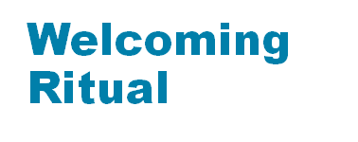

Answer these items to yourself.
What is inclusion?
What makes it meaningful?
Notes:
Virtual: Let's take a minute to reflect on our year so far. Put a GIF in the chat that captures your school year at its best moment and at its most challenging. Be prepared to explain your selection!
Moderator narrates gifs appearing in the chat using names to identify participants. Cold call on one participant to share some backstory about their responses.

Slide 3


Brave Space Norms
Be vulnerable
Look to your own growth first
Accept non-closure
Take the perspective of others
Assume best intentions
Lean into discomfort/fear
Think critically
Consider impact over intent
Practice mindfulness

Slide 4

To be more mindful of
exclusionary language and harmful mindsets about students with disabilities.
To understand the legal basis of inclusion.
Outcomes

Slide 5
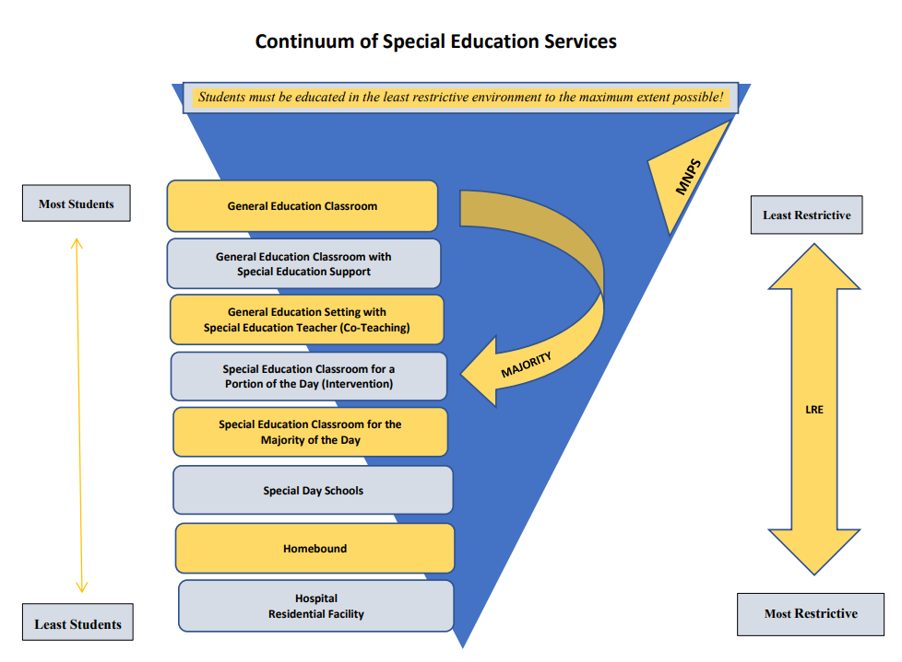
Social/Academic support w/paraprofessional or other support personnel (e.g. related service provider)
Notes:
This is the updated MNPS Department of Exceptional Education services continuum model. Remember when making decisions we always start with the least restrictive service and move to the most restrictive based on student needs. The goal is always to move towards the least restrictive service as the student’s needs are met.

Slide 6
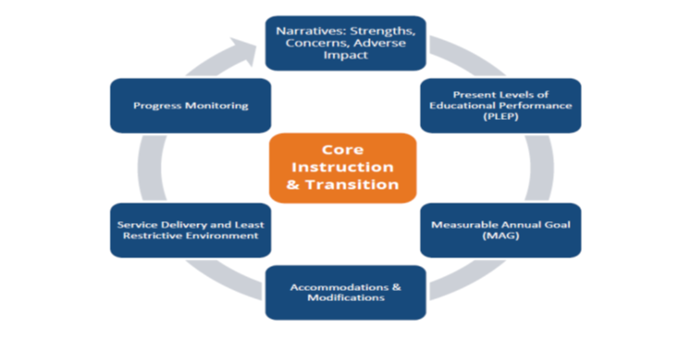

Special Education is all about…
Therefore,
Notes:
This is a reminder of our district’s vision, mission and values
Our vision is thus: That Metro Nashville Public Schools will be the fastest improving urban school system in America, ensuring that every student becomes a life-long learner prepared for success in college, career, and life. Our mission is that we deliver a great public education to every student, every day. Through this, we value the whole learner, literacy, excellence, relevance, innovation, talent, collaboration, equity, and diversity.
The purpose of the IEP process is to ensure that SWD have meaningful access to core instruction and Transition no matter the grade-level or ability of the child. Core instruction and a focus on transition should prepare students for life after high school—whether that is post-secondary education and training or career.

Slide 7
Inclusive Education
  Inclusive education views ________ as the norm and ensures a high-quality education for every ___________by setting _______ standards and providing effective instruction along with necessary ________for ________.
diversity
student
rigorous
support
success
Notes:
This is the district’s definition of inclusive education. Take a minute to see if you can figure out what the missing words are. Click to bring in words one at a time.
Discuss necessary supports + the importance of accom/modif

Slide 8
What Does the Law Say?
Federal and state laws and regulations require schools to provide accommodations and modifications to make sure that students with disabilities have access to an appropriate education program.
The Individuals with Disabilities Education Improvement Act (IDEIA 2004) requires that students with disabilities have the opportunity to be involved and make progress in the general curriculum.
Section 504 of the Rehabilitation Act of 1973 requires that accommodations be provided to students with disabilities, even if they don’t have an IEP.
The Americans with Disabilities Act of 1990 prohibits discrimination against any people with disabilities.
Notes:
Before we can talk about accommodations and modifications, we have to understand the laws that govern students with disabilities. Read bold statement first “Federal and State…)
Click prior to reading each bullet to highlight the bullet you are on:
(Click) “The Individuals…”
(Click) “Section 504”
(Click) “The Americans…”
ADA prohibits discrimination on the basis of disability, so schools need to accommodate for student’s disability within the general curriculum.

Slide 9
Federal Least Restrictive Environment (LRE) Requirements
34 C.F.R. Section 300.114
Each public agency shall ensure –
(i) That to the maximum extent
appropriate, children with disabilities, …
are educated with children who are
nondisabled;
and
Notes:
Least Restrictive Environment is defined in federal law as the following.... READ LAW

Slide 10
Federal LRE Requirements
34 C.F.R. Section 300.114
(ii) That special classes, separate schooling or other removal of children with disabilities from the general educational environment occurs only if the nature or severity of the disability is such that education in general classes with the use of supplementary aids and services cannot be achieved satisfactorily.
Notes:
READ THIS

Slide 11
Federal LRE Requirements
34 C.F.R. 300.116
(e) A child with a disability is not removed from education in age-appropriate general classrooms solely because of needed modifications in the general curriculum.
(Authority: 20 U.S.C. 1412 (a)(5))
Notes:
READ THIS AND DISCUSS….what do you think about this wording in the law? Do you agree?

Slide 12

Continuum of LRE Options
“...a continuum of alternative placements is available to meet the needs of children with disabilities... including instruction in general classes, special classes, special schools, home instruction, and instruction in hospitals.” (Federal Register, 1977).
Notes:
- Placement will be different for each child.
- Placement should be in most “natural” environment in which the child can succeed.
- Placement should not be based on a label.
Remind participants of the continuum shown earlier (image on screen)

Slide 13

The “least dangerous assumption” states that in the absence of absolute evidence, it is essential to make the assumption that, if proven to be false, would be least dangerous to the individual. Considering general education first for all students, regardless of disability, is a critical component of the least dangerous assumption. Evidence and data collected should be discussed at each IEP meeting before making the determination that a student requires a more restrictive setting.”
TDOE Special Education Framework 2018
Notes:
We have discussed what Federal laws say but what does Tennessee say in regard to LRE? According to the TN Sped Framework we keep the Least Dangerous Assumption in mind when thinking about LRE. READ SLIDE.
Emphasize general education first and data collection (data-based decision making)

Slide 14
Now you know the legal basis for inclusion.
Let’s talk about the mindset of inclusion.

Slide 15
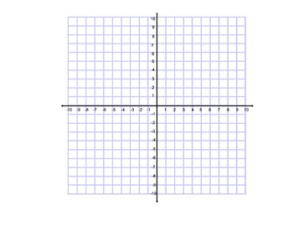
Looks Like | Sounds Like | Feels Like
Looks Like | Sounds Like | Feels Like
Growth-Mindset
Q2
1.
2.
Q1
1.
2.
Exclusionary
Inclusive
Q3
1.
2.
Q4
1.
2.
Looks Like | Sounds Like | Feels Like
Fixed-Mindset
Looks Like | Sounds Like | Feels Like
Notes:
In order to think deeply about this, let’s juxtapose the concept onto coordinate plane. What does bravery look like juxtaposed against injustice? The ideal is probably for bravery to produce justice. But what about if we are brave and yet injustice prevails anyway? How about success? Lastly, let’s think about a classroom that perpetuates or disrupts inequity. I want my bravery to disrupt the patterns of inequity that disadvantage my students. What is happening in a classroom where the teacher just gets by? Continued inequity is harmful. SO let’s acknowledge when our lack of action perpetuates inequity.

Slide 16
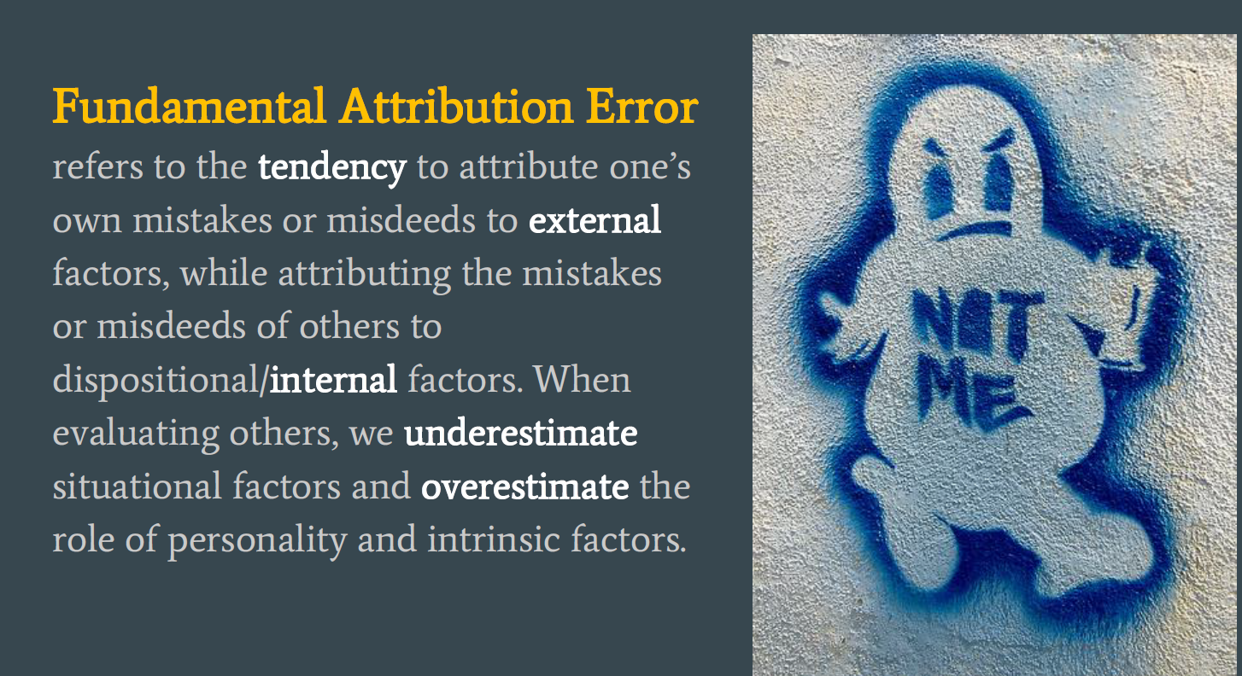

Slide 17
Turn and Talk:
Fundamental Attribution Error can lead to fixed mindsets by…

Slide 18
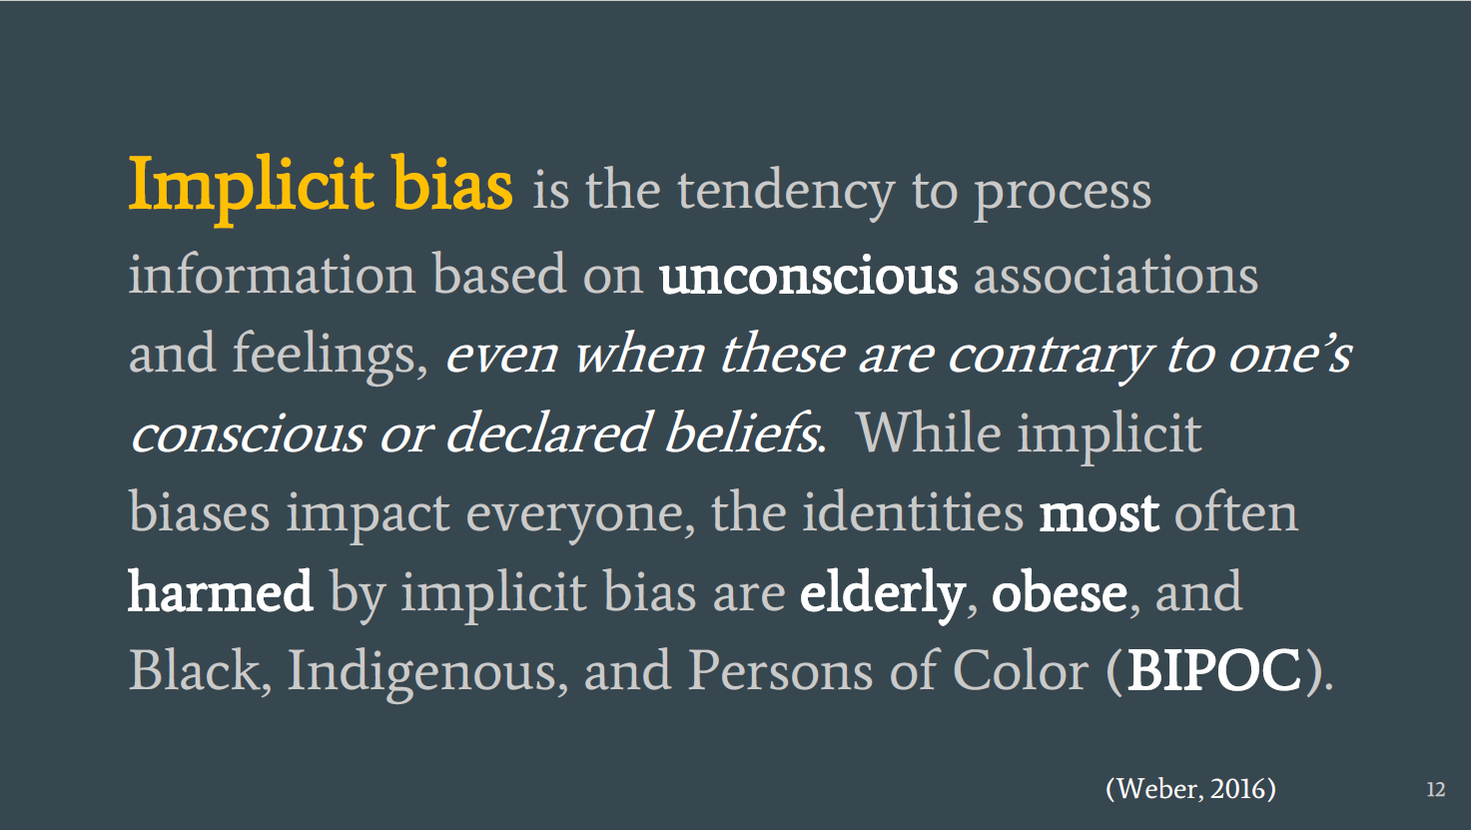

Slide 19
An Invitation to Discomfort
Stop and Jot
One-way implicit bias can manifest toward individuals with disabilities in our classrooms.

Slide 20
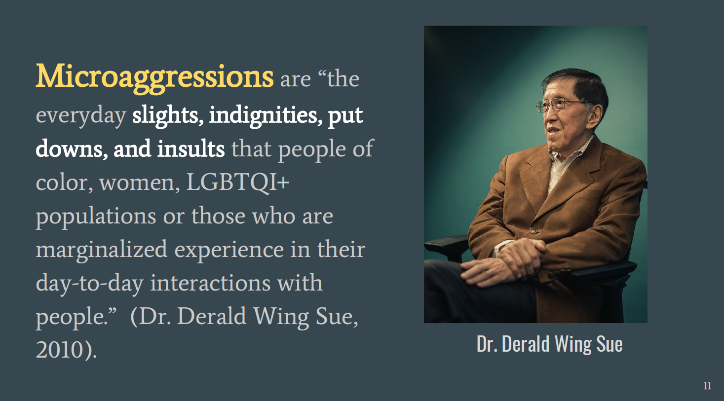

Slide 21
Can microaggressions have a function?
Antecedent | Behavior | Consequence
Student is misbehaving | Microaggression associating behavior with identity: She is just BAD. | Escape having to meaningfully support the student. Justification of exclusionary practices.
Antecedent | Behavior | Consequence
Class with chronic misbehavior. | They just don’t value education in their community. They do not care. | Escape having to meaningfully support the class. Justification of exclusionary practices
Antecedent | Behavior | Consequence
Student sleeping in class | He knows he should be working in class. He is choosing not to. | Escape having to meaningfully support the class. Justification of exclusionary practices
Antecedent | Behavior | Consequence
Student fails reading. | He doesn’t want to try in my class. It is never not going to be hard for him. | Escape having to meaningfully support the student. Justification of exclusionary practices

Slide 22
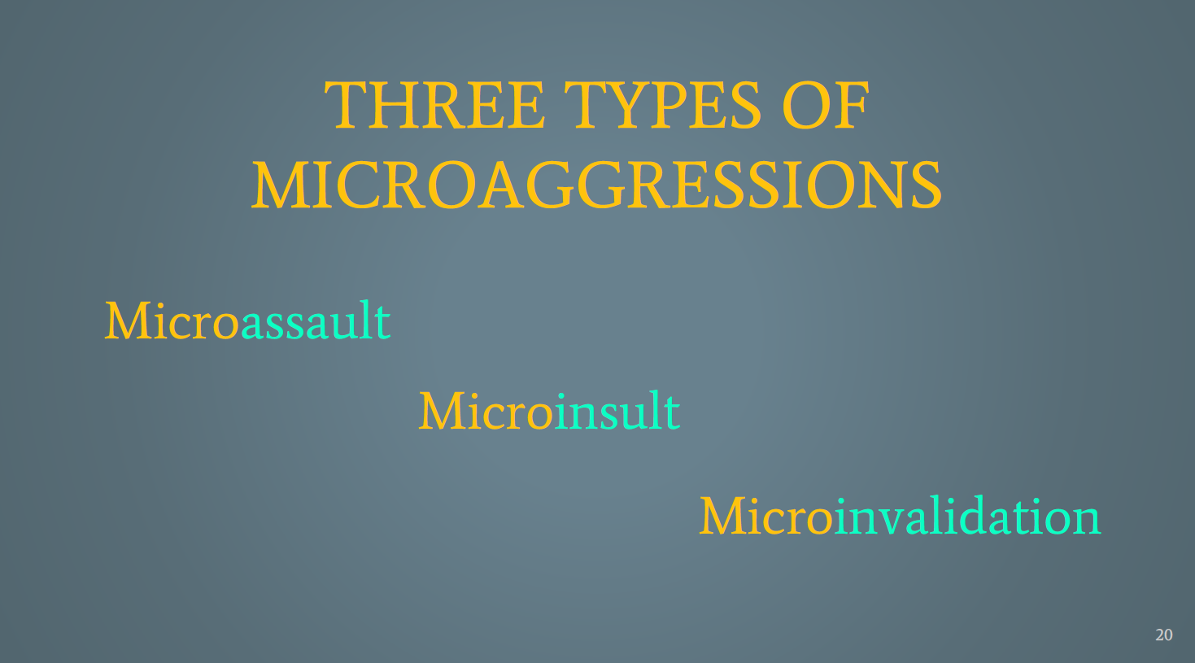

Slide 23
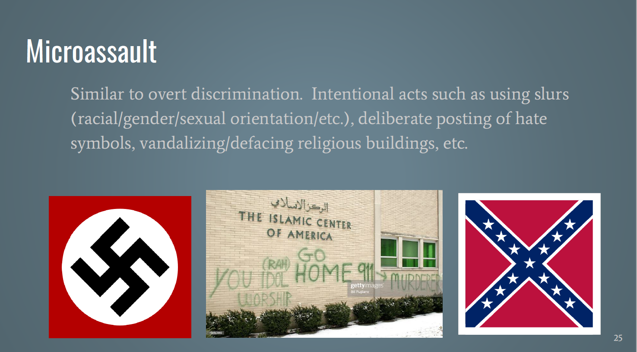

Slide 24
Can you think of another example of a micro-assault commonly used toward students with disabilities?

Slide 25
THE R WORD
SPAZ
SLOW

Slide 26
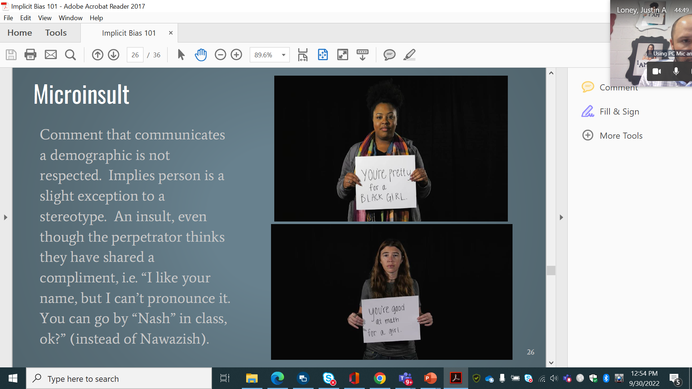
She looks normal for a child with autism.
He isn’t EMN. He is just B.A.D.
He did great in class today. Didn’t do any work.. but no tantrums.

Slide 27
Activity: Turn to a partner and identify an example of a micro-insult regarding a student with a disability.

Slide 28
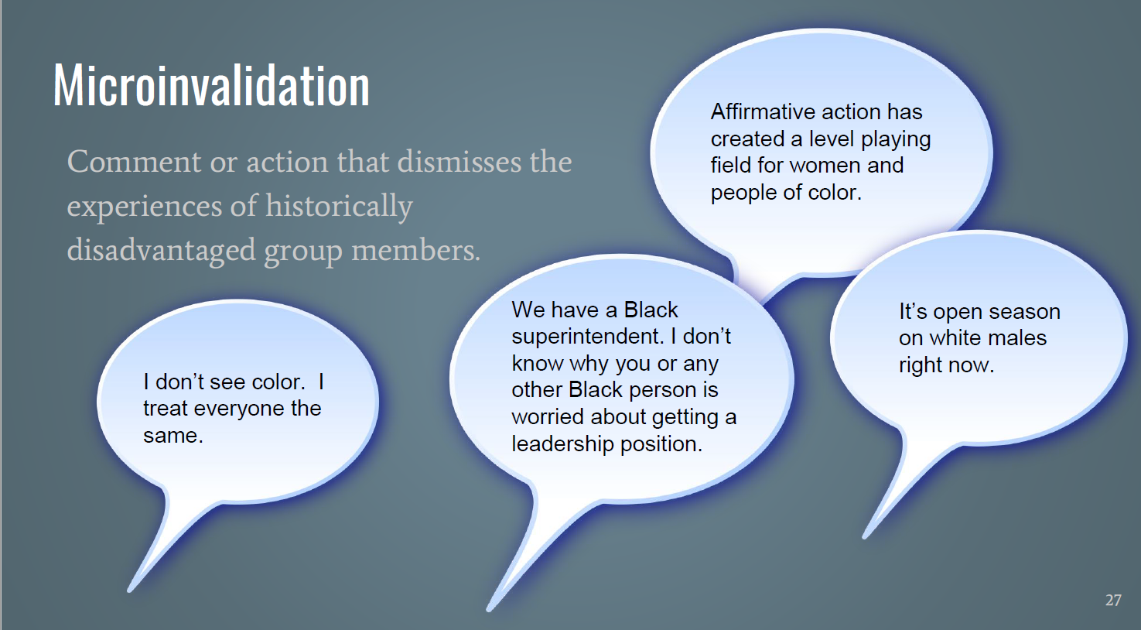
Don’t worry about the assignment. It’s not on your level.
Sure he can come to my class, but I doubt he will get anything out of it.
Don’t expect any support from the family…

Slide 29
Activity: On a sheet of note paper, list a few micro-invalidations that often are used toward students with disabilities.

Slide 30
With your table, discuss the micro-invalidations you had and draw connections between them and what we do as special educators. How does this relate to the legal components we discussed earlier? Be prepared to share out.

Slide 31
Exit Ticket
Write on a piece of paper a time where you displayed a microaggression toward a student with a disability. Then throw your exit ticket into the trash when you leave.

Slide 32
Q&A
Presenters:
Christopher.Flor@MNPS.org and Adrienne.Cook@MNPS.org

