Slide 1
Identifying and Serving Multilingual Learners with Disabilities
Murfreesboro City Schools
Casey Brasher, Ph.D
Aerial Mosley, Ed.S

Slide 2
OBJECTIVES
1
2
3
Discuss practical and consistent procedures for identifying language differences and disability in multilingual learners.
Help educators select appropriate and effective teaching and learning strategies in general education and special education settings.
Discuss considerations for evaluating multilingual learners for educational disabilities.

Slide 3
A little about the presenters…
Casey Brasher, Ph.D
School Psychologist for 15 years
Ph.D. in Literacy Studies -Specialization: Dyslexia & Reading Disabilities
Adjunct instructor in the Elementary and Special Education Department at Middle Tennessee State University
Dyslexia Assessment Specialist at the TN Center for the Treatment and Study of Dyslexia (2011-2016)

Slide 4
A little about the presenters…
Aerial Mosley, Ed.S
Murfreesboro City Schools ELD District Specialist/Coach
Ed.S in Curriculum and Instruction
English Language Development Teacher for 13 years
Taught in Dual Language & Arts School in Texas

Slide 5
01.
The Process

Slide 6
The Bilingual Difference
Monolingual English Speakers | Bilingual Learners
Exposed to English exclusively in the home, school, and environment. | Hear and use multiple languages in various environments.
Only one language in the neuro-cognitive processing. | Use both languages when listening, reading, and planning speech in either language.
Can speak and understand the language in which they are learning to read. | Are learning to read in a language they are simultaneously still learning to speak and understand.
Can understand classroom instructional and management language. | Are learning to interpret teacher management and instructional language as well as learn to hear sounds in words to decode, understand and read English fluently.
Reading programs and assessments have been developed and normed on monolingual English speakers. | Reading programs and assessments were not normed on bilingual learners and often underestimate their abilities.

Slide 7
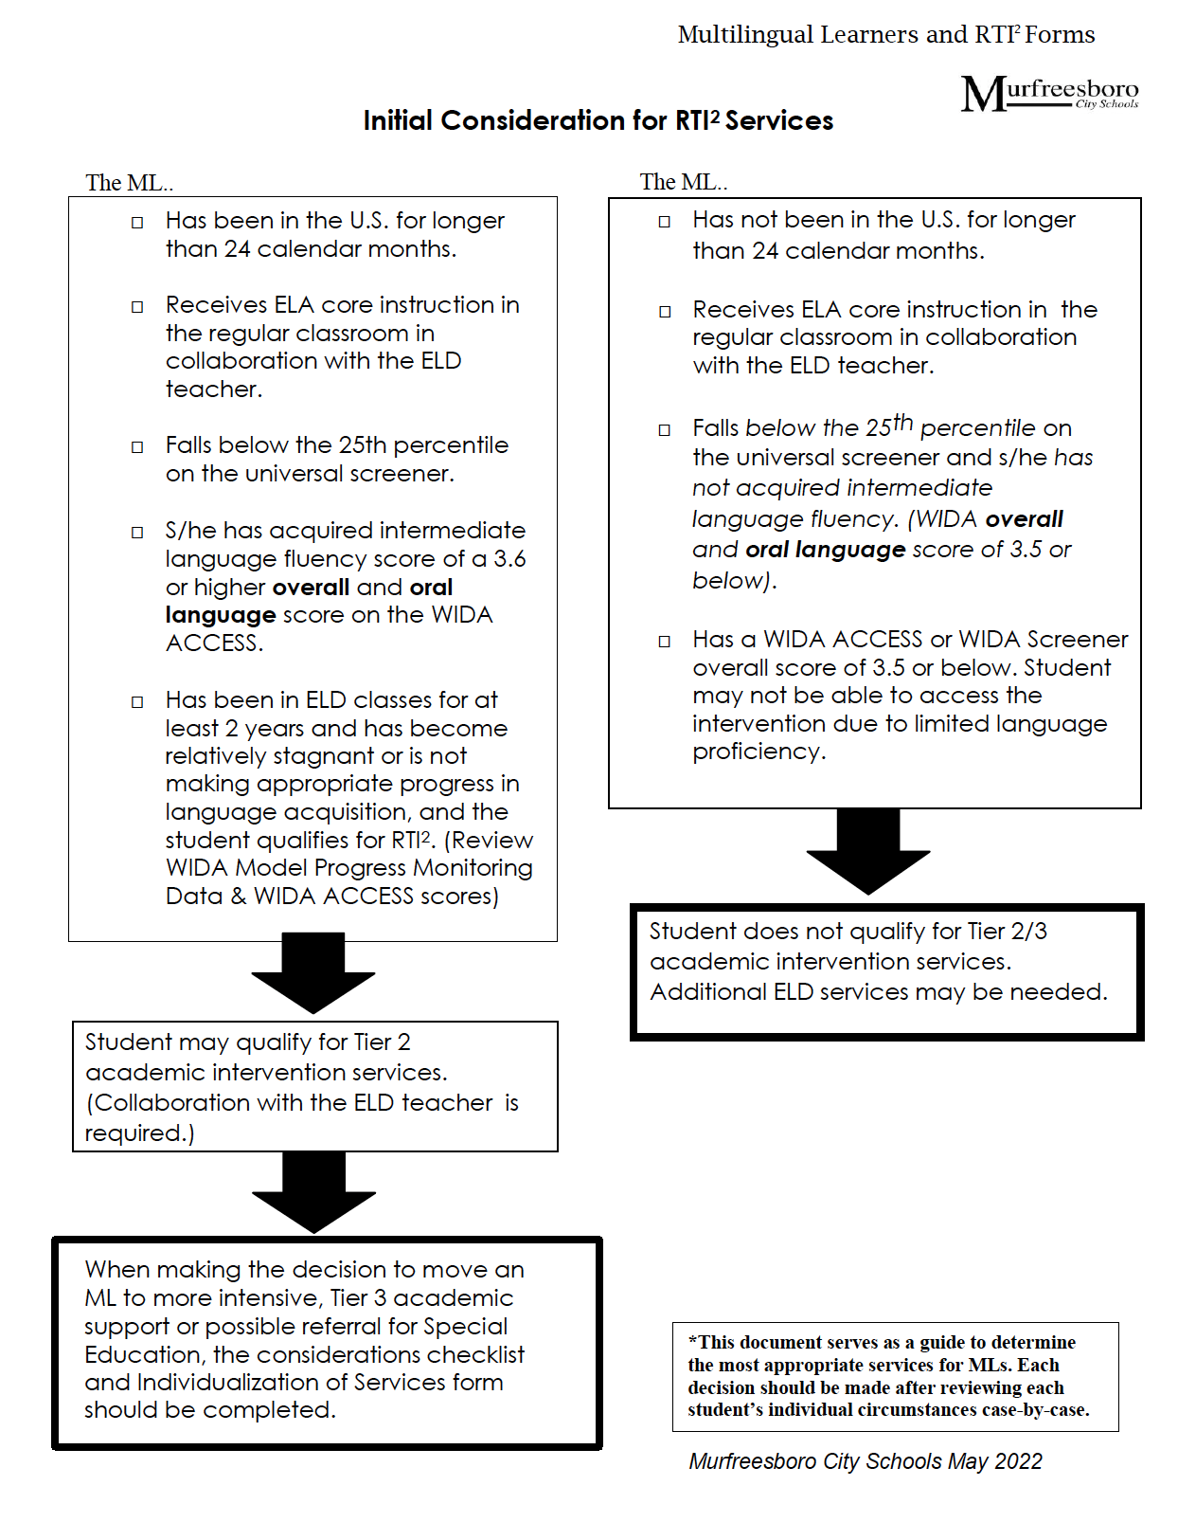
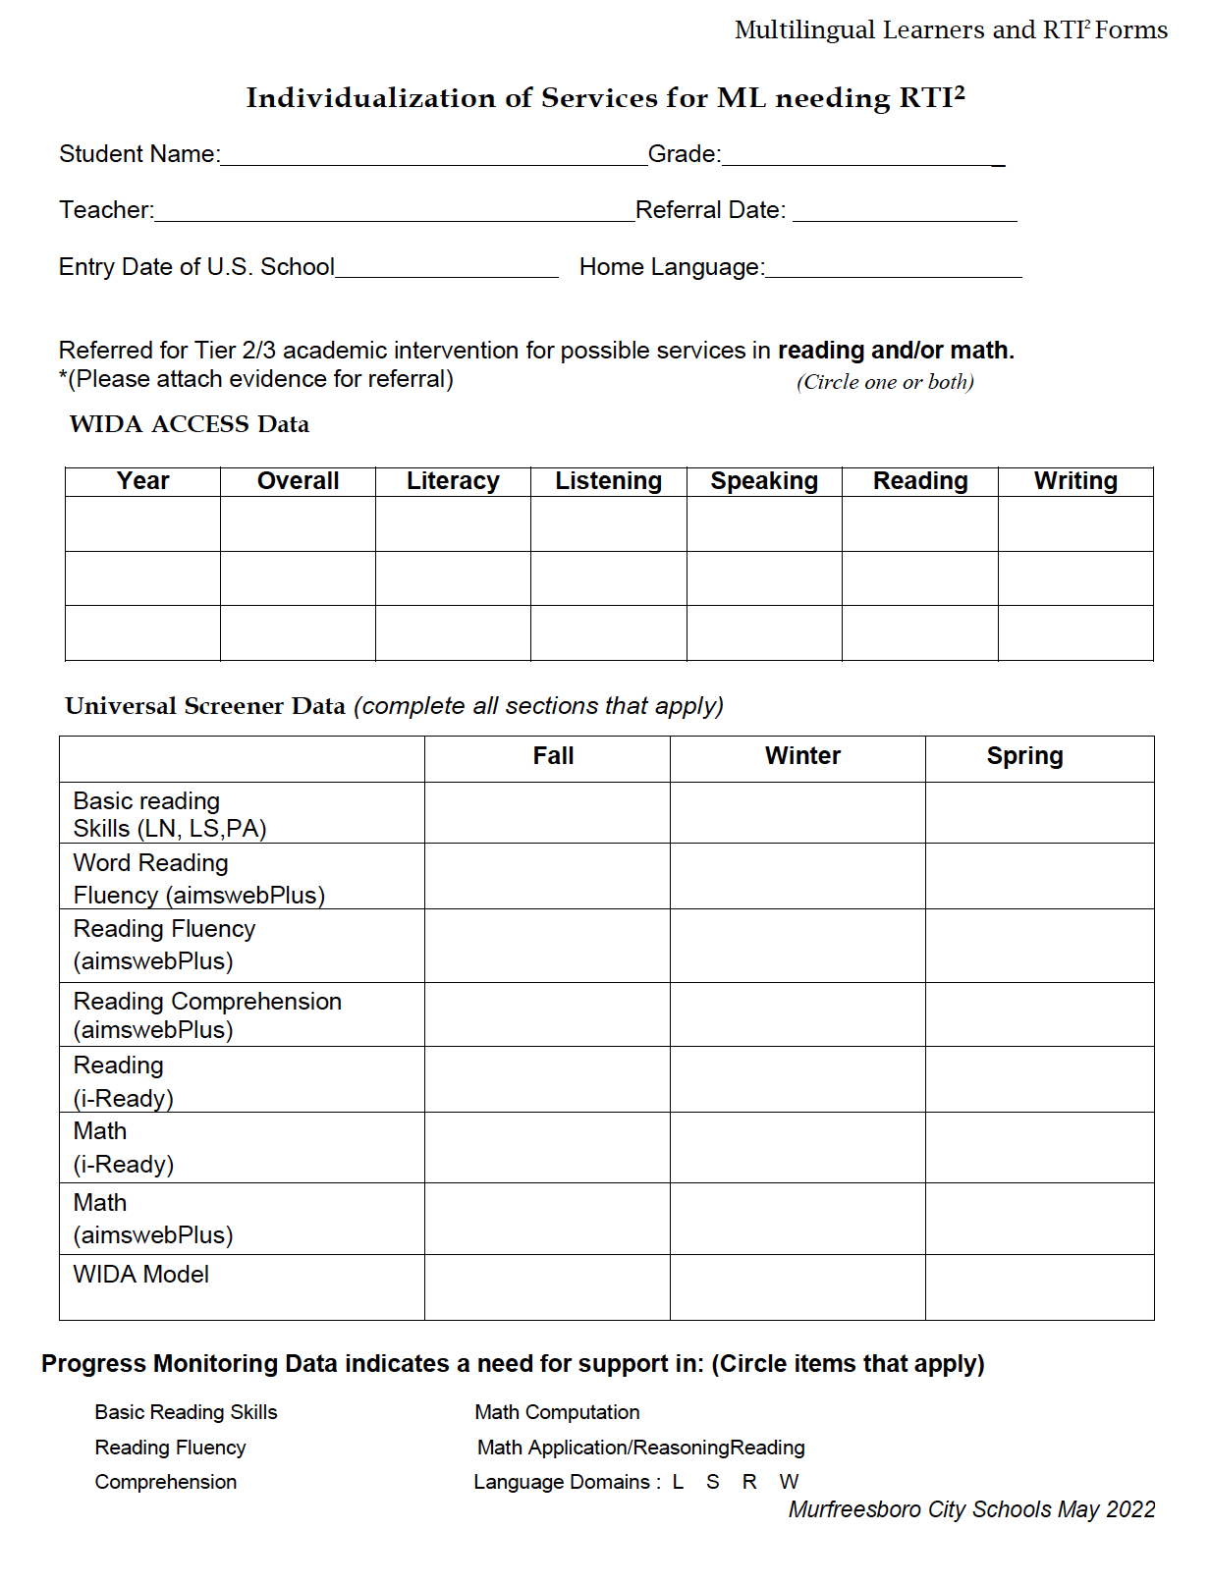
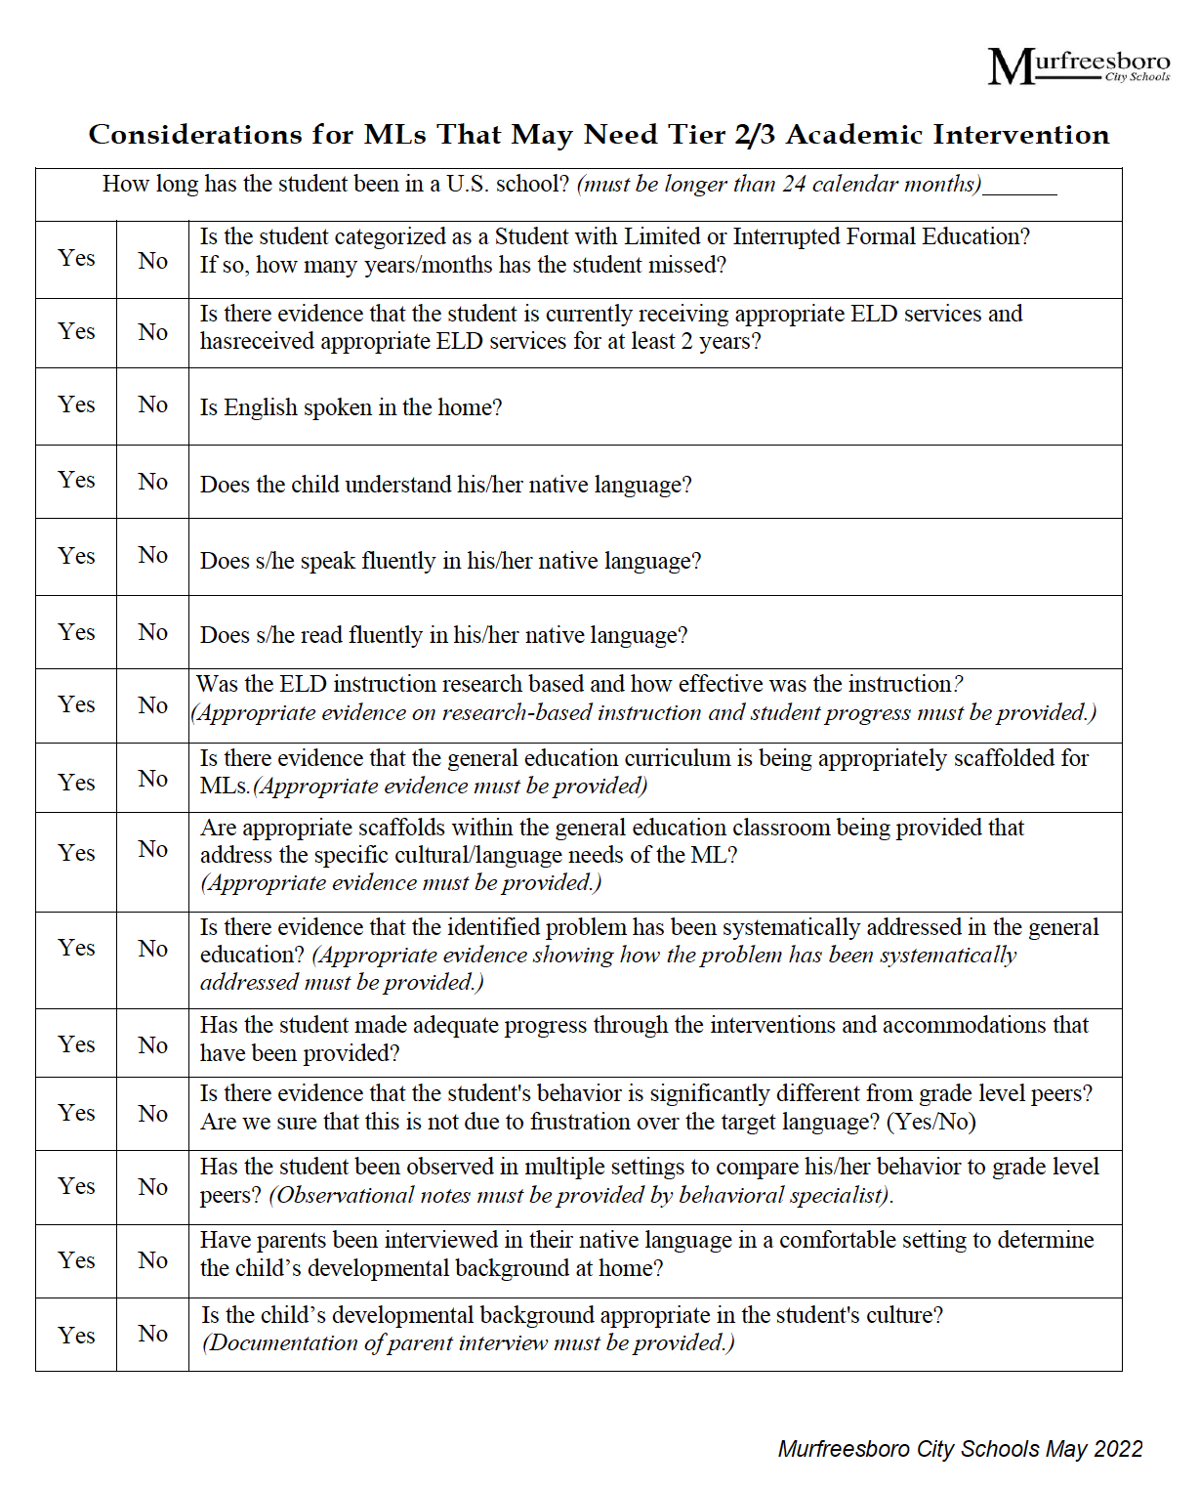
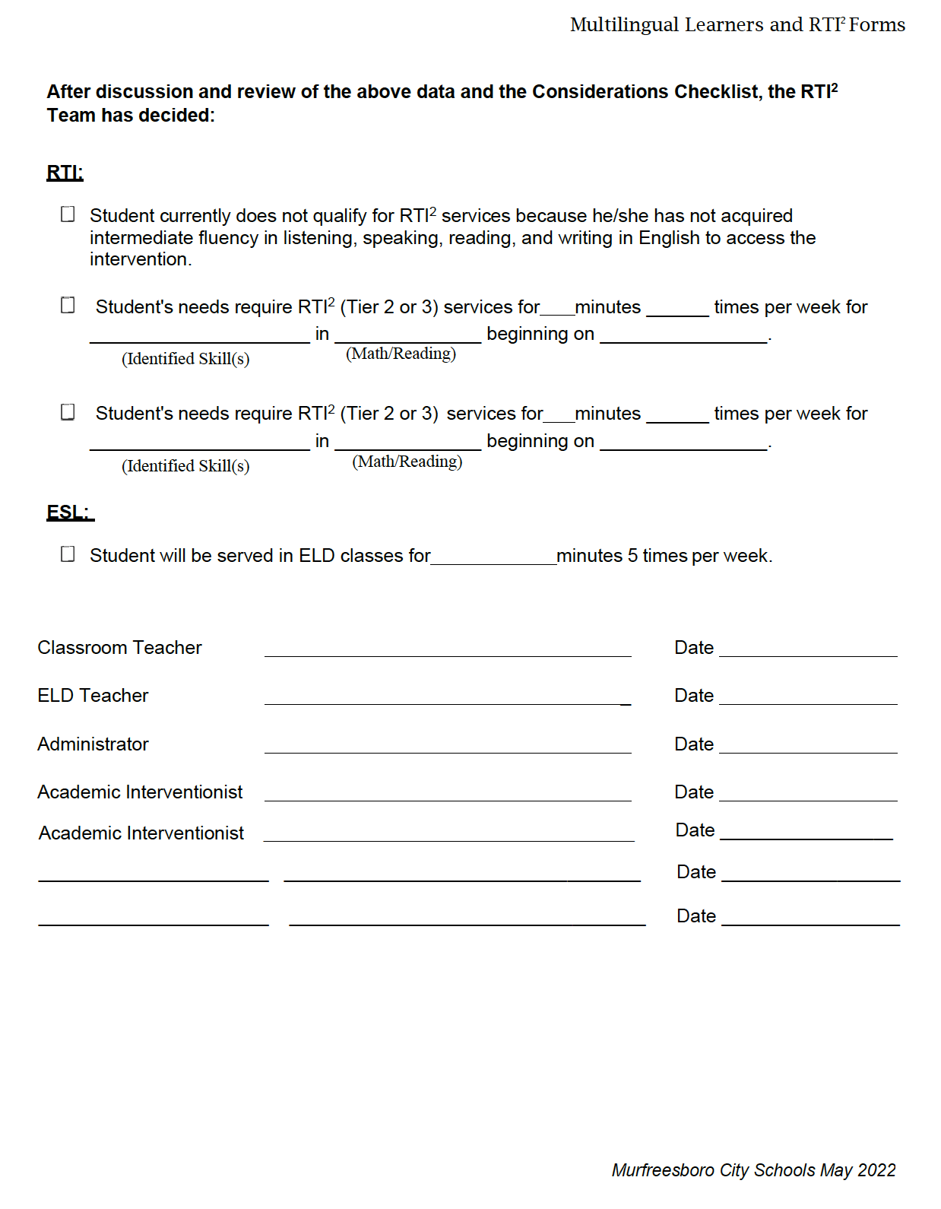
Identifying Multilingual Learners
MTSS/RTI + Multilingual Learner Guidance
Document

Slide 8
MTSS/RTI + ML Guidance Document

Slide 9
MTSS/RTI + ML Guidance Document

Slide 10
Considerations
Language of Instruction
Developmental Background
•Proficiency level in language of instruction
•Culturally responsive practices
•Grouping
•Modeling
•Bridge background experience to curriculum
•Medical concerns
•Developmental milestones
•Trauma
01
Prior Schooling
Culture
•Previous schooling experiences
•Instructional model (dual, primary language, English immersion, etc.)
02
•Family structure
•Student’s Responsibilities in the home
•Beliefs about education
3

Slide 11
02.
Collaborating

Slide 12
PROBLEM SOLVING
Process for determining what additional supports/accommodations/interventions should be implemented in general education for the student and classroom teacher.
Supporting the classroom teacher with ELD strategies
Identifying and supporting the student in the specific language domain(s)
Collaborating with other specialists (behavioral, speech, vision, etc.)
Progress monitoring

Slide 13
COLLABORATION WITH STAKEHOLDERS
*Emphasize problem solving with team members in a team format
Look outside the child
Does the instructional environment support the student’s cultural and linguistic needs?
What accommodations have been successful?
Has student been able to access intensive general education supports? What do they look like?
How many years of direct English language development instruction? Was it research-based?
Has effective differentiation occurred in instructional settings?

Slide 14
03.
Evaluation

Slide 15
Special Education Evaluation
Under the Individuals with Disabilities Education Act (IDEA), the school system must evaluate a student when a disability is suspected, regardless of their status as a multilingual learner.
We must not delay evaluations because of the student’s language status.
At the same time, we must ensure that we are not identifying a disability because of limited English language proficiency.

Slide 16
Special Education Evaluation
What disability is suspected? What services/needs are evident?
What methods/tests are appropriate to measure the student’s abilities?
What other factors should be explored?
Previous educational experiences
Language assessments
Parent input
Medical or environmental history
Teacher input

Slide 17
Special Education Evaluation
13 federal categories of disabilities
Majority of states under-identify ML students for disabilities (identification rate of 8% or lower).
TN has a 2% identification rate.
There is a myth/misconception that we should not refer ML students to special education. Disability rates should be comparable to the general population.

Slide 18
Special Education Evaluation
Specific Learning Disability (SLD)
Identification of multilingual students for SLD in 33 states were far greater than the national average, including TN.
50% of ML students with a disability in TN are under SLD eligibility.
Different state policies and procedures contribute to a wide range in identification rates.

Slide 19
Special Education Evaluation
Considerations for determining a disability versus a language difference
Consider progress in relation to the progress of similar peers
Use resources to screen, assess, and monitor the progress of academic language development (CALP)
Review guiding questions/considerations
https://www.mnase.org/uploads/4/7/7/9/47793163/el_referral_guiding_questions.pdf

Slide 20
Indicators of Possible Disability
Consistent confusion with verbal directions in L1 and L2.
Often forgets or needs further explanation in L1 and L2
Consistently takes longer to respond in L1 and L2 and it does not change over time
Comprehension/Listening

Slide 21
Indicators of Possible Disability
Doesn’t remember letter sounds after initial and follow-up instruction (even if they are common between L1 and L2)
Makes letter substitutions when decoding not related to L1; cannot remember vowel sounds; difficulty blending the sounds to decode the whole word
Consistently confuses letters/words that look alike
Phonemic Awareness

Slide 22
Indicators of Possible Disability
Difficulty memorizing math facts from one day to the next and requires manipulatives to complete math problems
Often forgets the steps required to complete problems from one day to the next
Does not understand how to process the problem or identify key terms in L1 or L2.
Mathematics

Slide 23
REFERENCES
Butterfield, J. (2014). Meeting the needs of English learners with disabilities. Resource Book. Goleta, CA: Santa Barbara County Special Education Local Plan Area (SELPA). Retrieved from http://www.sbcselpa.org/wp-content/uploads/2014/06/EL- Resource-Book-Revised-6-14.pdf.
Poudre School District Integrated Services Department (n.d.). Guiding questions for English language development students. Available at www.tinyurl.com/WIDAsped
Differences Impacting Literacy Development Between Monolingual English Learners and Bilingual Learners. Dr. Kathy Escamilla
https://v5e685.p3cdn1.secureserver.net/wp-content/uploads/2022/09/21025-NCEL-Monolingual-vs-Bilingual-Speakers-FINAL.pdf

Slide 24
THANKS!
DO YOU HAVE ANY QUESTIONS?
casey.brasher@cityschools.net
aerial.mosley@cityschools.net

