Slide 1
Ensuring Equitable Services for Dually Certified English Learners
Debbie McAdams Executive Director Dept. of Exceptional Education | Molly Hegwood Executive Director Dept. of English Learners | Dr. Joe Gordon Coordinator School Counseling Services

Slide 2

mission
We deliver a great public education to every student, every day.
Notes:
DEBBIE

Slide 3
Vision
Metro Nashville Public Schools will be established as the premier large school district in Tennessee and beyond by ensuring that every student is known.
Notes:
DEBBIE
The vision of MNPS is that Metro Nashville Public Schools will be established as the premier large school district in Tennessee and beyond by ensuring that every student is known.
The focus on every student is what you will see and hear throughout our presentation.

Slide 4
Learning Outcomes
Understanding the why
Ensuring the Continuum of Supports
Getting to know our students
Notes:
Molly

Slide 5
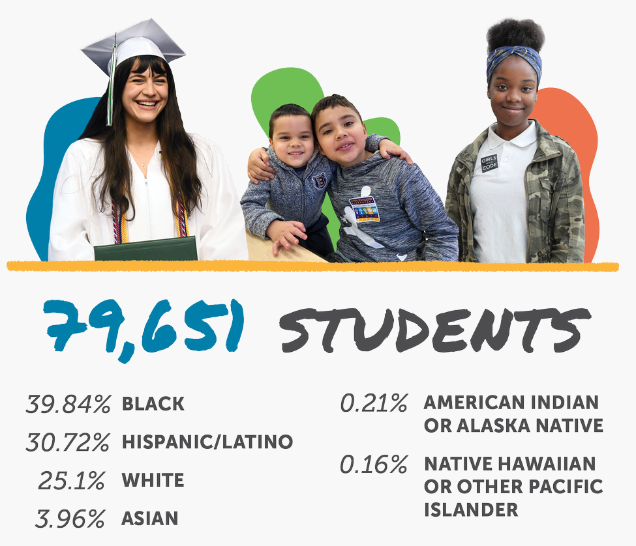

Notes:
Debbie

Slide 6

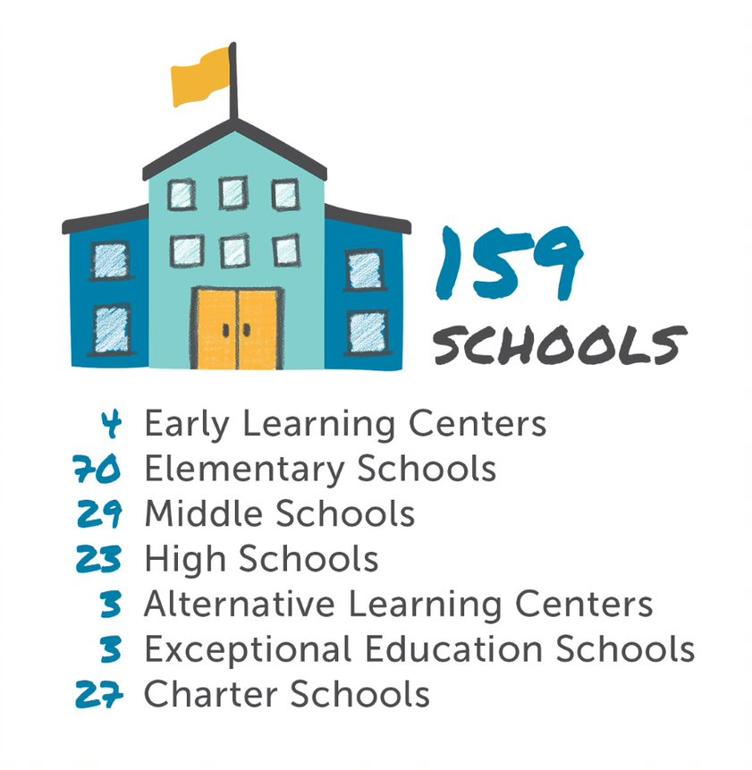

Slide 7
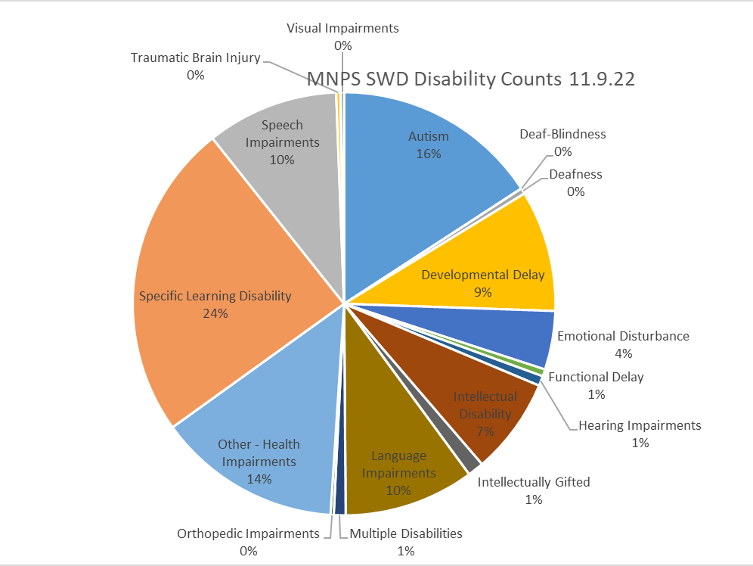

Slide 8
Primary Disability | Total
Autism | 1738
Deaf-Blindness | 1
Deafness | 48
Developmental Delay | 1019
Emotional Disturbance | 492
Functional Delay | 59
Hearing Impairments | 83
Intellectual Disability | 810
Intellectually Gifted | 135
Language Impairments | 1094
Multiple Disabilities | 99
Orthopedic Impairments | 27
Other - Health Impairments | 1543
Specific Learning Disability | 2661
Speech Impairments | 1109
Traumatic Brain Injury | 37
Visual Impairments | 29
Grand Total | 10984

Slide 9
Least Restrictive Environment

Slide 10
MNPS Students with Disabilities Eligible for EL services
9,185 | Students with Disabilities
18,506 | Active EL Students
Notes:
Debbie
We wanted you to know about population.....11% of students in our district have an IEP and of those 11% ...19% of all of our students with disabilities are also EL

Slide 11
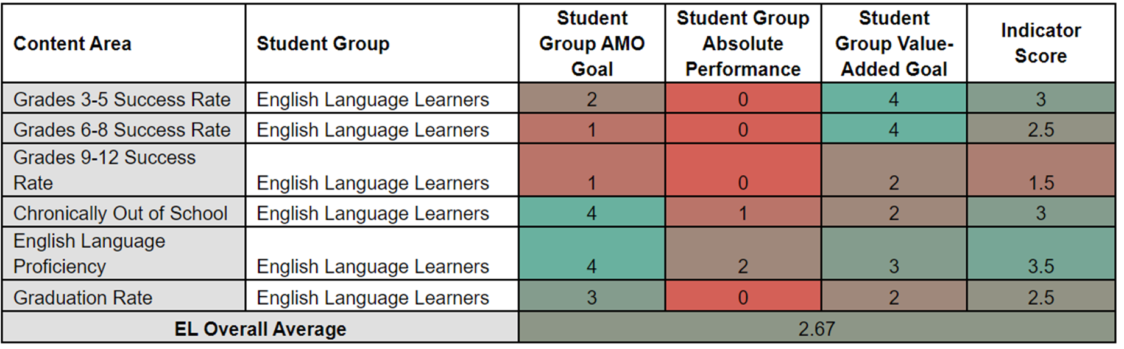
MNPS Accountability Heat Map
English Learners
Notes:
This heatmap shows our district’s success rate on achievement testing, chronic absenteeism, English Language Proficiency Assessment, and Graduation Rate accountability indicators for 2022. The English Language Proficiency Assessment (ELPA) indictor observes K-12 students’ progress toward language acquisition as performed on WIDA ACCESS. Growth standards are differentiated based on students’ prior-year composite performance.
MNPS EL students met their double AMO target for the English Language Proficiency and received the highest accountability score for growth.

Slide 12
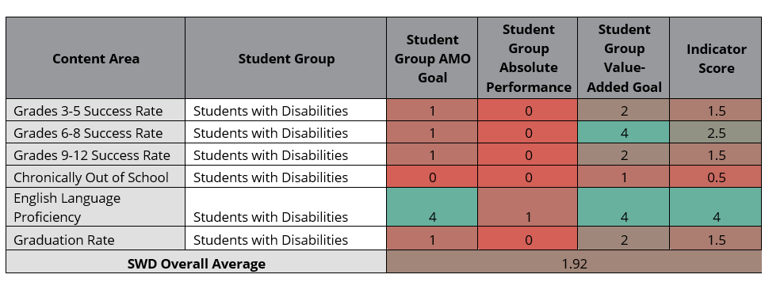
MNPS Accountability Heat Map
Students with Disabilities
Notes:
MNPS students’ that are EL and have an IEP also met their double AMO target for the English Language Proficiency as measured by ACCESS.

Slide 13
Myth or Reality?
All EL students must participate in the MTSS Academic/Dyslexia Screening Process (aka the Universal Screener).
Placing a student in a skills-based intervention is a pipeline to special education.
Academic interventions can benefit EL students.
EL students must have a minimum ACCESS score of 3.5 to be placed in intervention.
Notes:
Add these as questions in the form, then talk through the answers on this slide.

Slide 14
Understand the Why Behind the Shift
Ensuring English Learner Students Can Participate Meaningfully and Equally in Educational Programs
  U.S. Department of Justice Civil Rights Division and U.S. Department of Education Office for Civil Rights
  Evaluating EL Students for Special Education and Providing Dual Services
Child Find
  Identify, locate and evaluate
  Language is not the determining factor
    Child suspected of having SLD, the determination of the group concerning the effects of limited English proficiency on the child's achievement level must be documented.
  Assessments must be selected and administered to not be discriminatory on a racial or cultural basis
  Assessments provided in the child’s primary language
Notes:
We started our work elevating the Civil Rights of English Learners and Child Find obligations. We needed to ground our shifting of practices in the why to ensure equity was at the forefront
Under Title VI of the Civil Rights Act of 1964 and the Equal Educational Opportunities Act of 1974 (EEOA), public schools must ensure that EL students with disabilities must be provided both the language assistance and disability-related services. We were often facing the myth of one service trumps another.
We are NOT disproportionality identifng students in any of the 13 federal disability areas.
Child Find- as molly stated we focused on child find obligations....and ensured that everyone had an understanding of best practices
For students who may qualify for special education and related services,
Mindshift change.....to ensure that all students have an equal educational opportunity includes an evaluation for IDEA eligibility that measures the students' disability-related deficits and needs, not their English-speaking ability.
Annual Performance Report ….Indicator 9 and 10 We have not had a finding for Indicator 10 – Disproportionate Representation
Districts with disproportionate representation of racial and ethnic groups in specific disability categories (autism, emotional disturbance, intellectual disability, other health impairment, speech or language impairment, and specific learning disability) that is the result of inappropriate identification
See 34 CFR 300.304 (c)(1)(ii) (stating that IDEA evaluations must be provided and administered in the child's native language or other mode of communication and in the form most likely to yield accurate information on what the child knows and can do academically, developmentally, and functionally).
To ensure that the language proficiency of an EL is validly and reliably assessed, the IEP team or 504 team must determine whether an EL with a disability needs to receive appropriate accommodations on the regular annual ELP assessment or, for an EL who is a student with a most significant cognitive disability as identified under 34 CFR 200.6 (a)(1)(ii), needs to take an alternate assessment to the regular ELP assessment, if she cannot take the regular ELP assessment even with appropriate accommodations. Addendum to Sept. 23, 2016, Non-Regulatory Guidance, 119 LRP 714 (EDU 01/02/19).
If a district discovers that appropriate accommodations on an EL screening assessment were not provided to a student with a disability, the "logical step" would be to retest the student with appropriate accommodations. Addendum to Sept. 23, 2016, Non-Regulatory Guidance, 119 LRP 714 (EDU 01/02/19).

Slide 15
Special Education Laws
Issues of Access
Issues of Quality
Moving Toward
1. Heroic Individual and Group Efforts
4. The Individuals with Disabilities Education Act Amendments of 1997
2. The Education for All Handicapped Children Act of 1974
The Individuals with Disabilities
Education Improvement Act of 2004 (IDEIA)
(other amendments have been made over time)
3. The Individuals with Disabilities Education Act of 1990 (IDEA)
Notes:
Special Education Laws have changed over time from (Down Arrow) simply providing access to services to (Down Arrow) ensuring quality of those services being provided. The laws have moved from issues of access towards issues of quality. As you can see here, one, two, and three are dealing with issues of access. With IDEIA students now have quality access to the least restrictive environment.

Slide 16
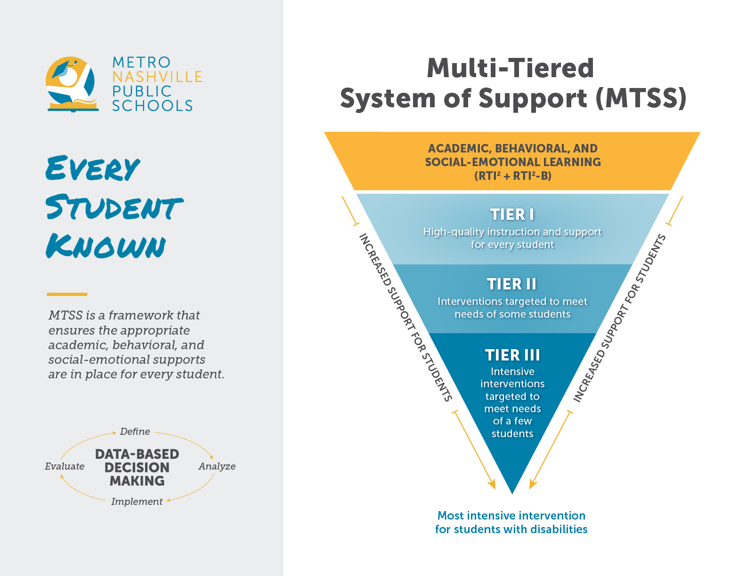

Slide 17
School Counseling Alignment with EE & EL Supports
Manage
  Program Focus
    Beliefs
    Misson Statement
    Vision Statement
  Program Planning
    School Data Summary
    Annual Student Outcome Goals
    Action Plans
Deliver
  Direct Services
    Appraisal & Advisement
  Indirect Services
    Consultation
    Collaboration
    Referrals
Notes:
Add these as questions in the form, then talk through the answers on this slide.

Slide 18


Shifting MTSS Practices for Multilingual Learners
Altering practices to equip school teams
  Ensuring a culturally and linguistically responsive process
  Creating the most effective Tier 1 learning environment for multilingual learners
  Equipping school based MTSS leadership or data team to consider language proficiency when determining this placement
  Ensuring EL students have access to all tiered supports
Notes:
After grounding ourselves in the why behind the work, we reflected on our continuum of supports for English Learners to ensure that school teams were equipped to make these decisions.

Slide 19
Personalized Learning Time (PLT)
WHAT?
  A grade-wide or school-wide block of time during which students receive supplemental support according to student need(s).
WHY?
  Ensures that this layer of differentiated support is
  in addition to core.
  Allows for more strategic grouping to target student needs
HOW?
  Consider both group needs and resources available
  "All Hands on Deck"
  Establish school-wide expectations and procedures
Notes:
When we're thinking about personalized learning time, it's good to think about the what, the why and the how. ​
​
PLT is a block of time that we have put in place so that all students can get support according to their specific needs. ​
​
And why do we have this special block to do this? Well, it's because we want to protect all students’ access to that tier one core instruction, so it's really important to have this block outside of that so that we can provide access to BOTH the core instruction AND the additional targeted support for all students. ​
​
The how is where we analyze Universal Screener data and consider both students’ needs and available resources. Instead of approaching the how from the point of view of “How many slots in this intervention group do we have?”, it is more beneficial and student-centered to first look at the needs that are revealed by the Universal Screener, and then think about how you can use all of your resources to meet those needs.

Slide 20

Individual Student
Decisions
2nd grade
ELP = 2.5
Length of time in US Schools = 3 years (K)
Past… | Where we’re going…
Automatic placement in language support based on: Proficiency level Length of time in US Schools | Examine multiple sources of data, which may include: Universal Screener Language growth over time (based on WIDA Screener and ACCESS) Length of time in US Schools Student work samples (i.e. Focusing Question Task, EOM Task) with accommodations from ILP ILP goals IEP or 504, if applicable
Based on the data snapshot and student considerations, begin to think about how Personalized Learning Time can be used to meet Eduardo’s needs.
Notes:
This slide shows the 6 language proficiency levels as defined by WIDA. In Tennessee, students are eligible for Direct ESL Services until they achieve a composite score of 4.4 or higher on the WIDA ACCESS assessment, and 4.2 or higher on the literacy portion of WIDA ACCESS. It is important to note that language acquisition is not a strictly linear process, and there is not a set timeframe for achieving English proficiency. Each student is different and has different needs depending on many factors.

Slide 21
Equitable Access for Evaluations
School psychology services and EL teams have ongoing consultation throughout the school year.
Ongoing professional development in school psychology services on best practices for EL assessments
School psychology trains interpreters on their role during evaluations
English language proficiency is discussed and monitored through 5-week data checks of the ILP during MTSS data team meetings.
Notes:
There is not a minimum English Language Proficiency (ELP) score or time in EL program required to participate in Tier II or Tier III intervention.
EL students determined to need Tier II or III must receive their Direct ESL services outside of PLT time.
Training side by side

Slide 22
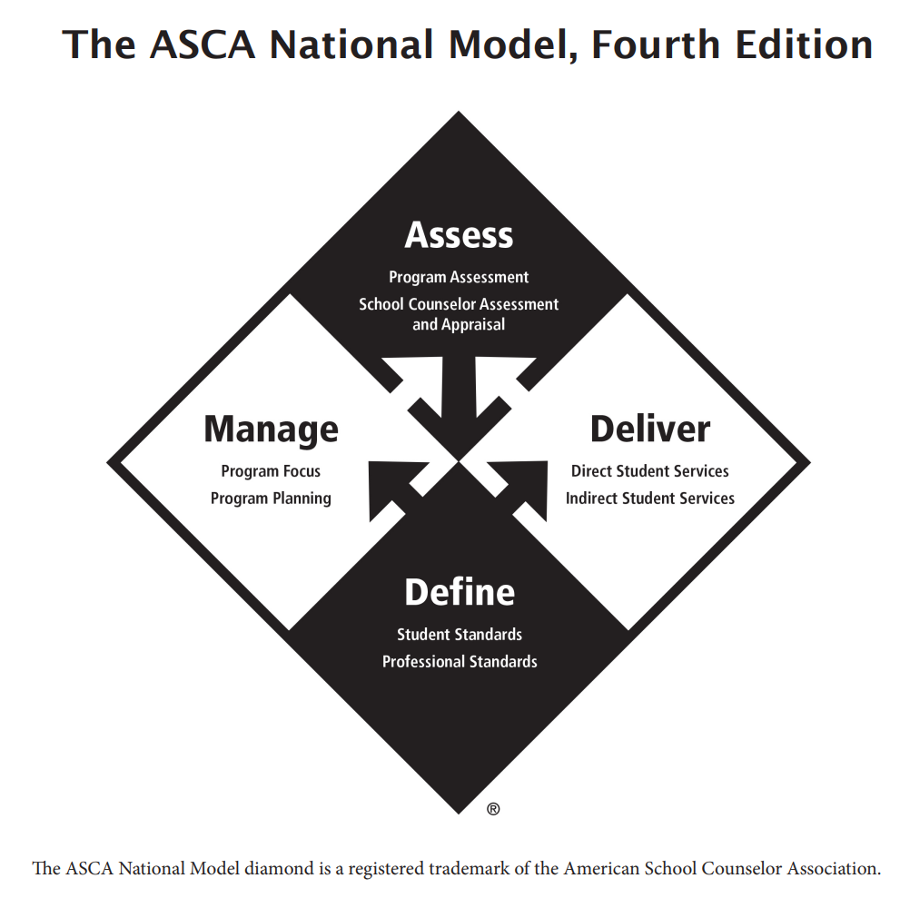
School Counseling Model of Practice
Notes:
Molly

Slide 23
How do we know if a multilingual learner also has a disability versus a difference?
By eliminating all other possible explanations for underachievement
  Best Practice Framework, Samuel Ortiz
Notes:
It is so important to always keep in mind that good data collection will help the team determine if the problematic issues are a difference or a disability. We have an obligation to eliminate all other possible explanations for underachievement.

Slide 24
Possible explanations for underachievement
What is the student's primary language?
Did the student demonstrate language confusion when learning additional languages?
Did the student receive formal education in their primary language?
What was the student's performance if they did receive education in their primary language?
Did the student learn to read in their primary language?
Are they learning English at the same rate as other EL peers?
Is the student responding positively to targeted intervention at a level similar to their EL peers?
Is there evidence of past academic difficulty for the student of concern?
Do the EL services provided have a proven rate of success for the majority of students?
Are the parents of the student literate in their primary language?
Gill, Steve & Nanayakkara, Ushani, 2020. Evaluating ELL Students for the Possibility of Special Education Qualification – 2nd Edition
Notes:
What are possible explanations for underachievement. In looking at this questions, some of these are student-focused, and others are system-focused. For this reason, it is important to have effective collaboration between all appropriate school team members. Working closely together across departments helps remove the risk of making assumptions. When we make assumptions, there are heavy risks and potential mine fields associated with it. Finding the answers to the questions shown here can help eliminate potential assumptions that can negatively impact a student's progress.

Slide 25
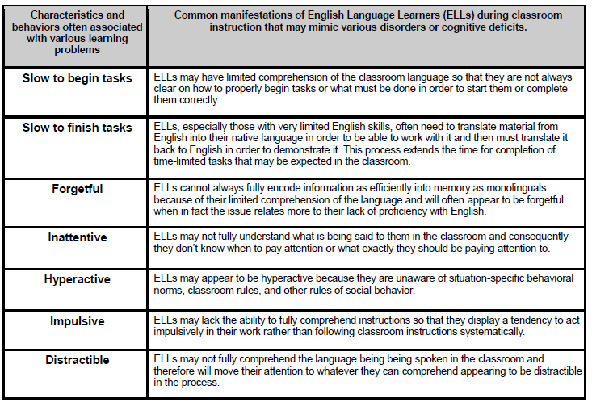
Notes:
This is a brief list of behaviors most often associated with learning problems and the common manifestations during classroom instruction for our EL students. The full document is in the Resources folder of this Schoology course. This is great reference material during the pre-referral process to help guide the team into meaningful understanding of behaviors and potential accommodations. This information is also extremely helpful in determining if the problematic issues are a difference or a disability.

Slide 26
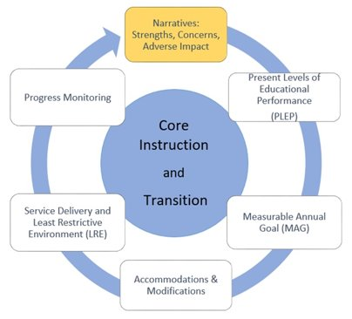
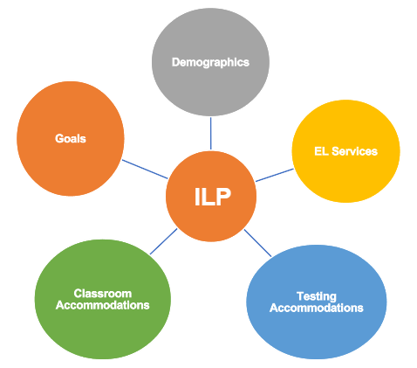
IEP PROCESS
ILP PROCESS
Notes:
Here is another visual that displays the process for both an IEP and an ILP. There are many components of these processes that are similar. As we know, students with dual service needs benefit from collaborative and supportive relationships, to meet their IEP skill deficit(s) and ILP language proficiency needs.
EL services are based on grade level content and standards. EE services are based on students' IEP goals that are made based on skill deficit areas identified in the student's most recent present level of educational performance
ILP and IEP Goals – both help to provide opportunities that can bridge educational gaps for the student.
IEP goals focus on skill deficits, ILP goals focus on language proficiency
Both help meet student needs by bridging gaps from different perspectives and increase the student's knowledge.
Educators supporting the IEP AND ILP processes are BOTH integral to meeting student needs.
Student's needs impact their access and process in general education.
.

Slide 27
Aligning the IEP and ILP
IEP | ILP
Legally binding document (Federally Mandated in the US) Updated at minimum yearly Goals are monitored frequently Contains current present levels of performance, narratives, measurable annual goals, accommodations and modifications, service delivery and least restrictive environment (LRE), and progress monitoring | Required per TN State Rule 0520-01-19 Updated at minimum yearly Goals are monitored every 4.5-5 weeks Contains current proficiency levels, standardized testing scores, service model, classroom and testing accommodations, language goals, and progress monitoring More information to come with TISA
Notes:
Now let’s dive into aligning IEPs and ILPs. Both are updated at a minimum annually. However, both are working documents that can be amended at any time to meet the needs of the student.
IEP stands for Individualized Education Plan: IEPs are federally mandated, legal documents that are individualized for specific student educational needs. IEPs are updated annually, and goals are monitored frequently. Goals may be monitored weekly, bi-weekly, or monthly depending on the individual goal. The IEP contains CURRENT present levels of performance, narratives (including Strengths, Concerns, Adverse Impact Statement, and Medical Information), Measurable Annual Goals, Accommodations (what the student needs over and above the classroom universal supports) and Modifications (used for a very small percentage of students across the district), Service Delivery and Least Restrictive Environment (LRE), as well as Progress Monitoring.
ILP stands for Individual Learning Plan: ILPs are required by the TN State Rule. ILPs are updated yearly, at minimum. ILP goals are monitored every 4.5-5 weeks. ILPs contain current proficiency levels for the student, includes standardized test scores, a description of the service model, accommodations, language goals, and progress monitoring.
Remember – adverse impact is documented in both the ILP (when marked off track) and the IEP

Slide 28
School Support
Mapping with school team
Content and language instruction aligned to the student’s IEP
Monitoring and collaboration
EL Teacher MUST be a member of the IEP Team
Notes:
Mapping of SWD/Els to ensure both services are delivered The purpose of Mapping is to ensure that all student needs and services are met as outlined on their individual education programs and ILP
Support from EE and EL Coach to provide content and language instruction aligned to the student’s IEP
Monitoring and collaboration across EL teachers, EE teachers, and other service providers at the school level
EL Teacher MUST be a member of the IEP Team
Tips for English learners' IEP development
English learners with disabilities may need to have language goals in addition to academic, functional, and other goals in their IEPs. Indeed, under the IDEA, in the case of a child with limited English proficiency, the IEP team must consider the language needs of the child as those needs relate to the child's IEP. 34 Cfr 300.324 (a)(2)(ii). Special education directors should ensure teams know what to consider when developing an IEP for an EL. Share these ideas.
Use these strategies to develop EL's IEP
Tip
Detail of tip
• Consider EL's English proficiency level.
Develop IEP goals with the EL's English proficiency level in mind. For example, an EL may be in eighth grade, but speak and write English at a third-grade level.
• Match instructional materials to EL's need.
Choose interventions that take into account the level of exposure the EL has had to English vocabulary and syntax.
• Address specific learning subjects.
Create content-specific language goals, such as:
•Goals related to the language of science, social studies, or math.
•Goals related to oral language if developing reading goals.
• Offer supports.
Include in the IEP accommodations and modifications that facilitate English learning as well as making progress toward other goals. For example:
•Let the student listen to a recording of a story in his native language along with reading the text in English so he can work on reading comprehension and language skills.
•Equip a student with an iPad with translation software during a social studies activity so the student can have access to translations in his native language while becoming more familiar with English terminology.
• Know what to skip.
Focus on what the EL has to learn to continue to make progress in the curriculum. If the EL is in high school and doesn't know the names of all the colors in English, prioritize more practical skills.
• Involve parents.
When developing the IEP, ensure the parents have access to visual aids, such as graphs, to help them understand their child's strengths and needs if they are also ELs. Also, use an interpreter when necessary. Make sure team members:
•Look at the parents, not the interpreter, when they're talking.
•Show patience if parents respond to questions with more or less information than sought because of their cultural background.
•Provide procedural safeguards and other documentation in the parents' native language when feasible.

Slide 29
Collaborative Staff Training
Interpreters trained in Special Education terminology and processes
Training for school counselors, EE coaches, school psychologists, EL Coaches, and other service providers to deliver the continuum of services
  Understanding how the IEP and ILP work together
MTSS training for school teams on equitable access to the continuum of supports and Child Find

Slide 30
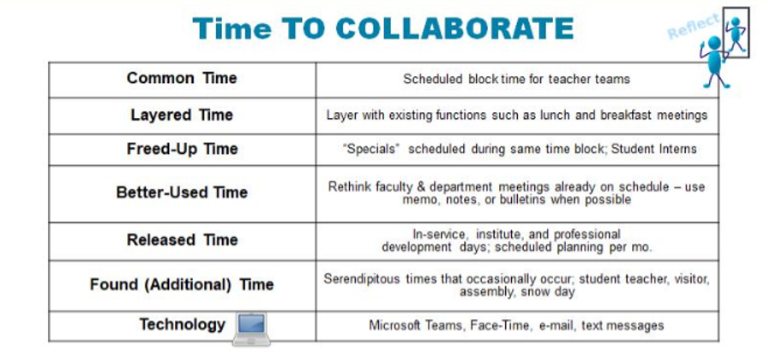
Notes:
NEARPOD: One challenge that often impedes collaboration is time. Here are some possible examples of being flexible with time to collaborate
Questions to ask:
Have you ever flexed your time in any of these ways? Can you identify one that you would like to try? What other opportunities have you tried that are not listed? What will the collaboration look like, sound like, and feel like.

Slide 31
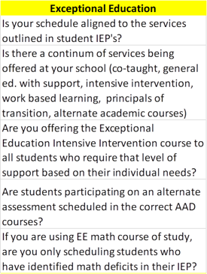
Questions to ask about your master schedule

Slide 32

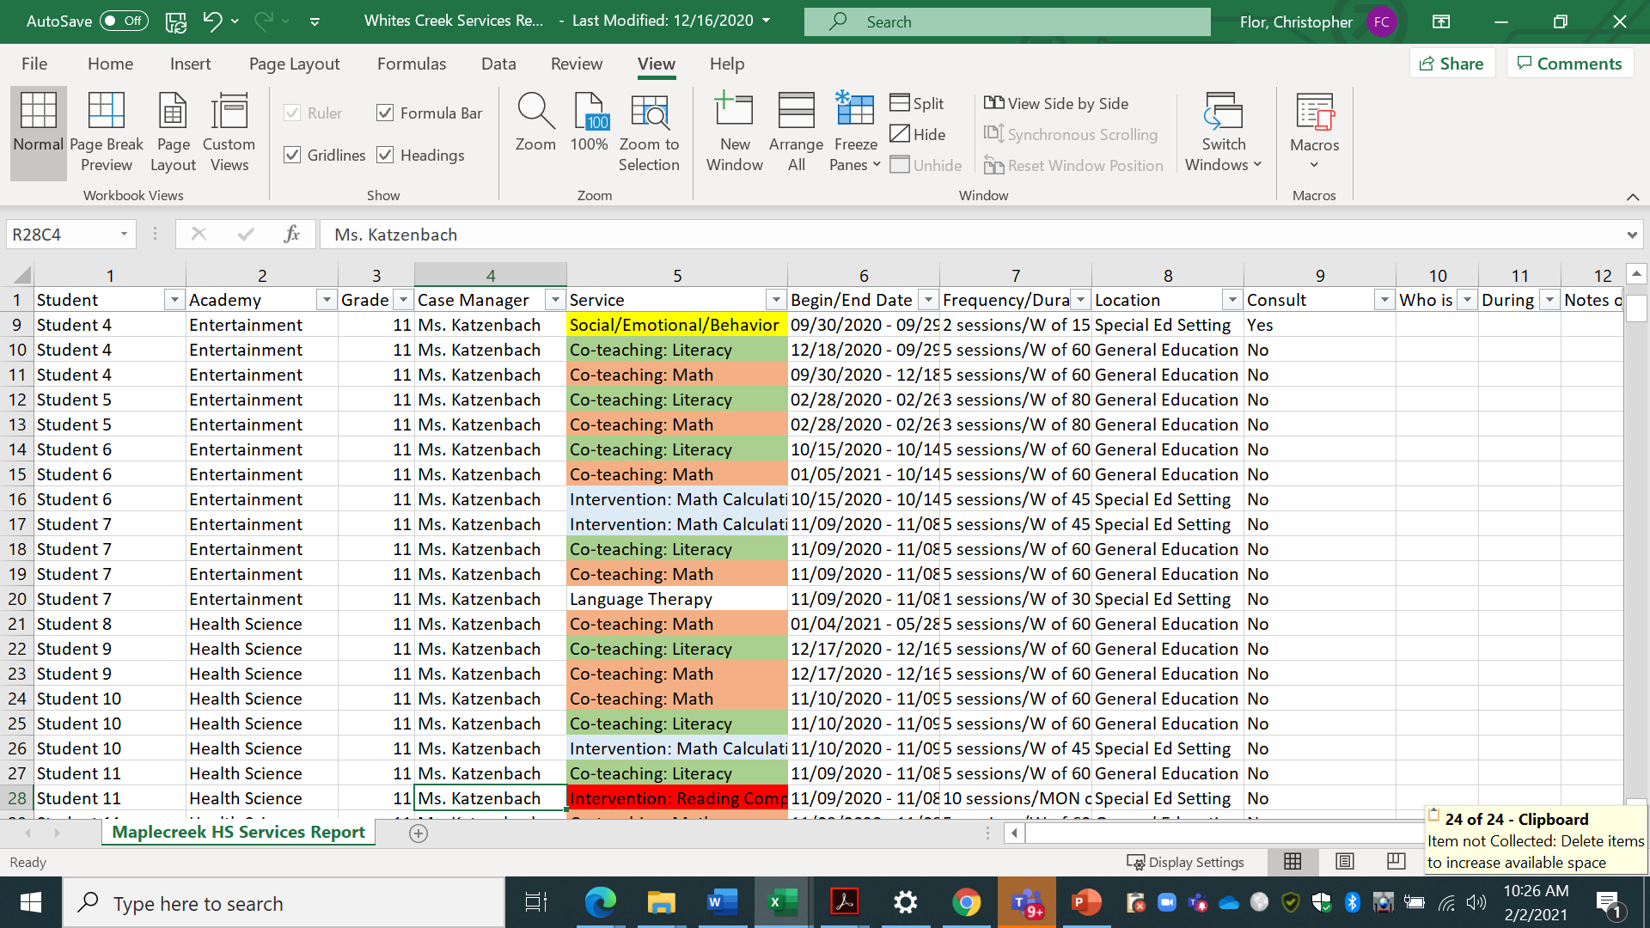
Notes:
Here is the Special Education Services Report. This report is only accessible through central office, so your EE coach is the only person who can run the report. The report is not reader friendly, but can easily be organized by someone who has a general knowledge of excel.
Animation 1
This can include clearing expired services, removing unnecessary columns, bordering the cells,
Animation 2
adding filters to the top row, freezing the top row, and
Animation 3
color coding the service types.
Animation 4
When you organize the report, insert two columns to the right of the students’ names. Label those columns as follows: Grade and Academy. Because the EE Coach can run the report sorting students in several ways, we ask that you sort by grade, case manager, and last name in that order. Unfortunately, the grade level does not appear as a column on the report.

Slide 33
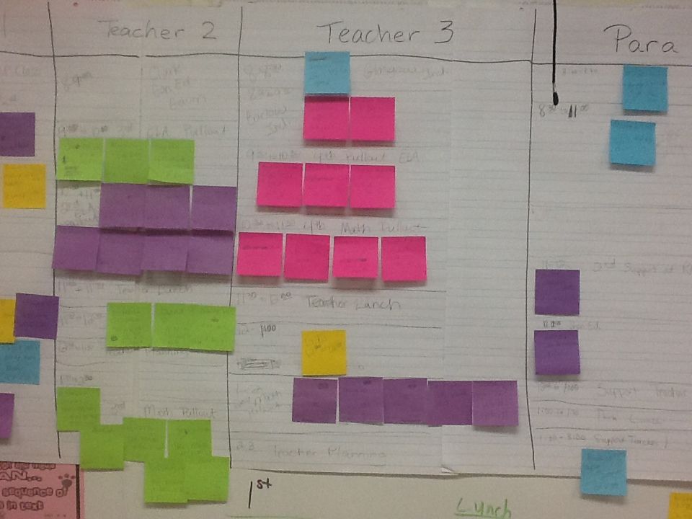
Mapping in Action
Notes:
Kassie and Sonya

Slide 34
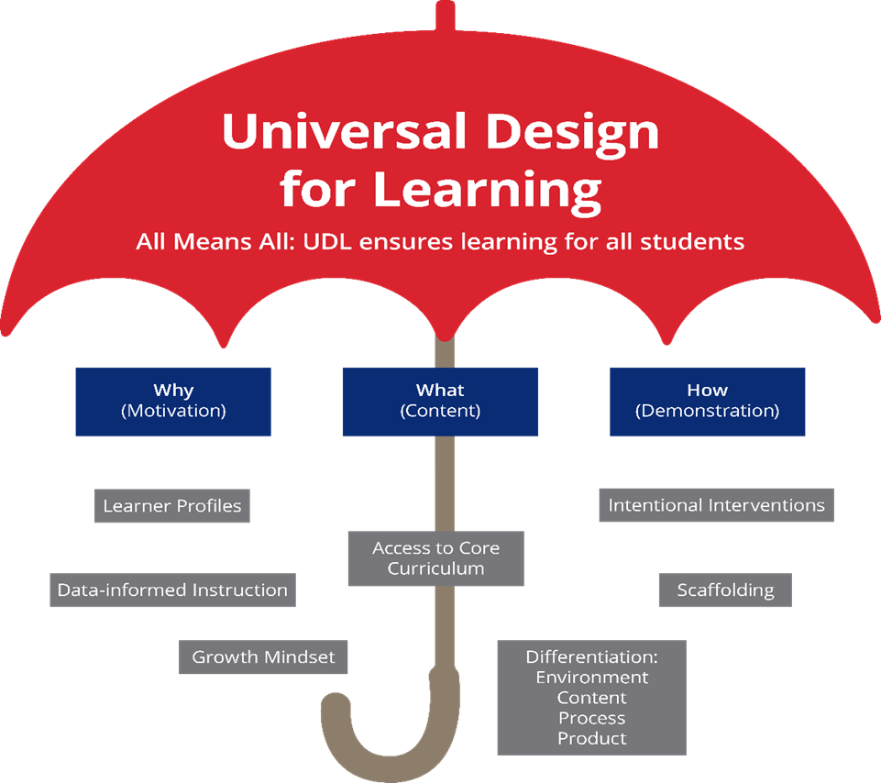
Universal Design for Learning
Curriculum design and instructional strategies that provide greater access to high-quality instruction that engages ALL learners
Reduces the need to single out individuals for accommodations and modifications
Notes:
Every classroom setting should start with the principles of Universal Design for Learning. When Universal Design for Learning (UDL) principles are implemented, it provides ALL learners more flexibility in how curriculum, instruction, and assessment are delivered, and multiple options in the way students can respond to instruction and demonstrate their knowledge
UDL addresses the Why (purpose) of the learning (found through tools such as learner-profiles, data-based decisions, and growth-mindset/high expectations for all students), the What (Content- what we teach…Core content), and the How (How we teach- Instruction, scaffolding, intervention, differentiated instructional strategies) to provide flexible learning paths for all students. When teachers design /plan for those on the margins they often meet the needs of everyone in between.

Slide 35
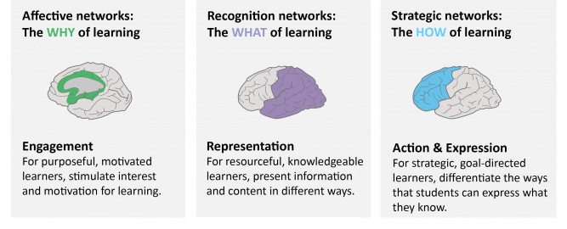
UDL
The setup and organization of the classroom, procedures and routines, and lesson design
What the teacher does to present the content
How the student shows their learning
Notes:
Emphasize Representation is WHAT presentation choices the teacher makes in the lesson design, Action and Expression is how the student shows their learning. Discuss teacher's role in establishing all areas of UDL.

Slide 36
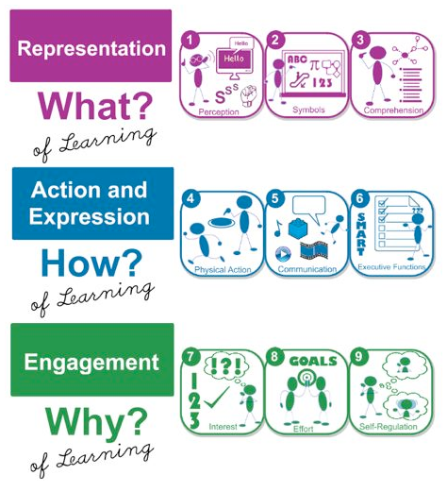
How Can I Recognize UDL In the Classroom?

Slide 37

Questions

Slide 38
Thank you!
Debbie McAdams Debra.mcadams@mnps.org | Molly Hegwood Molly.Hegwood@mnps.org | Dr. Joe Gordon Joseph.Gordon@mnps.org

