Slide 1
Connecting the dots
Creating an Authentic Data Platform for Systematic
ELP Growth
Emily Bruner, M.A. ED
Anderson County Schools

Slide 2
ELLevate Learning Program
Discover- An assets-based approach to discover the strengths of our learners
Support- Creating networks of scaffolding for students and families
Teach- Systematic ELD support
Notes:
We take a 3 part approach
Increasing number of newly immigrated families

Slide 3
Systematic & Authentic
Methodical, genuine, flexible and bands all our data together
There are lots of dots to connect and many not reflected in our system…
Notes:
Common methodology that combines our day-to-day data gathering with linguistic progress monitoring
These data begin to tell a story about the linguistic strengths in English of our learners

Slide 4
Our Guiding Questions along the way
1. Discover- What assets are our students bringing to the classroom and the school community?
2. Support- Where do I need to nurture linguistic growth?
3. Teach- How does this change my instructional practices with my learners?

Slide 5
A Data Story about our Program…
144 Multilingual Learners
200 Students with a Non-English Language Background
95% of our Multilingual Learners speak Spanish (15 languages)

Slide 6
11.7% of our Multilingual Learners have interrupted schooling experiences
18.7% of our Multilingual Learners are Experienced MLs (LTELs)
Increasing population of Unaccompanied Youth
FY21-FY22 53.1% Increase in our EL population
IDENTIFIED ASSET
High level of Resiliency
Notes:
Last year, we say a 46.9% increase- still growing

Slide 7
We need to know what our students know In language & Content
What linguistic assets in English are they bringing with them this school year? This month?
Where do scaffolds need to be placed?
Where do scaffolds need to be removed?
Language development is a fluid process…

Slide 8
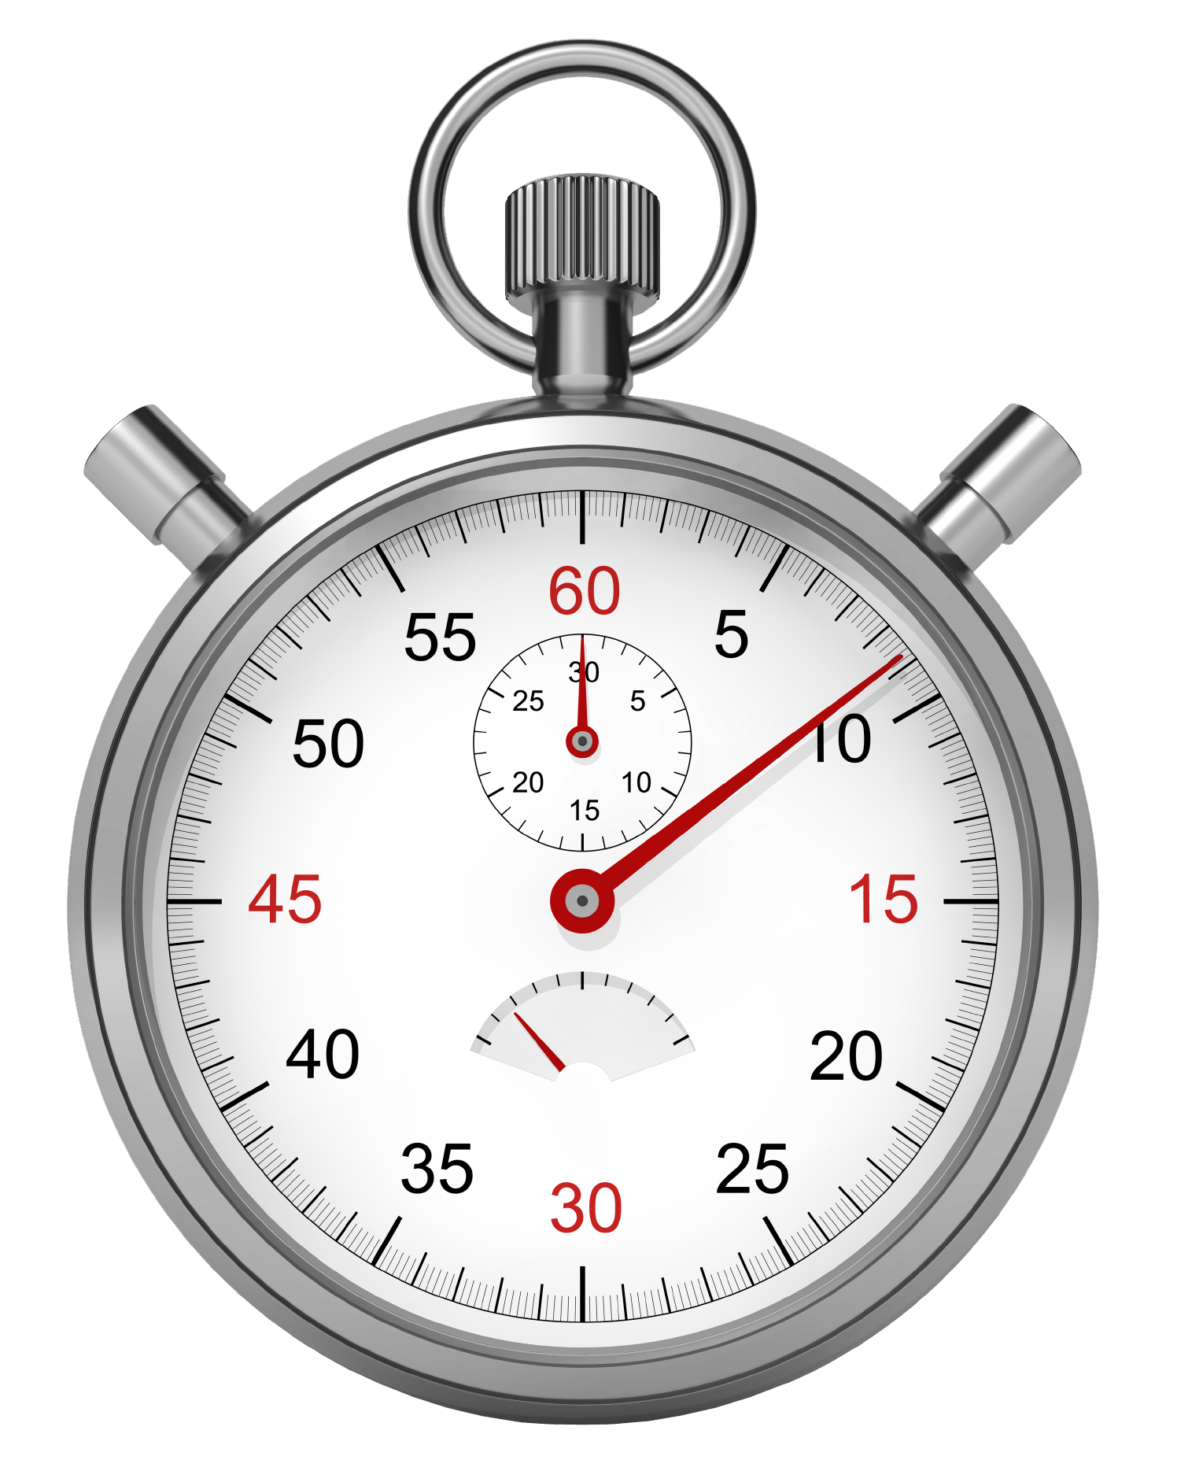
“Need to knows” for administrators
The TN English Language Growth Standard decrease as students move up in proficiency.
The goal is GROWTH!
Students need to practice.
TN ELPA Growth Standards
Prior Year Score | Growth Standard
4.5 - 4.9 | 0.2
4.0 - 4.4 | 0.4
3.5 - 3.9 | 0.5
3.0 - 3.4 | 0.4
2.5 - 2.9 | 0.7
2.0 - 2.4 | 0.8
1.5 - 1.9 | 0.7
1.0 – 1.4 | 1.3
language
Notes:
Snowcone analogy
On-demand speaking prompts
Practice taking the ACCESS with the Sample Items on the WIDA website- do this yourself and with your staff- debrief the experience

Slide 9
Progress Monitoring of academics
Important in addition to monitoring grades on SIS
Crucial for high school graduation rates
Very important if there is no common planning or if your ESL Specialist is itinerant
Federal requirement
Notes:
Has been every 4.5 weeks- now going to every 9 weeks
Can be quite labor intensive- we needed to create time and space for this to happen- and create a culture of IMPORTANCE for PM of academics
Not a “housekeeping” task- important data

Slide 10
Progress monitoring of Language
Pearson TELL (Test of English Language Learning)
Diagnostic- BOY & EOY
Progress Monitoring- 8 available
Longitude data
Quick
Game-like and low stress
Auto-scored
Notes:
TELL pg.:
5
12
14

Slide 11
Progress monitoring of Language
Parent report in English, Spanish, and Chinese for AUTHENTIC ESL progress reporting to parents
Predictive score for ACCESS
Notes:
TELL pg. 11

Slide 12
Where to Begin
Create an ELD Progress Monitoring Calendar
Create a culture of support in PLC
Build the ELPA Data Platform
Visible Data
SMARTER TOGETHER
Philosophy

Slide 13
Adding Data to ELPA Data Platform ~Day 1 PLC Task~
Add student names/numbers and grade levels
Add Experienced ML (LTEL) Indicator
Add ACCESS Scale and PL Overall scores for the prior spring assessment (ACCESS Report)
Add Growth Standard Targets

Slide 14
Determine ACCESS PL Goal (sum function)
Determine the ACCESS Scale Score Goal using PL/SS Chart (compare with WIDA SS to PL Chart)
Use TELL Concordance Tables to determine TELL Goal
I hear and I forget. I see and I remember. I do and I understand.
~Confucius

Slide 15
Next Steps…
Complete BOY Assessment
Update Goals using our Goal Bank
Complete Academic PM
This is a cycle of practice that is continued throughout the year.
Notes:
Show PM Platform for Academic PM and Goals
We use the Key Uses Can Do Descriptors because they are ACTIONABLE
Teachers can use their own Formative Data
TELL Booklet pg 11

Slide 16
PM #4- Predictive Score for ACCESS

Slide 17
Student Goal Setting & Data Collection
Notes:
Developing a Growth Mindset for their English language development

Slide 18
Data Notebooks
~ Shared Methodology ~
Tab for each student
Current Language Goals
ILP
Current TELL Individual Student Report
Flagged Academic PM Forms
Notes:
Data in different places- need it in one for planning and PLC

Slide 19
PM Self-Assessment tool
Self-assessment after PM #1
Refining our practice…

Slide 20
Flashlight 360
Extended practice & coaching for Expressive Language
Specific feedback
Ability to practice the same prompt multiple times and hear their Improvement
Notes:
TELL is auto-scored
We needed an additional resource for extended practice with expressive language
Lots of Experienced MLs have suppressed speaking scores

Slide 21
Flashlight 360
Handwritten writing prompts for K-3
Another source of data
Custom prompts to connect to Tier 1 Instruction
Notes:
TELL is auto-scored
We needed an additional resource for extended practice with expressive language
Lots of Experienced MLs have suppressed speaking scores

Slide 22
The end of our data story for FY23
 | Predicted Percentage of Students Meeting or Exceeding Predicted ACCESS Scale Score for 2023 (only those with growth indicators) | 2022 ACCESS Percentage of Students Meeting Growth Standard | Predicted Change (Percentage Points) | Notes | 2023 Estimated Percentage of Students Meeting Growth Standard | Projected Difference 22-23 | Actual Percentage of Students Meeting Growth Standard | Actual Difference 22-23
Claxton Elementary | 46% | 23.5% | 22.5 |  | 55.1% | 31.6%
Clinton Middle School | 59% | 7.7% | 51.3 |  | 29.4% | 21.7%
Clinton High School | 65% | 18.2% | 46.8 |  | 55% | 36.8%
Est. Avg. % of Students Meeting Growth Standard = 46.5%
Prior Year = 16.4%
Increase of = 30%

Slide 23
Next Steps for our Program
Student-Created
Language Portfolios

Slide 24
It’s been a pleasure…
Emily Bruner
ebruner@acs.ac
Resources for Participants:
WIDA ACCESS PL/SS Expanded Chart
ELPA PM Platform Template

