Slide 1
Supporting Parents of Children with Mental Health Issues: A Collaboration of School Counselors and Teachers
Presented by:
Dr. Tiffany Wilson
Dr. Pamela Kramer Ertel
Middle Tennessee State University

Slide 2

Session Roadmap
1. Introduction
2. Session goals
3. Content Presentation
4. Assessment and Closure

Slide 3
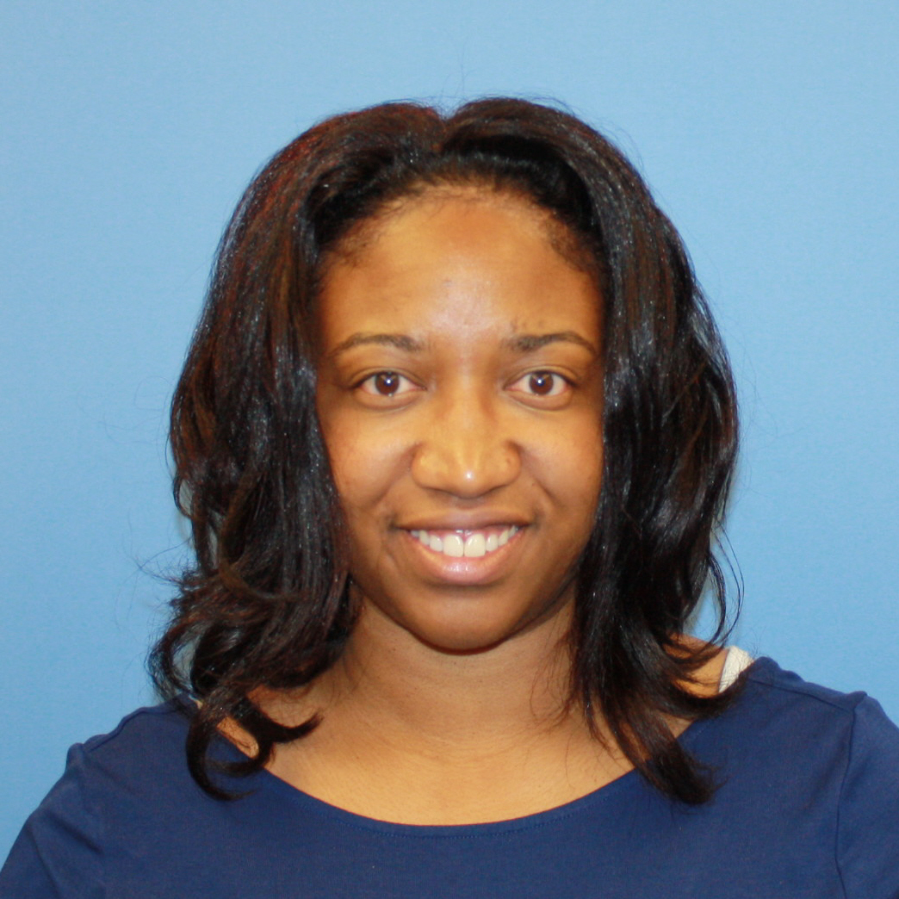
Introduction: Dr. Tiffany Wilson
12 years of professional counseling experience
Licensed School Counselor
(5 years)
Licensed Clinical Mental Health
Counselor (12 years)

Slide 4

Introduction: Dr. Tiffany Wilson
National Certified Counselor
Certified Clinical Trauma Professional (CCTP)
Counselor Educator (5 years)
Twin Family

Slide 5

Introduction: Dr. Pam Kramer Ertel
40+ years of Teaching Experience
*Elementary Teacher – 9 years
*Preschool teacher – summers
*Professor & Dean – 32 years

Slide 6

Introduction: Dr. Pam Kramer Ertel
Program Coordinator: Early Childhood Education Program - MTSU
Blended family – 3 daughters;
3 grandchildren

Slide 7

Presentation goals:
Participants will gain a collection of strategies that school counselors and teachers can use to collaboratively support parents in positively parenting their child(ren).

Slide 8
Presentation goals:
Participants will be able to identify 2 or more resources that can be used to help parents positively support their children’s mental health needs.

Slide 9

Our Collaborative History
Shared common interest and concerns about trauma
Initial collaboration: study of adoptive parents regarding parent perceptions of what schools should do to support adoptive families (online survey & phone interviews)
This Photo by Unknown Author is licensed under CC BY-SA

Slide 10

Adoption Study Results
1. Teachers need to understand/respect the
diversity of families, including those
created through adoption
2. Teachers need trauma training
3. Teachers need to better communicate and
listen to parents.
This Photo by Unknown Author is licensed under CC BY-SA

Slide 11

Lessons Learned: Collaborations Between a School Counselor Educator & Teacher Educator
Professionals must collaborate within schools and local communities to provide resources for parents and caregivers to help them better identify typical signs, symptoms and supports regarding child mental health issues.
(Fong et al. , 2020).

Slide 12
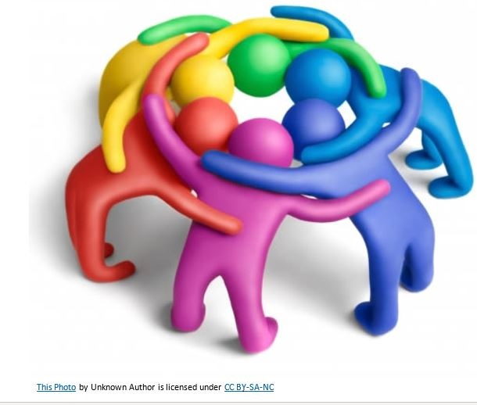
Lessons Learned
We believe there are great benefits when school counselors and teachers work together to address these and other issues related to the mental health needs of children.

Slide 13

Project #2: Our Actions
We obtained a grant to survey parents about
what they needed to better support their children’s mental health.

Slide 14

Results of the Parent Survey
*Parents first wanted basic parent training
*Other concerns included special topics:
*Positive Discipline
*ADHD
*Trauma
*Anxiety/Stress

Slide 15
“Parents are the scaffold the provides structure and support for the child as he or she grows up. They are there to protect and guide, but they don’t impede learning and risk-taking.”
Harold Koplewicz, M.D. , author of Scaffold Parenting
Main source of workshop ideas

Slide 16

Suggestions for School Counselors & Teachers
*Help support parents by sharing
key positive parenting strategies in workshops, conferences,
and communications.
*Take time to listen and try to understand their unique challenges/needs.

Slide 17

Suggestions for School Counselors & Teachers
Share resources with parents to support their role.
Talk to each other (school counselors & teachers)
to determine how you can support each other’s
work.

Slide 18

Positive Parent Training: Key Resource
Based on
Scaffold Parenting
by
Harold Koplewicz, M.D.

Slide 19

Scaffolding Pillars
Structure
Support
Encouragement

Slide 20
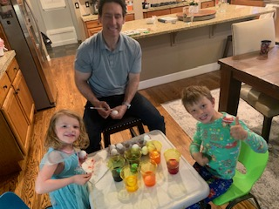
1. Structure
*Establish and enforce Rules
*Enhance Communication
(parent availability &attention)
*Create Family Rituals
*Establish Predictable Routines

Slide 21

2. Support (Providing Empathy & Validation)
*Truly hear
your child’s
feelings.
*No judging or
dismissing
your child’s
feelings!
*Encourage
them to
name and
discuss
emotions.

Slide 22

Support
*Intervene when necessary
+ Consider the need for a tutor or therapist.
- Don’t wait for a crisis to take action!

Slide 23
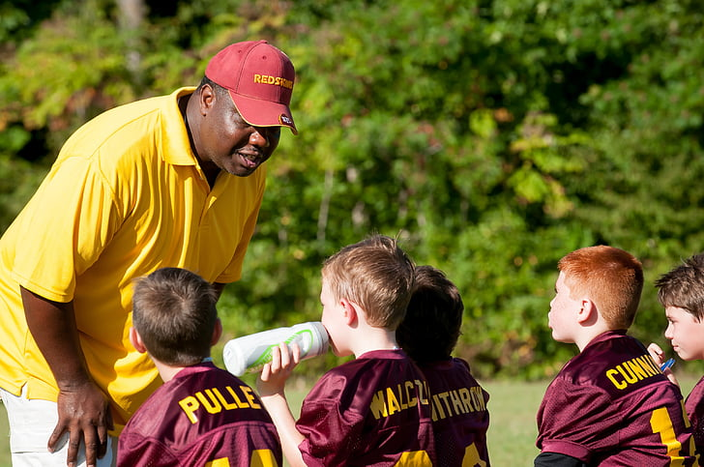
Support
*Provide instruction as needed
+ Coach and instruct
- Don’t do the work for them!

Slide 24

3. Encouragement
*Use mild pushing to try new things; take risks.
*Discuss “failures” and next steps.
*Provide corrective feedback.
*Failure is not fatal!
*Fail forward.

Slide 25
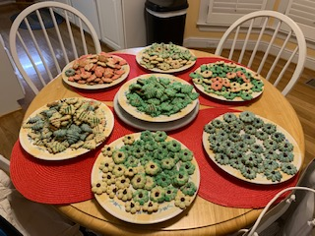
Turn & Talk… Share a family rule or ritual

Slide 26
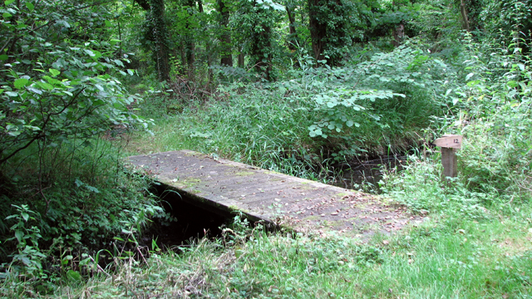
Scaffolding Planks
*Patience: slow and steady wins the race!
*Warmth: model love, compassion, kindness.
*Awareness: Tune in; be present.
*Dispassion: Stay Calm!
*Monitoring: Keep your eye on what is happening.
This Photo by Unknown Author is licensed under CC BY-SA

Slide 27

Scaffolding Strategy #1 Secure Yourself First
Self-care is crucial!
Proper rest and nutrition
“Me” time!
Laughter
Adult time

Slide 28
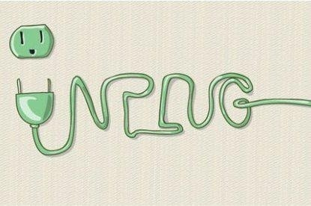
Scaffolding Strategy #1 Secure Yourself First
Establish a realistic schedule.
Celebrate baby steps!
Meditation/spiritual focus
Let your kids see you UNPLUG!!
This Photo by Unknown Author is licensed under CC BY

Slide 29

Scaffolding Strategy #2 Design a New Blueprint
Update outdated blueprints.
Focus on what’s working, rather
than just noticing what’s wrong!
3:1 Ratio of Appreciation vs. Criticism

Slide 30

Scaffolding Strategy #2 Design a New Blueprint
Data Delivers – track it!
Beware of self-fulfilling prophecies!
Give new strategies time to work!

Slide 31
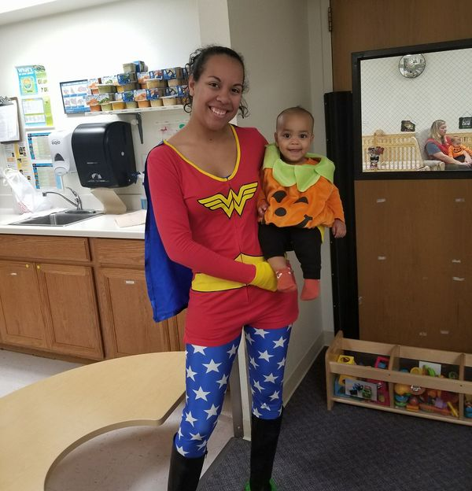
Scaffolding Strategy #3 Lay a Solid Foundation
Use good materials to lay a
solid foundation of your
parent-child relationship!
Be PRESENT!
Validate your child’s emotions.

Slide 32

Scaffolding Strategy #3 Lay a Solid Foundation
Emotional Regulation
Attachment Rituals
Non-judgmental Quality Time
(AKA – FUN!)

Slide 33
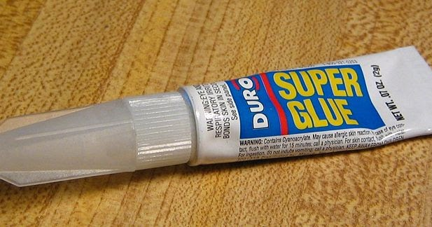
Positive Reinforcement: The Superglue of Parent-Child Relationships
Be sincere! No fake praise – make it meaningful!
Be specific! Assume nothing!
Make expectations visible!
BY
This Photo by Unknown Author is licensed under CC BY

Slide 34

Positive Reinforcement: The Superglue of Parent-Child Relationships
Praise the behavior/effort, not the accomplishment.
Use corrective feedback; focus on the behavior.
Link good behavior with appropriate rewards.

Slide 35

Scaffolding Strategy #4 Hold Steady
Bad weather happens! Be the umbrella!
Stay calm and carry on!
Face crises with control (It’s not about you!)

Slide 36
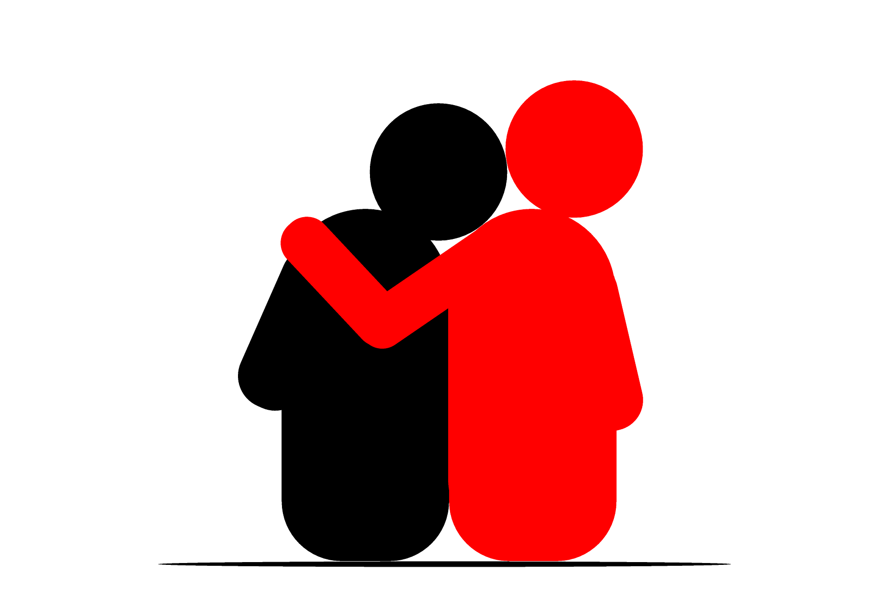
Scaffolding Strategy #4 Hold Steady
Role model the appropriate expression of emotions (No robots!)
Avoid parentification (child becomes the parent)
Turn to other adults for emotional support and comfort.
This Photo by Unknown Author is licensed under CC BY

Slide 37

Scaffolding Strategy #5 Stay on Their Level
Help your child name his/her emotions.
Use language your child will understand.
Tame your tone!
Ask about their interests.

Slide 38

Scaffolding Strategy #5 Stay on Their Level
Share your experiences, but keep the focus on them.
Listen without judgment!
Provide age appropriate responses.
Consider using children’s literature as a conversation starter.

Slide 39

Connection Strategies…
Play together
Watch tv and movies together
Laugh together!

Slide 40

Connection Strategies…
Know your audience!
Avoid the conversation killers
- How was your day?
- What did you do at school
today?
+ Instead, focus on their
interests… (Tell me about practice today.)

Slide 41
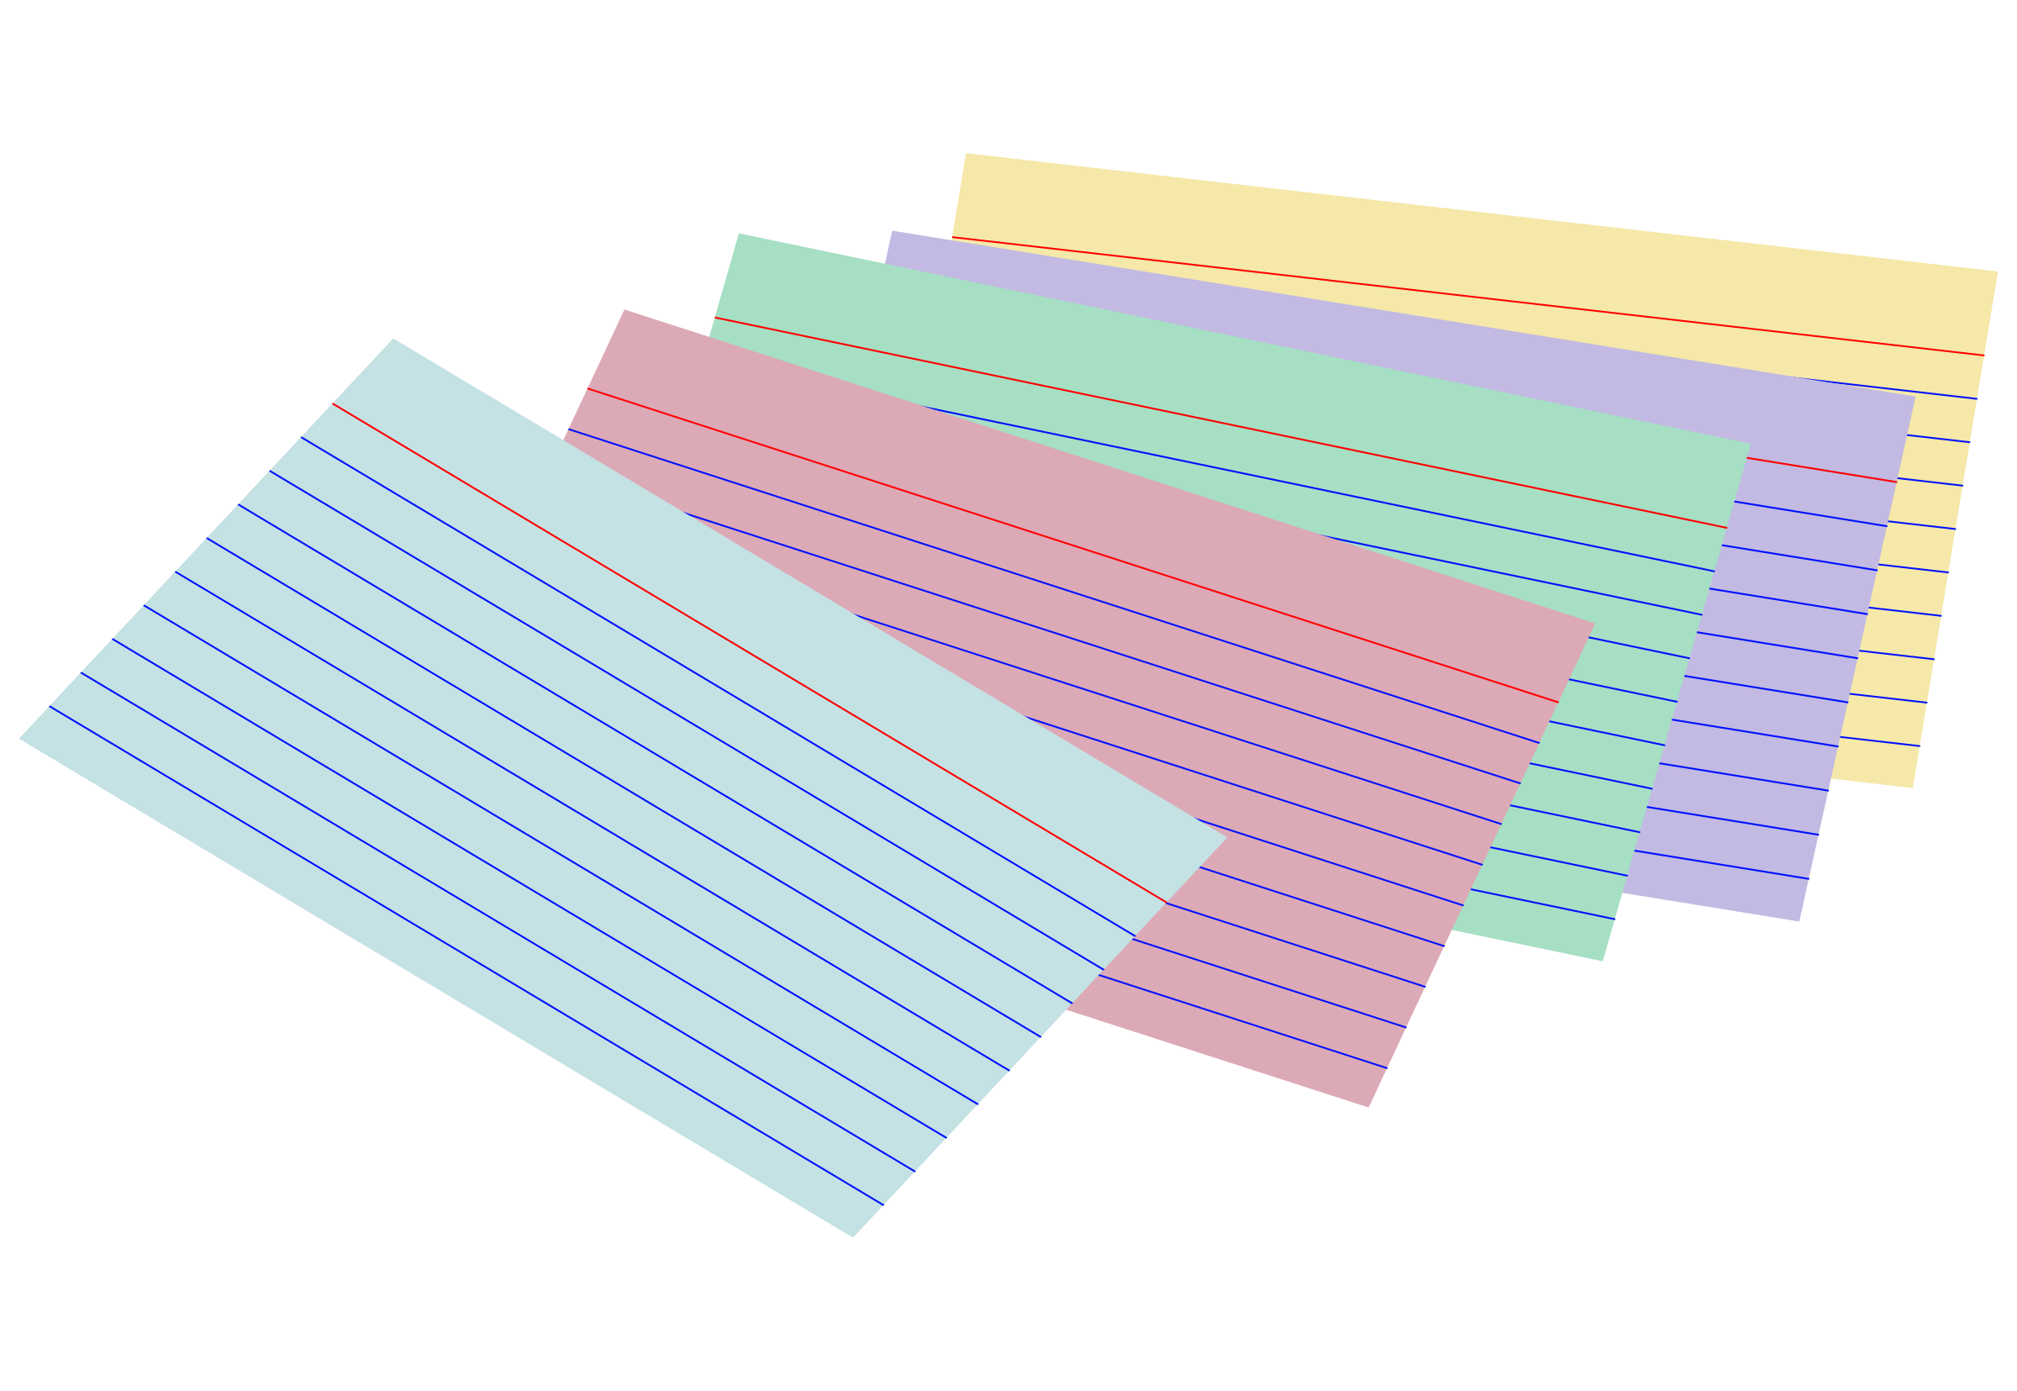
IQ Time!
On one side of the index card, write a new INSIGHT you’ve gained so far.
On the other side of the card, write a QUESTION you have about what’s been presented.

Slide 42

Scaffolding Strategy #6 Empower Growth
“When parents do too much for their kids they block growth”. ~ Dr. H. Koplewicz, M.D.
Support with instruction; guide them in finding their own answers to challenges.
Encourage efforts!

Slide 43
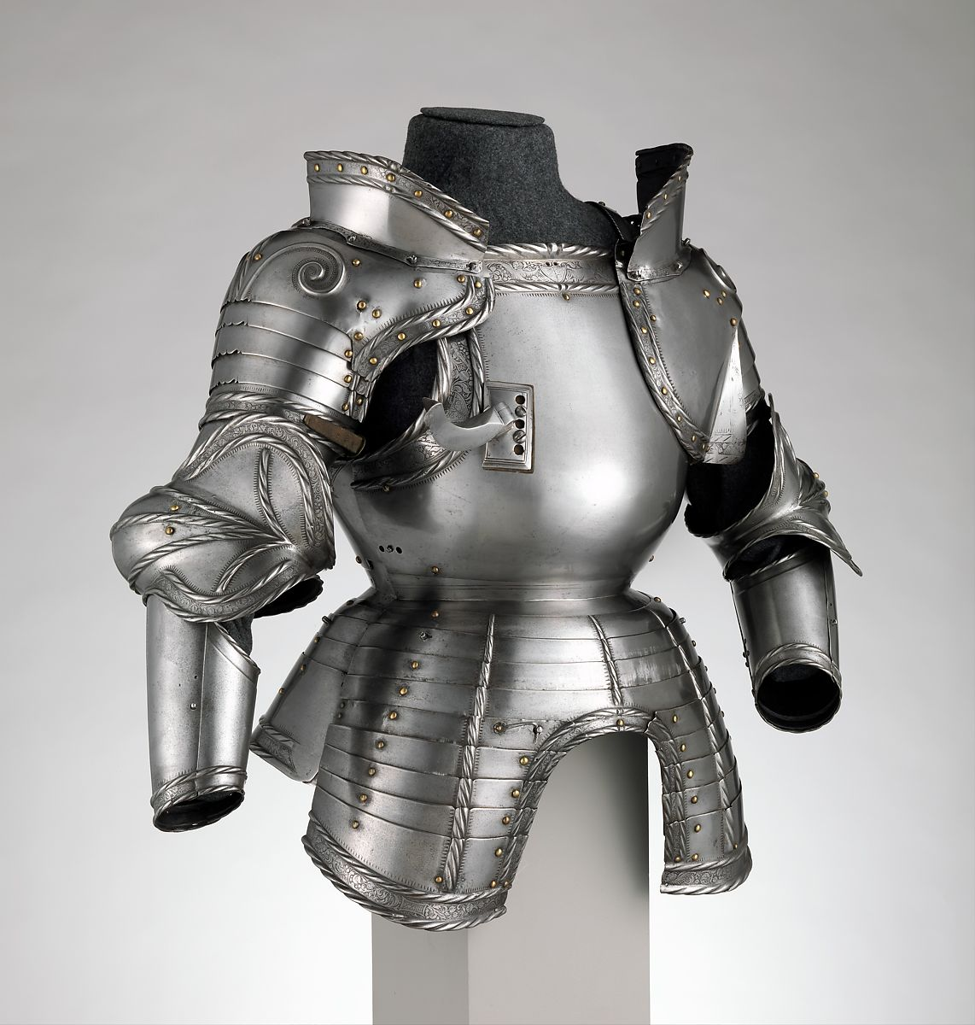
Scaffolding Strategy #6 Empower Growth
Allow them to fail! It builds their emotional armor.
Guide them in preventing repeated mistakes.

Slide 44
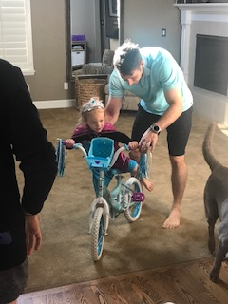
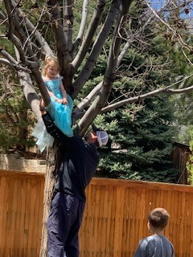
The Growth Zone
Welcome to the Zone of Proximal Development
Utilize Scaffolding
Beware of the Danger Zone!

Slide 45

Failing Forward
“The reward of being patient as your child struggles is a self-reliant, self-motivated learner” (Koplewicz)
Be the shoulder!
Failure is an opportunity for learning.

Slide 46

Failing Forward
Don’t be the “helicopter parent”!
Don’t be the “concierge parent”!
Don’t be the “swooper”!

Slide 47

Scaffolding Strategy #7 Build Strength
Install courage, confidence, resiliency, and tenacity
Never belittle or tease them!

Slide 48

Scaffolding Strategy #7 Build Strength
Reframe negative experiences into positive ones.
Teach and model a healthy perspective.

Slide 49
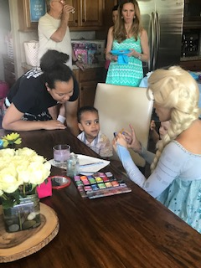
Build Strength: Encourage Children to Try New Things

Slide 50
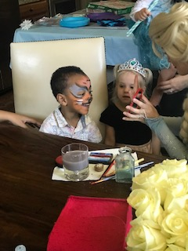
Reinforcement Tools:
Guidance, Support, and Modeling Strength

Slide 51

Teach Tenacity!
Honor your commitments!
Hold back from jumping in and solving it for them!

Slide 52

Teach Tenacity!
Use warmth to comfort them when they fail.
Don’t push YOUR past on your child!
Don’t overreact!

Slide 53

Scaffolding Strategy #8 Set Realistic Limitations
Maintain Quality Control
Teach, Model, and Reinforce Rules
Make Visible Your Invisible Expectations!
Praise the good!

Slide 54

Scaffolding Strategy #8 Set Realistic Limitations
Use your words!
Use active ignoring (aka “Choose Your Battles!)
Teach them about consequences; apply logical consequences
This Photo by Unknown Author is licensed under CC BY-SA

Slide 55

Teach Coping Skills – To Avoid Negative Consequences!
Distraction (“change the channel in your mind”)
Reframing (look at the situation in a different way).
Deep breathing
Expressiveness (use your words!)

Slide 56

Discipline with Dignity
Your goal is to shape behavior, not inflict pain!
Stay calm and neutral (wait if that’s not happening!)
Know their why (Consider the goal of the misbehavior).
Use logical consequences.

Slide 57

Scaffolding Strategy #9 Support Unconditionally
Remember - “You don’t decide who your child is”.
Encourage age-appropriate decision making.
Help your child recognize positive attributes.

Slide 58

Scaffolding Strategy #9 Support Unconditionally
Be realistic about your child’s deficits.
Seek help as needed.

Slide 59

Scaffolding Strategy #10 Repair and Minimize Cracks
Face problems head on!
Use a Symptom checker: childmind.org/symptomchecker
Stay flexible!

Slide 60

Scaffolding Strategy #10 Repair and Minimize Cracks
Nix the nagging!
Cut yourself some slack when you make mistakes.
Establish family bonding rituals.

Slide 61

Final Structural Checks
Strive to scaffold children towards “I can do it” .
Strive to instill a sense of competence, independence, & optimism.

Slide 62

Final Structural Checks
Strive to promote a “growth mindset”
(I can learn it).
Remember that scaffolding can be adjusted!
Scaffolding is not meant to be permanent!

Slide 63
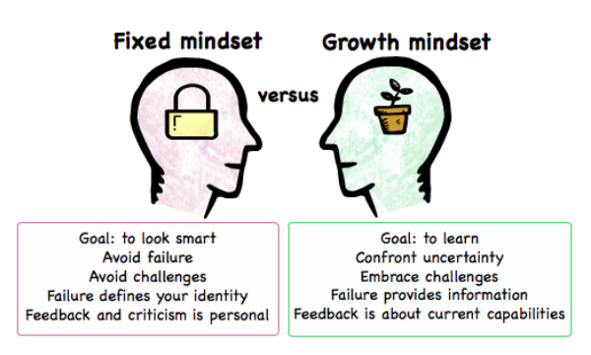
Promote a Growth Mindset
This Photo by Unknown Author is licensed under CC BY-SA

Slide 64

Tips from a School Counselor’s Perspective….

Slide 65

Tips from a Teacher’s Perspective…

Slide 66

Questions & Discussion

Slide 67

Program Evaluation
Please share your anonymous feedback with us!
qrcc.me/rj12spilbsho

