Slide 1
Language and Content in the Co-Taught Classroom
Dr. Hannah Hopper

Slide 2
Objectives
Explore supporting Multilingual students through simultaneous content and linguistic instruction
Deepen our understanding of co-teaching and considerations for effective implementation

Slide 3
Language and Content
Weaving Instruction
Language and content are intertwined
Language acquisition and content instruction support and build on one another

Slide 4
Language and Content
How can we do this?
Know our students
Build relationships
Assess and understand language acquisition processes
Support our colleagues as we collectively deepen our understanding of how to support Multilingual students

Slide 5
Language and Content
We have to build systems that provide equitable instruction to students. Accessible instruction must occur throughout the school day, not just in one hour of EL instruction.

Slide 6
How can EL Specialists and Content Area Teachers Support One Another?
Share instructional strategies
Collaboratively set goals for students
Work together to assess progress toward goals
Build community to support students’ linguistic and academic needs

Slide 7
Models of Co-Teaching
One Leads, One Supports
Parallel Teaching
Alternate Teaching
Team Teaching
Station Teaching

Slide 8
One Leads, One Supports
Description | Benefits
One teacher leads the content lesson, the other teacher supports students’ understanding throughout the lesson | Can provide targeted support for EL student(s) Ensures that learning will be aligned to content Provides opportunity for in-the-moment scaffolds

Slide 9
Parallel Teaching
Description | Benefits
Two teachers teach the same content to two groups of students | Increased opportunity for collaboration among educators Increased student to teacher engagement and feedback Both teachers have the opportunity to build collective expertise in content and linguistic instruction

Slide 10
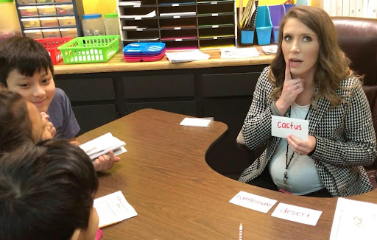
Station Teaching
Description | Benefits
Students receive instruction through teacher-supported small groups | Provides students with targeted, small group instruction Allows educators to plan separately and together Entry point into collaborate teaching

Slide 11
Team Teaching
Description | Benefits
Two teachers collaboratively teaching the same instructional content | Two educators working in tandem to provide instruction to students The lesson benefits from both instructors’ expertise

Slide 12
Alternate Teaching
Description | Benefits
One Teachers provides instruction whole group, one provides small group | Allows one teacher to pre-teach or re-teach content to a small group, while the other teacher provides whole group instruction Can be beneficial for a targeted lesson

Slide 13
Considerations for Co-Teaching Model
Leverages strengths and knowledge of multiple experts
Requires specific and intentional collaborative planning
Strengthens the collective community of educators working to support students’ linguistic and academic growth

Slide 14
Student Considerations for Co-Teaching Model
English proficiency level
Grade level
Educational background
Percentage of ELs in a class/ grade

Slide 15
Cycle of Instruction
Co-Planning
Co-Teaching
Co-Assessing
Co-Reflection

Slide 16
Co-Planning
Structures
When will the educator team work together to collectively plan for students’ content and linguistic goals?
What structures are in place that will specifically allow for these conversations?

Slide 17
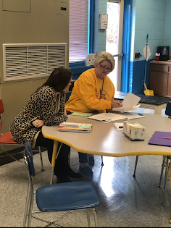
Co-Planning
Roles
EL Specialist | Content Teacher
Serves as the linguistic specialist Provide culturally responsive, instructional tools and strategies to support students’ diverse linguistic abilities and needs, in order to experience success | Serves as the content expert Align content and instruction with grade-level standards to support students’ growth and learning in order to experience success

Slide 18
Co-Planning
Tools
What tools or documents will be used to facilitate discussions around unit and lesson planning?
Where will those tools or documents be housed?
What will the expectation be around timing of completion?
Notes:
What forms of data would be helpful

Slide 19
Co-Teaching
Structures
What systems and structures in the master schedule are in place to allow co-teaching to successfully occur?
How will the co-teaching cycle be supported throughout the school year?

Slide 20
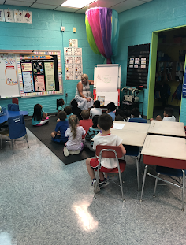
Co-Teaching
Roles
What will the role of each educator in the room be?
Will those roles shift throughout the lesson or unit?

Slide 21
Co-Teaching
Tools
What resources are necessary and/or available to support collaboration among educators and to ultimately ensure student success?

Slide 22
Co-Assessing
Leverage multiple forms of assessment data to inform instruction
Educators collaboratively construct and assess learning through formative and summative assessments

Slide 23
Benefits of Co-Teaching
Increase access to content instruction through equitable and linguistically responsive instructional practices
Deepen content-area teachers’ understanding of cultural and linguistic aspects of learning
Streamlines student learning and prevents “learning in silos”
Strengthened engagement of Multilingual students in the content area classroom

Slide 24
How do we know if we’re doing it right?
Effective co-teaching is what works for the students in the classroom.
Be willing and open and communicate your expertise.
When educators work together, students benefit.

