Slide 1
Scaffolding in Content Instruction
Sara Kathryn Hendrix
EL Coordinator|Office of Academics
Division of Special Education & Intervention Programs

Slide 3
What is Scaffolding?
Just as scaffolding in construction is used to describe a temporary structure used to support a work crew...
Instructional scaffolding in the classroom will be a temporary, student-specific support structure designed to maximize access to grade-level concepts and tasks

Slide 4
Scaffolding enters the educational scene…
By the late 1970s, the idea of scaffolding is introduced as it pertains to young child’s oral language acquisition.
Jerome Bruner, cited for the Cognitive Learning theory explained that when children are first learning to speak, their parents and caregivers provide the initial frameworks that facilitate the child’s learning.
(Wood, Bruner & Ross, 1976)

Slide 5
Bruner argued that students should discern for themselves the structure of subject content- discovering the links and relationships between different facts, concepts and theories (rather than the teacher simply telling them).
“The aim of education should be to create autonomous learners!
(Wood, Bruner & Ross, 1976)

Slide 6
Scaffolding…
equips a student to do something beyond what he/she could do independently.
supports access to meaning while a student acquires more language.
builds on prior knowledge and forming associations among new information, concepts, and language acquisition.
provides opportunities for students to be successful before moving on to unfamiliar territory.

Slide 7
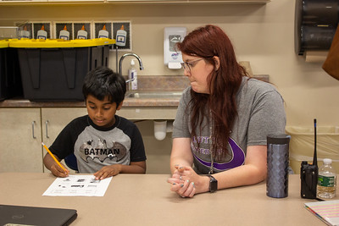
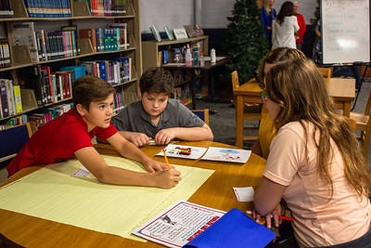
Theory of Development
Contingency
Temporary
Transfer of Responsibility
Support is provided to the extent it is needed.
Support is reduced and removed as the learner gains competence.
Responsibility for successful performance is transferred from the support provider to the learner.

Slide 8
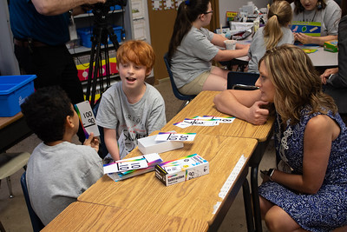
Why Scaffold?
By utilizing access points within High Quality Instructional Materials and applying the appropriate instructional scaffolds in Tier I instruction, the need for individualized accommodations and modifications are greatly reduced!
Lowers the need for student intervention
Helps meet objectives
Allows the teacher to be the facilitator
Creates Discussion

Slide 9
In order to ensure ALL students have access to grade level content, it takes…
strong core instruction that is inclusive of all learners, where all students are given the opportunity to access grade-level instruction, and high-quality instructional materials have multiple access points so all learners can maximize their grade-level learning opportunities.
What are “access points”?

Slide 10
Access Points
Annotations within high-quality instructional materials that help teachers determine additional supports for students within the lessons to ensure they can fully engage (e.g., pre-teach vocabulary, additional practice, alternative writing tools, etc.).

Slide 11
Instructional Scaffolding
Instructional Scaffolding A temporary, student-specific support structure designed to maximize access to grade-level concepts and tasks.
Structure
The support structure may take one of many forms:
Tools - graphic organizers, sentence frames, bookmarks, concept maps, realia, visuals, etc.
Peer Interactions – pair share, peer tutoring/feedback, etc.
Teacher interactions – assessing and advancing questions, wise feedback, etc.
Exercises – routines, self-evaluation or reflection, visualization, etc.
Student-specific
Scaffolds respond to evidence (not assumptions) of individualized needs and assets to clear the path to learning. If evidence supports entire class needing a scaffold, then it may be applied whole-group while still meeting the criteria of being student-specific.
Scaffolds function as temporary supports that are strategically removed over the course of the lesson, unit, or year to foster independent learning.
Temporary
Scaffolds provide students with a pathway to experiences that build competence and confidence with grade-level content.
Grade-level
Maximize access
The purpose of an instructional scaffold is for students to maximize their time grappling productively with complex grade-level content, which means the scaffold must minimize anticipated, student-specific barriers to learning, such as interference from non-essential content or other cognitive distractions.
Notes:
5 min.
Notice and Wonder
Framing:
Language matters, so our exploration of strong instructional scaffolding begins by recognizing instructional scaffolding as both a NOUN (the scaffolding as an observable thing) and a VERB (scaffolding as an intentional action in the planning process and implementation). The table below offers a simple definition and an explanation of the critical features of the noun form.
Notes:
Remember - grade-level work is a critical resource for student success, and research continues to show that remediation focused on mastering below-grade level content before providing access to grade-level content is ineffective as a strategy for academic growth and achievement.

Slide 12
Access Points
Instructional Scaffolds
Accommodations
Modifications
Annotations within high-quality instructional materials that help teachers determine additional supports for students within the lessons to ensure they can fully engage (e.g., pre-teach vocabulary, additional practice, alternative writing tools, etc.).
A temporary, student-specific support structure designed to maximize access to grade-level concepts and tasks.
An IAIEP/504/ILP team decision based on individual student need that requires a change to how the student accesses information, engages in learning, or demonstrates knowledge in a particular setting.
An IAIEP/504/ILP team decision based on individual student need that requires a change to what the student is taught or expected to learn.
This greater access to flexibility in how curriculum and instruction are delivered, and multiple options in the way students can respond to instruction for demonstrating their knowledge should reduce the need for singling out individual students to provide accommodations.​
All Students
IEP, 504, ILP

Slide 13
Evaluating HQIM and applying scaffolds
What are the grade-level expectations of this standard, complex text, and/or task?
What prerequisite knowledge/skills (including those related to language) are needed in order to access the new learning?
Which content might require instructional scaffolds for access?
Notes:
SAY: “Now let’s walk through some HQIM resources that can support us in applying instructional scaffolding.”
GIVE participants time to discuss the questions at their table group, then debrief as a whole group.

Slide 14
Key Details when Scaffolding:
Allow for mistakes
Be a guide towards autonomy
Encourage productive struggle and risk-taking in learning

Slide 15
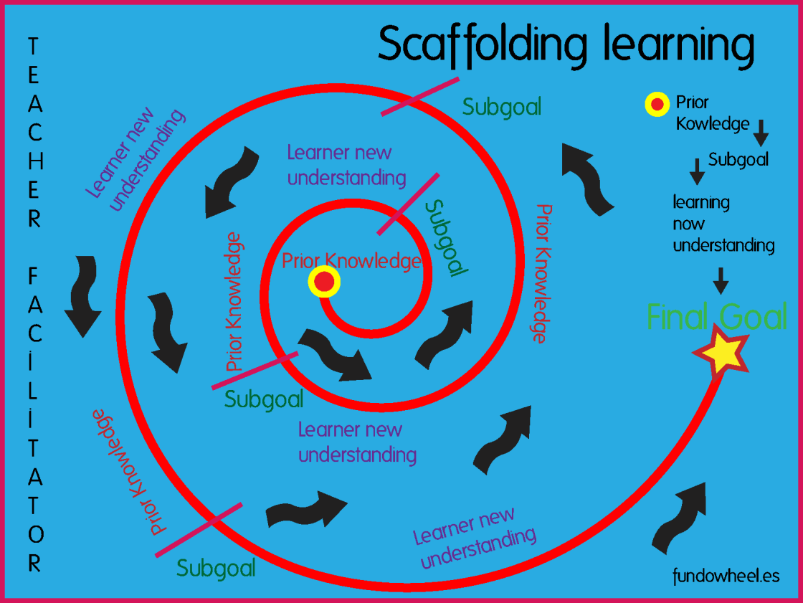
This Photo by Unknown author is licensed under CC BY-SA-NC.

Slide 16
Allow for Mistakes
Let students make mistakes they can learn from. It will take longer to get tasks done at first, but over time they will become so much more capable than if they constantly relied on your help.
If they are struggling or get frustrated, there are ways you can be there as a sense of support, but still allow them to be independent in the task.

Slide 17
Allow for Mistakes
For example, breaking down a tougher task into smaller parts
→ Think of cooking…
At first a child may do little things like pour ingredients or stir…
But then they learn to use a butter knife… then a sharp knife…
And eventually, they can cook all by themselves.

Slide 18
Be a guide towards autonomy
As much as we may want to micromanage every detail, it is way more FUN to watch our students learn and grow independently, but always be there as a means of support for your students, helping nurture that relationship and trust!

Slide 19
“Teachers who foster positive relationships with their students create classroom environments more conducive to learning and meet students’ developmental, emotional and academic needs” (Rimm-Kaufman & Sandilos, 2015).
A student who feels a strong personal connection to their teacher, talks with their teacher frequently, and receives more constructive guidance and praise rather than just criticism from their teacher, “is likely to trust their teacher more, show more engagement in learning, behave better in class and achieve at higher levels academically” (2015).

Slide 20
Encourage Productive Struggle and Risk-taking in Learning
In the words of Larry Ferlazzo, “If students don’t feel comfortable, they’re not going to take the risk… and if they don’t risk, they don’t learn” (Education Week, 2019).
Reward the Struggle!

Slide 21
How to Scaffold
Build Rapport
Know their knowledge Level
Select Task
Anticipate Errors
Apply Scaffold
Gradually Remove the Scaffold

Slide 22
Creating an Environment for Scaffolding Success…
Create a comfortable environment where mistakes, growth, and learning can take place
Learn to pronounce student’s names correctly and note key details about each student…
What is their family structure?
Cultural background?
Learning styles/preferences?
A few likes/dislikes?
Assign them a buddy/allow peer-assisted learning
Set clear goals and expectations

Slide 23
Creating an Environment for Scaffolding Success…
Write a review question on the board
Give opportunity for review and comprehension checks
Keep vocabulary accessible (word walls, labeling, etc.)
Connect content to their culture and experiences when possible

Slide 24
Guidelines
Praise
Appropriate Tasks
Various Supports
Second Chances
Formative Assessments

Slide 25
Types of Scaffolds
Verbal: how information is verbally presented or explained to the students during instruction
Model a “think-aloud”
Slow your speech and enunciate
Reinforce contextual definitions
Simplify questions
Engage in read-aloud in which you model correct pronunciations and prosody

Slide 26
Procedural: tools and resources to support the students as they gain access to the learning
Provide explicit modeling through visuals, gestures, and realia
Allow for visual tools (organizers) as students manipulate information
Use wait-time when asking questions to give all students an opportunity to respond
Provide discussion prompts (sentence frames) to support discussions
Allow students to collaborate with other students as they discuss the learning

Slide 27
Various Scaffolds
Cue Cards
Examples
Vocabulary Books
Prompting
Sentence Frames
Choral Read/Echo Read
Give Hints
Graphic Organizers
Visual Aids
Cue, Do, Review
Teacher Models ( I DO IT)
Teacher with Students (WE DO IT)
Students Do It Together (YOU ALL DO IT)
Students Do It Independently (YOU DO IT)
Student Models (I DO IT)

Slide 28
Scaffolding Reading
Adapted Texts
Same content, different reading level
Partner Reading
Reading the same text with a peer
Shared Reading
Reading together in unison as a group
Primary Language Support
Using students’ native language as a leverage
Chunking
Section reading into smaller pieces

Slide 29
Echo Reading
The teacher first reads the text aloud, one sentence or line at a time, modeling appropriate fluency. After reading each line, the students echo back the reading of the line with the same rate and prosody.
Front Loading Vocabulary
Students are introduced to and explicitly taught the academic vocabulary related to the text before going to comprehend the text.

Slide 30
QSSSA
QSSSA Script | Why?
Class, without calling out answers, think about this question… (QUESTION) | Linked to objectives and lesson goals, focuses and activities prior knowledge for ELs
When you think you have an answer in mind, let me know by ________. (SIGNAL) | Build in wait time for ELs to process.
When you discuss your answers, I want you to respond in this format… (STEM) | Provides opportunity for student to practice targeted academic language
Turn to your partner and discuss… (SHARE) | Increases student talk, chance to compare their response with others, and 100% of the class practices targeted language
Select students to share or ask everyone to write their response. (ASSESS) | Scaffolds for ELs, ensures students are prepared to respond
Question
Signal
Stem
Share
Assess
(Seidlitz & Perryman, 2019)

Slide 31
One of my favorite strategies: QSSSA
Q: What is your favorite scaffolding strategy (either shared from today or one you already implement) and how would you use it?
S: When you are ready to answer, put a peace sign up in the air.
S: My favorite scaffolding strategy is __________________________. I will use this in my classroom by _____________. I liked this strategy because__________.
S: Share your response in a small group discussion.
A: I will call on one person from each group to share their response aloud. Go ahead and decide which person in your group will be the speaker.
Activity Time!

Slide 32
Results to expect from scaffolding
Minimized failure & frustration
Supportive learning environment
Freedom to ask questions, provide feedback, and support peers
Teachers become facilitators of knowledge rather than content “experts”
Students take a more active role in learning
Students take ownership of their learning and their classroom as a community of learners

Slide 33
Connecting ELD & TN State Standards
This summer, a working group of content math and ELA teachers, alongside ESL specialists, collaborated at the TN State Department of Education to develop a standards crosswalk, bridging the content standards to the English Language Development Standards.

Slide 34
Goal:
Simultaneously Support
What
How
Content Objectives
Content
Language Acquisition
Language Objectives

Slide 35
The ELD & TN State Standards Crosswalks
As a result, we were able to develop two finished crosswalks, in the areas of Math and ELA, across all the grade levels. These crosswalks include the TN State Standard, the connecting ELD standard, a student friendly language objective, and the suggested linguistic supports and scaffolds appropriate when teaching the standard. We hope these crosswalks will help save educators time and provide increased access to content for English learners!

Slide 36
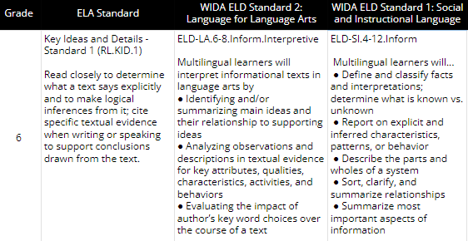
Example from the Crosswalk: 6 ELA

Slide 37
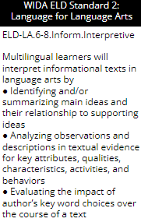
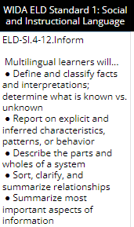
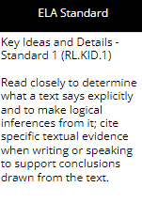
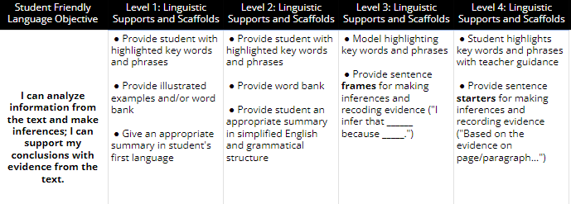

Slide 38
Remember the goal!
High Challenge
Frustration/ Anxiety Zone
Learning/ Engagement Zone
Boredom Zone
Comfort Zone
Low Support
High Support
Balance Challenge and Support!
Low Challenge

Slide 39
Sources Cited:
Education Week. (2019). Differentiating Instruction: A Guide for Teaching English-Language Learners [YouTube Video]. In YouTube. https://www.youtube.com/watch?v=9hekJsCOHLU
Rimm-Kaufman, S., & Sandilos, L. (2015). Improving students’ relationships with teachers to provide essential supports for learning. Apa.org. https://www.apa.org/education-career/k12/relationships
Seidlitz, J., & Perryman, B. (2019, March 13). QSSSA: More than turn & talk. Seidlitz Education. https://seidlitzblog.org/2019/03/27/qsssa-more-than-turn-talk/
Wood, D. J., Bruner, J. S. and Ross, G. (1976). The role of tutoring in problem solving. Journal of Child Psychiatry and Psychology, 17(2), 89-100.

Slide 40
Thank You!
Sara Kathryn Hendrix
EL Coordinator
Office of Academics, Special Education and Intervention Programs
Sara.Hendrix@tn.gov
Permission is granted to use and copy these materials for non-commercial educational purposes with attribution credit to the “Tennessee Department of Education”. If you wish to use these materials for reasons other than non-commercial educational purposes, please contact Joanna Collins (Joanna.Collins@tn.gov).

