Slide 1
Planting the Seeds to Promote Family-Centered Support in Student Mental Health
Jaime Grammer | School Counseling Manager
Student and Family Services,
Division of Coordinated School Health
© Tennessee Department of Education

Slide 2
Notes:
Talking points:
• Academics: ALL TENNESSEE STUDENTS WILL HAVE ACCESS TO A HIGH-QUALITY EDUCATION, NO MATTER WHERE THEY LIVE. This might look different across the state, but we must ensure that every child has access to an excellent education and access to the similar opportunities as their peers.
• Student Readiness: TENNESSEE PUBLIC SCHOOLS WILL BE EQUIPPED TO SERVE THE ACADEMIC AND NON-ACADEMIC NEEDS OF ALL STUDENTS IN THEIR CAREER PATHWAYS. This has been the #1 piece of feedback that we heard for the strategic plan and we know that the needs of our children have shifted over the last 10 years – we must devote capacity to meeting those needs to ensure students are successful in their chosen career pathway.
• Educators: TENNESSEE WILL SET A NEW PATH FOR THE EDUCATION PROFESSION AND BE THE TOP STATE TO BECOME AND REMAIN AN EDUCATOR. The single most important factor in a child’s education in our K12 public schools is the teacher, so we must support the profession to ensure our teachers feel supported, and valued.
Talking points:
• Academics: ALL TENNESSEE STUDENTS WILL HAVE ACCESS TO A HIGH-QUALITY EDUCATION, NO MATTER WHERE THEY LIVE. This might look different across the state, but we must ensure that every child has access to an excellent education and access to the similar opportunities as their peers.
• Student Readiness: TENNESSEE PUBLIC SCHOOLS WILL BE EQUIPPED TO SERVE THE ACADEMIC AND NON-ACADEMIC NEEDS OF ALL STUDENTS IN THEIR CAREER PATHWAYS. This has been the #1 piece of feedback that we heard for the strategic plan and we know that the needs of our children have shifted over the last 10 years – we must devote capacity to meeting those needs to ensure students are successful in their chosen career pathway.
• Educators: TENNESSEE WILL SET A NEW PATH FOR THE EDUCATION PROFESSION AND BE THE TOP STATE TO BECOME AND REMAIN AN EDUCATOR. The single most important factor in a child’s education in our K12 public schools is the teacher, so we must support the profession to ensure our teachers feel supported, and valued.

Slide 3
Agenda
Build and enhance knowledge of PCEs (Positive Childhood Experiences)
Recognize the importance of PCEs to help buffer the effects of ACEs (Adverse Childhood Experiences)
Identify strategies to increase PCEs

Slide 4
Positive Childhood Experiences (PCEs)

Slide 5
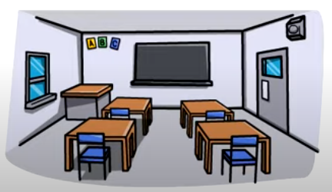
Positive Childhood Experiences
I was able to talk with my family about my feelings.
I felt that my family stood by me during difficult times.
I felt safe and protected by an adult in my home.
I enjoyed participating in community traditions.
I felt a sense of belonging in high school.
I felt supported by friends.
I had at least two non-parent adults who took a genuine interest in me.
(Bethell et al., 2019)
Notes:
Talking points:
In 2021, the Tennessee Behavioral Risk Factor Surveillance System (BRFSS) included the Positive Childhood Experiences module, a series of statements about childhood with yes/no responses. The number of “yes” responses indicates a PCEs score out of 7:
There are 7 positive childhood experiences that occur before the age of 18. The first three PCEs occur in the family and in the home. The last 4 occur in schools and communities, and we have ample opportunities to ensure that every student has an opportunity for all four of these experiences in school.
We’ll look at the impact and specific data from TN BRFSS on the next few slides

Slide 6
Impact of PCEs
Notes:
Talking points:
We now know what PCEs are, but next we’ll find out why they are so important and their impact on our collective well-being.
The future prosperity of Tennessee depends on its ability to foster the health and well-being of the next generation. Healthy child development is the foundation for economic productivity, responsible citizenship, and lifelong health—all elements of a strong community and healthy economy

Slide 7
Impact of PCEs
Notes:
Review slide.
Talking points: PCEs can also protect children from Adverse Childhood Experiences (ACEs). ACEs are potentially traumatic experiences during childhood that can affect lifelong health. PCEs can buffer the negative effects of ACES that have occurred (CDC, 2019). Still, even children without traumatic experiences need to feel belonging and connectedness to thrive.
Opportunities for PCEs are affected by a child’s environment and community. Understanding PCEs in Tennessee helps communities create and encourage the conditions to support positive relationships and environments for everyone. Our collective well-being depends on creating a strong foundation of health for all children (Sege et al., 2017).

Slide 8
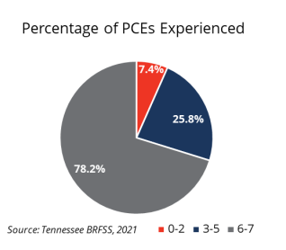
TN Data on PCEs
Most adult Tennesseans reported experiencing several positive experiences during childhood
Most reported feeling safe and supported at home and by their friends while growing up; nearly half of adults reported experiencing all 7
The least common PCE was “I felt a sense of belonging in high school” (71.3%)
Notes:
Talking points:
The Behavioral Risk Factor Surveillance System administered to Tennesseans in 2021 included a module on Positive Childhood Experiences and the results are shown on the graph on this slide.
Most adult Tennesseans reported experiencing several positive experiences during childhood. Looking at the graph: In red you can see that 7.4% of adults reported experiencing 0-2 PCEs. In blue, 25.8% reported experiencing 3-5 PCEs and in gray 78.2% reported experiencing 6-7 PCEs.
Nearly half of adults reported experiencing all 7 PCEs.
The least common PCE was “I felt a sense of belonging in high school” at 71.3%. As educators/counselors, we can help our students “find their niche” in high school, so that we can raise this number.
Ask: So what does this data mean?

Slide 9
HOPE: Healthy Outcomes from Positive Experiences
Four building blocks:
Relationships: With other children, adults and through interactive activities
Environment: Safe, equitable and stable, positive home and school environments
Engagement: Develop a sense of connectedness
Opportunities: Playing with peers, learning self-reflection, collaboration in art, sports, drama and music
https://positiveexperience.org/about/
Notes:
We now know that even in the face of adversity, key positive experiences help us heal. Although the effects of trauma can be serious, many adults have overcome their own trauma and now lead healthy productive lives as a result of those positive experiences. Through our work, we know there are four building blocks that promote HOPE:

Slide 10
More PCEs can lead to….
Better mental health
Lower prevalence of depression
Better physical health
More physical activity
Better overall health status
Less cardiovascular disease
Less disabilities
More commonly employed
Notes:
Talking Points in ( )
Better mental health (44% of adults with 0-2 PCES spent 2 or more weeks of the last month dealing with poor mental health, compared to just 12% of those with 6-7 PCEs.)
Lower prevalence of depression (Adults who had more PCEs were less likely to have ever been diagnosed with depression)
Better physical health (Eleven percent (11%) of people with 6-7 PCEs reported spending 14 or more of the last 30 days with poor physical health compared to nearly 1 of 3 (32%) of those with 0-2 PCEs. )
More physical activity (Those with high PCEs had more physical activity compared to those with less PCEs. )
Better overall health status (As the number of PCEs increased, so did the probability of reporting good or better health.)
Less cardiovascular disease (PCEs were associated with CVD; those with more PCEs less commonly reported cardiovascular diseases (3-5 PCEs: 12.9% and 6-7 PCEs: 11.4%)—such as coronary heart disease, heart attack, and stroke—compared to those with 0-2 PCEs (19.7%).)
Less disabilities (People with more PCEs less commonly reported having any disabilities.)
More commonly employed (People with more PCEs are more commonly employed, giving them better access to insurance. Because they’re more likely to have health insurance and be employed, people with more PCEs are also less likely to delay medical care due to cost.)

Slide 11
Strategies to Increase PCEs

Slide 12
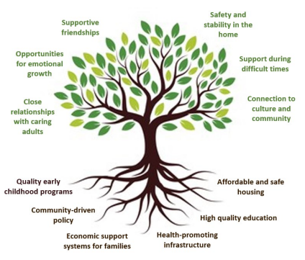
Notes:
Talking Points:
If you’ve seen the tree graphic with the 3 realms of ACEs- household, community, and environment- PCEs follow that same pattern. We must water this tree if we want to see growth and prosperity.
The PCEs data tell us that encouraging safe, stable, and nurturing relationships and environments for children has lifelong positive effects on the health of Tennesseans. Children with high PCE scores are less likely to engage in risky health behaviors, less likely to experience long-term illness, and more likely to enjoy better mental health and overall health later in life.
However, many children are born into systems and structures that limit opportunities for connection and safety. Not all communities in Tennessee have fair access to resources that provide protection against harmful experiences like ACEs. For example, communities lacking affordable housing, high-quality schooling, or healthy food may negatively impact a child’s environment.
When we focus on community conditions (seen in the roots of the tree) and support opportunities for safety, stability, and meaningful relationships (seen in the leaves of the tree), we can help all children thrive, no matter where they live. We need to be the watering can for these roots in our schools and communities. This affects safety, tax spending, and quality of life for communities across our state (Levine & Reed, 2022).
High PCE scores improve resilience, well-being, and prosperity for us all.

Slide 13
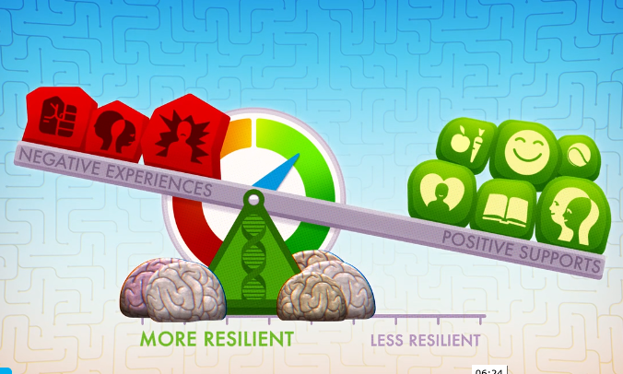

Slide 14
Strategies to Increase PCEs
Teaching relationship and self-regulation skills
Supporting mentorship, extracurricular and cultural programs
Strengthening public-private partnerships
Increasing access to early childhood programs
Adapting systems of care to focus on whole-person wellness
Improving economic support for families
Notes:
Talking points in ( )
Teaching relationship and self regulation skills (Teaching students relationship building skills and self regulation skills in school and community programs- using trauma-informed strategies like circles, restorative practices, classroom meetings, and classroom traditions to help teach relationship skills- breathing techniques, mindfulness, exercise/movement and calming corners/rooms to teach self-regulation skills
Supporting mentorship, extracurricular and cultural programs (Establish programs in your schools and support existing ones- examples: attend student’s extra curricular activities, buy the girl scout cookies and boy scout popcorn, support the student’s 4-H community service project, highlight culture and diversity throughout the year)
Strengthening public-private partnerships (Partner with county health councils because they have stakeholders from a variety of sectors and influence and they work on getting effective policies implemented and systems change throughout the county)
Increasing access to early childhood programs (This would include high quality childcare and PreK programs and evidence- based home visits)
Adapting systems of care to focus on whole-person wellness (There are many programs that focus on physical health, but as we’ve seen with the data, a person’s overall wellness is equally about mental health as well)
Improving economic support for families (This would include lowering overall family stress by providing as many free resources for programming that supports child development

Slide 15
Fostering Hope
“All four of my children have attended Oak Ridge Schools since their Kindergarten year. I am beyond grateful for Mrs. Bruce and her colleagues. As a single mother, who has no biological family in the state of Tennessee other than my children, the struggle becomes unbearable. The monetary support I have received has been a God send in my times of desperation and I am beyond grateful that there is a program to help support struggling parents as myself. More than the monetary support, I would like to share that mental and emotional support is not anything money can buy. There are genuine people, with genuine hearts, genuine intentions, who genuinely care! So much of my faith and hope has been restored by knowing that I have support outside my household to lean into in our time of need. Thank you to all those that make, support, and advocate for this program,”
-Parent, Oak Ridge Schools

Slide 16
Fostering Hope with Families: Schoolwide Strategies
Encourage supportive relationships
Understand and consistently evaluate relationships with families
Trust and two-way communication
Strength-based approach
Celebrate families and their role
© Tennessee Department of Education

Slide 17
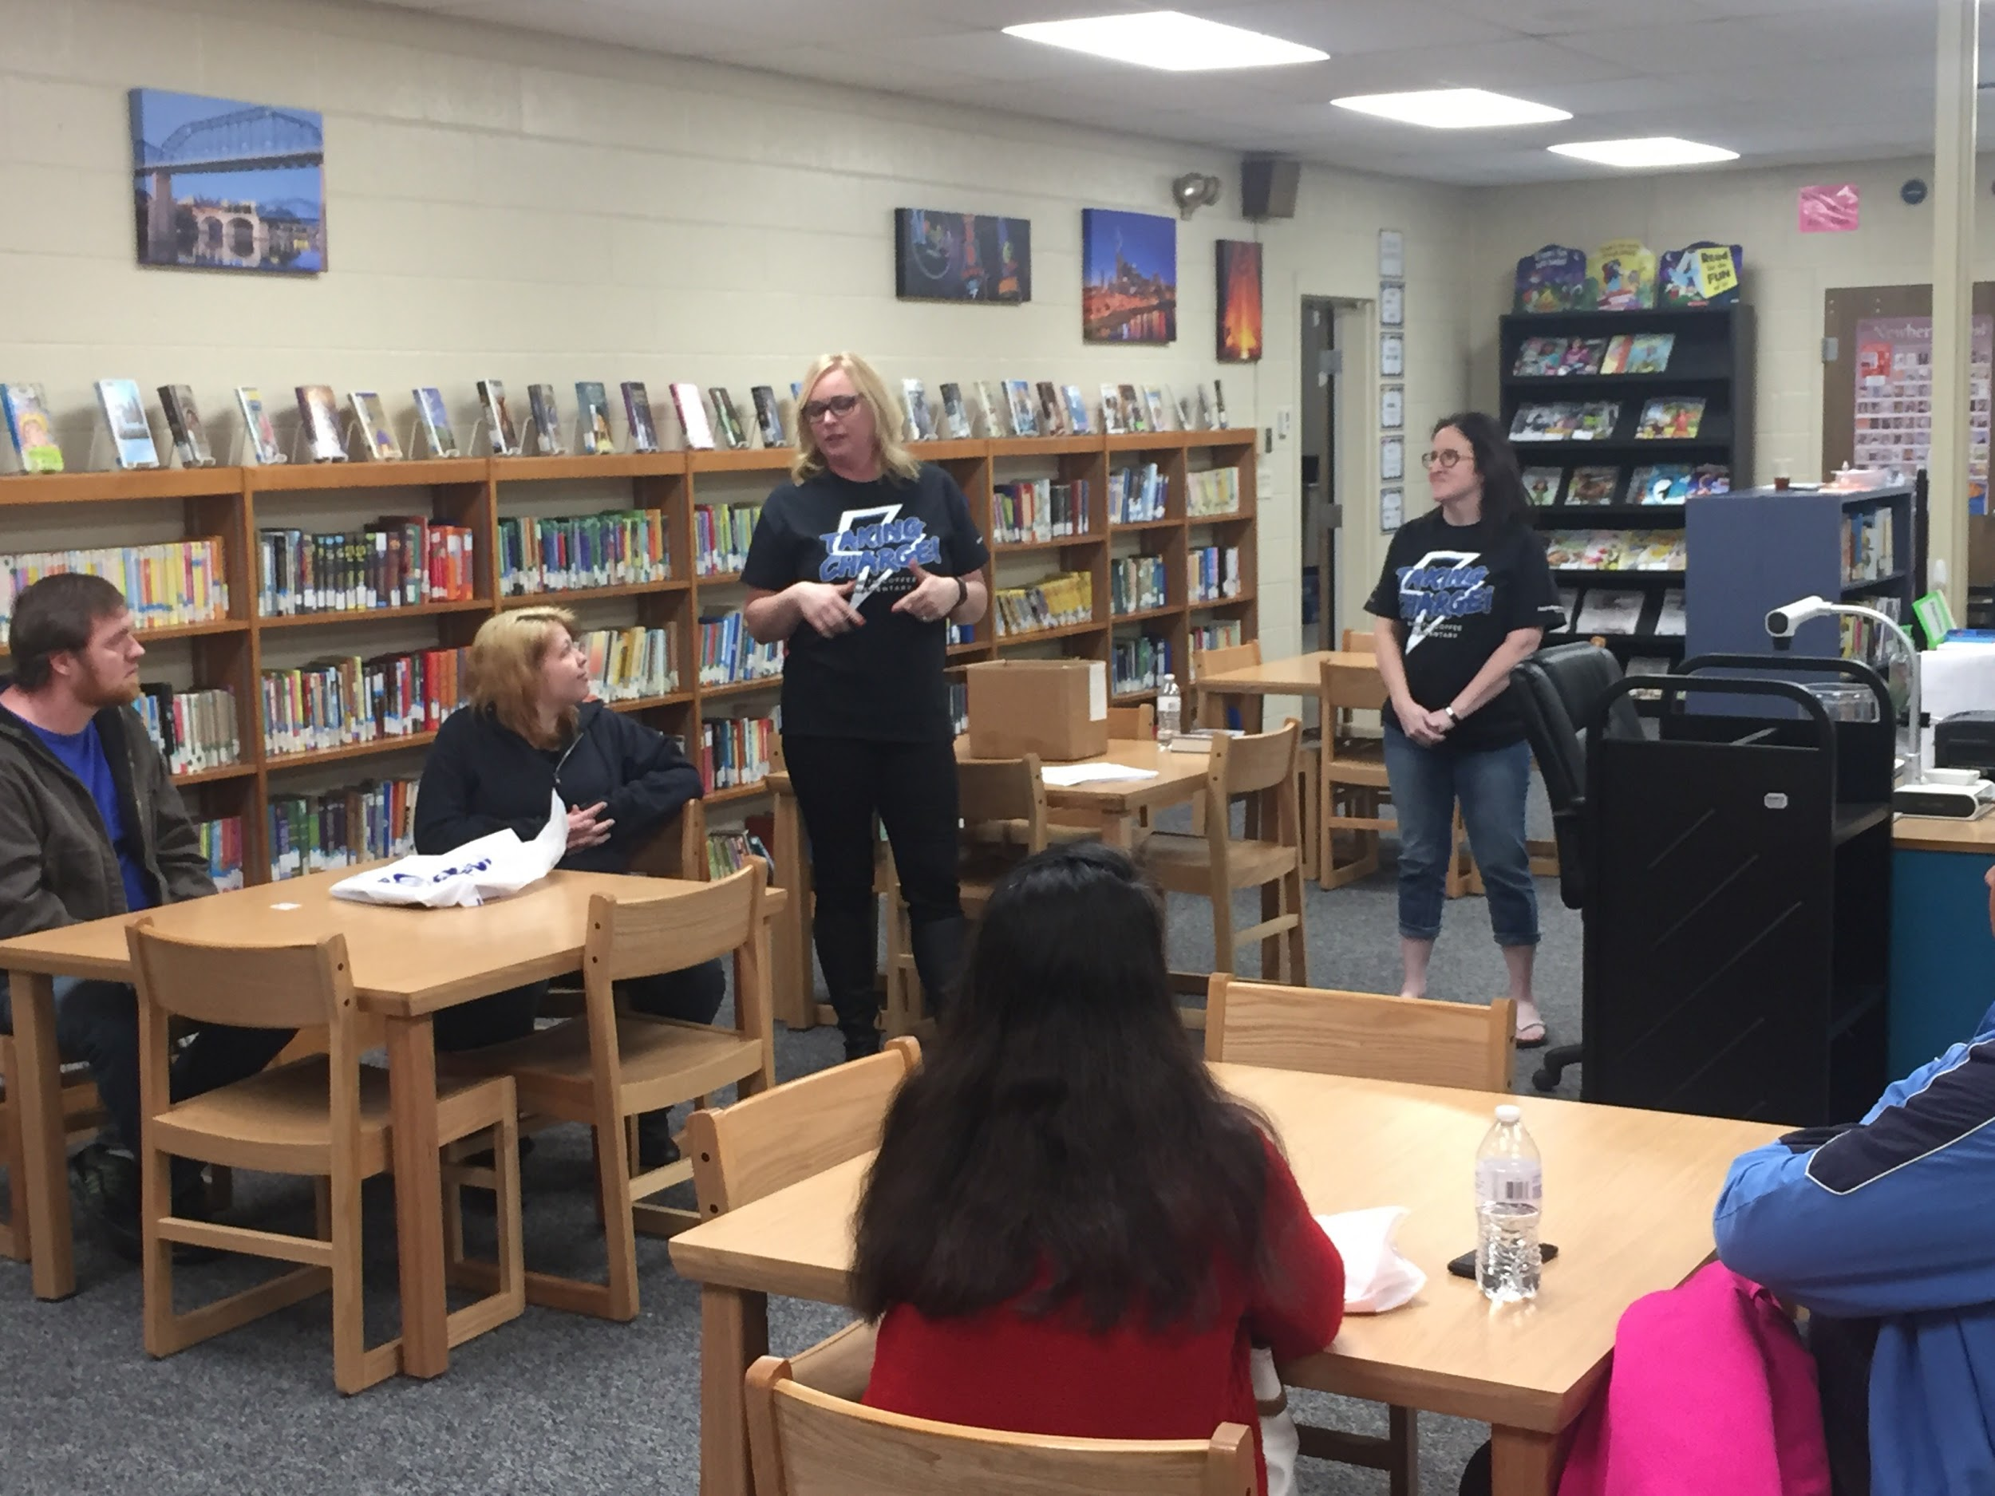
Fostering Hope with Families: Schoolwide Strategies
Families and school staff engage in regular, two-way, and meaningful communication about student learning.
Use multiple modes of communication consistently.
Ensure families know their opinions and contributions matter.
Use feedback and survey results to ensure effective forms of school-to-home and home-to-school communications.
Notes:
Communicating effectively goes far beyond a newsletter. Effective communication that promotes a strong relationship and engaged families focuses on strong two-way systems of communication that meet the needs of individual families. When families communicated with through a two-way approach, they are more likely to be engaged in the process. Families are more likely to be involved when communications are consistent, timely, accessible and are specific.

Slide 18
Communicating Effectively
Sender
Message
Receiver
Feedback
Communication Plan
Structure for sending home information related to student learning
Includes multiple modes of communication consistently
Tracks strategies that do not work
Ensures opportunity to provide feedback and dialogue
Two-Way Communication
Home visits, e-mail, surveys, social media, student-led opportunities, family conferences, phone calls
Notes:
Two-way communication allows the opportunity for families to be connected and involved in their child’s academic success. When developing a communication plan, utilize feedback data to serve as an essential component in the structure building. Forms of two-way communication include home visits, e-mails, surveys, social media – allowing families to give dialogue, student-led opportunities such as a student-led conference, phone calls.

Slide 19
Fostering Hope with Families: Schoolwide Strategies
Building a system of support
Integrate protective factors into everything
Infuse professional development opportunities for educators to learn about their families and needs
Connect families with appropriate support staff based on needs
Kinship care
Help families understand how systems work.
Promote mental health for the entire family unit.

Slide 20
Fostering Hope with Families: Schoolwide Strategies
Helping families know how the system works
Offer workshops to families to build understanding of school and district programs (e.g., school safety, academic policies, resources)
Help families become familiar with education acronyms and jargon
Ensuring families feel empowered
Communicate regularly on services offered, such as “Family Resource Friday”
Develop and implement ways for families to ask questions, suggest improvements, voice concerns (e.g., family forums, drop-off/pick-up walk and talk, suggestions/question text line)
Notes:
Here are some strategies to help support families:
Offering workshops to families to build understanding of school and district programs. This may include understanding school safety components, academic policies – families should know where their child is supposed to be performance wise at any given time. This transparent process also allow families the ability to understand organizational structures and how to navigate when issue arises and the best way to easily resolve.

Slide 21
Fostering Hope with Families: Schoolwide Strategies
Encouraging family voice
Hold focus groups to elicit ideas and surface concerns
Encourage participation in decision-making
Parent and Family Engagement Policy
School and/or district Parent and Family Engagement Council
School and/or district Improvement Plan
Encouraging leadership
Support the development of parent/family groups (e.g., PTA, PTO, school health councils)
Notes:
Encourage families to be a part of the process as well by asking them for their feedback but also encouraging families to serve as part of a district school improvement plan team, parent and family engagement policy team, school-parent compact, etc.

Slide 22
Fostering Hope in the Classroom
Celebration Bucket: Students can drop a note about a celebration they encountered that day.
Student Mentors: Provide leadership opportunities. Show older students how to act as a mentor to younger students.
Catch me! “Catch” students doing or saying something kind and acknowledge it.
Thumbs up, thumbs down: Each morning and afternoon, students can check in to show how they are feeling through a quick thumbs-up, thumbs down.
https://www.edutopia.org/article/building-students-resilience-bus
Notes:
From the same Edutopia article, Lori Desaultes gives examples of strategies to build resilience and foster relationships.

Slide 23
At Home Strategies for Families
Establish a routine that promotes active listening and sense of structure.
Model and encourage skill building opportunities such as family-wide media curfew, mindfulness practices, self-regulation opportunities.
Ask your child about positive relationships they are making at school
Focus on your child’s strengths before talking about things they can do to improve their confidence.
Encourage child’s participation in extracurricular activities.

Slide 24
What do I leave with?
How will you be the watering can for your students and community?
Notes:
Say: Using the post its on your table, write down how you will take the information you learned today, and use it to be a watering can for your students and community.
Take a few responses from the group and have them post their post its on the watering can drawing.

Slide 25
Thank You!
Jaime Grammer | School Counseling Manager
Student and Family Services, Division of Coordinated School Health
Jaime.Grammer@tn.gov
(615) 638-5235
Permission is granted to use and copy these materials for non-commercial educational purposes with attribution credit to the “Tennessee Department of Education”. If you wish to use these materials for reasons other than non-commercial educational purposes, please contact the Office of General Counsel at (615) 741-2921 or Joanna Collins (Joanna.Collins@tn.gov).

