Slide 1
Who Has Time for a
Silent Period?
Facilitating Purposeful Student Engagement for Newcomers
Raven Cleveland
Coordinator of ENL K-12 Academics & Instruction
Hamilton County Schools, Chattanooga, TN

Slide 2
The “Silent Period”
Hypothesis coined by Stephen Krashen
Pre-production Stage
Can last months/years
It's real!

Slide 3
Defining Newcomers
Multiple definitions
Recently arrived English learners (RAELs)
WIDA proficiency level
Educational Background
Literacy Level
SIFE/SLIFE

Slide 4
Defining Programming
Integrated student body
High Quality Instructional Material
SIOP® components
Functional Language Approach
Clear Learning & Language Targets built around WIDA & TN State Standards
Academic Language in Context
Language Forms in Context
Stop siloing ELD Instruction

Slide 5
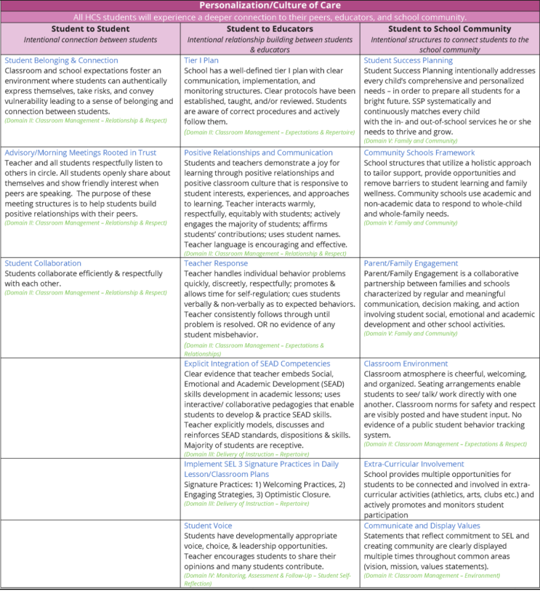
Academic Press & Personalization

Slide 6
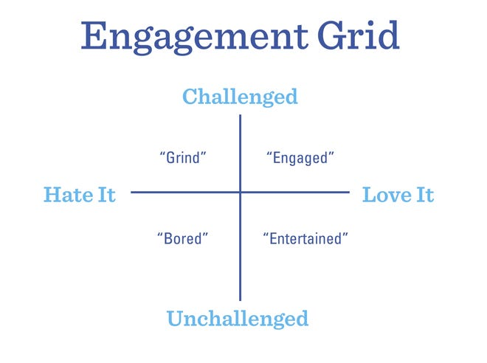
What is Engagement?
Three types of engagement:
Emotional
Cognitive
Behavioral
Engagement can fluctuate from day to day, class to class, even minute to minute.

Slide 7
Engagement Types
Emotional Engagement
How a student feels in general and about learning
Feels a connection to the learning
How a student FEELS is linked to what they THINK

Slide 8
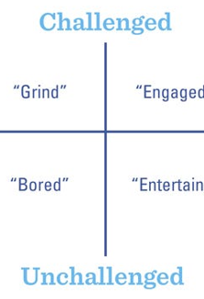
Engagement Types
Emotional Engagement
How a student feels in general and about learning
Feels a connection to the learning
How a student FEELS is linked to what they THINK
Cognitive Engagement
What the student is thinking about in the classroom
Specific Teaching Strategies prompt thinking
If a student is THINKING it, they are more likely to REMEMBER it
(Almarode & Miller, 2017)

Slide 9
Behavioral Engagement
What students do
Observable type of student engagement
Goal is to complete a task in the way it was designed to be completed

Slide 10
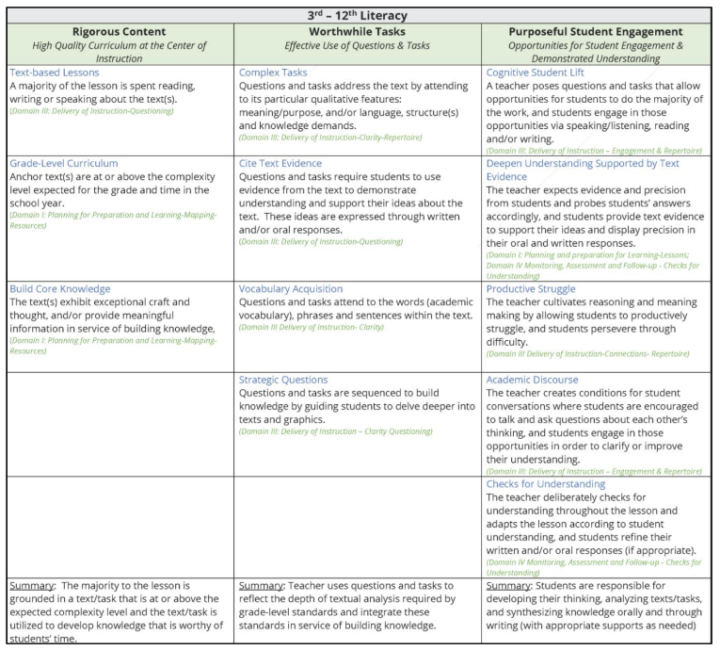
Academic Press & Personalization

Slide 11
Personalization of Learning
Building Connections
Student to Student
Student to Teachers
Student to Community
Welcoming Rituals
Activities for inclusion that establish safety and predictability; that support contribution by all voices; that set norms for respectful listening; and that encourage students to connect with one another.
“The reality is that we do have the time when we make time for things that produce more Academic Engaged Time.”
Notes:
Evidence shows that people remember most about the first few minutes of an experience, and secondly the last few minutes of experiences (Willis, 2010b, 2010).
One of the high leverage strategies educators can infuse into their daily practice, that produces on average 20% more Academic Engaged Time in the average hour long class, is intentionally greeting students at the door. (Cook, et al., 2019)
5 minutes per day = +25 minutes per week; +15.8 hours per year
10 minutes per day = +50 minutes per week; +30.6 hours per year
30 minutes per day = +150 minutes per week; +92.8 hours per year
Cook, C. R., Fiat, A., Larson, M., Daikos, C., Slemrod, T., Holland, E. A., . . . Renshaw, T. (2018). Positive Greetings at the Door: Evaluation of a Low-Cost, High-Yield Proactive Classroom Management Strategy. Journal of Positive Behavior Interventions, 20(3), 149-159.
Willis, J. (2010a). The current impact of neuroscience on teaching and learning. In D. A. Sousa (Ed), Mind, brain, and education: Neuroscience implications for the classroom (pp. 44-66). Bloomington, IN: Solution Tree Press.
Willis, J. (2010b). Understanding and planning achievable challenge. Learning to love math teaching strategies that change student attitudes and get results (pp. 16-32). Alexandria, VA: ASCD.

Slide 12
Academic Press
Rigorous Content
High Quality Curriculum at the Center of Instruction (Grade Level)
Text based lessons
Building Core Knowledge

Slide 13
Academic Press
Rigorous Content
High Quality Curriculum at the Center of Instruction (Grade Level)
Text based lessons
Building Core Knowledge
Worthwhile Tasks
Complex Tasks
Strategic Questioning
Citing Text Evidence
Vocabulary Acquisition

Slide 14
Purposeful Student Engagement
All HCS students will show measurable growth in their ability to read, write, and think through classrooms dedicated to rigorous content, worthwhile tasks and
purposeful student engagement.

Slide 15
Cognitive Student Lift
Students participate actively in the lesson through:
SPEAKING
WRITING
READING
LISTENING

Slide 16
Productive Struggle
“Productive struggle is what I call the "sweet spot" in between scaffolding and support. Rather than immediately helping students at the first sign of trouble, we should allow them to work through struggles independently before we offer assistance. That may sound counterintuitive, since many of us assume that helping students learn means protecting them from negative feelings of frustration. But for students to become independent learners, they must learn to persist in the face of challenge.”
Blackburn, B. (December 2018).

Slide 17
Academic Discourse
The teacher creates conditions for student conversations where they are encouraged to talk and ask questions about each other’s thinking, clarify ideas, or improve their understanding.

Slide 18
Engagement Strategies
Technology
Gamification
Authentic or Novel
Choice Boards
Personal Experiences

Slide 19
Listen to the Sound of Silence
What are students “saying” with their faces?
What are students “saying” with their bodies?
How are students interacting with other students?

Slide 20
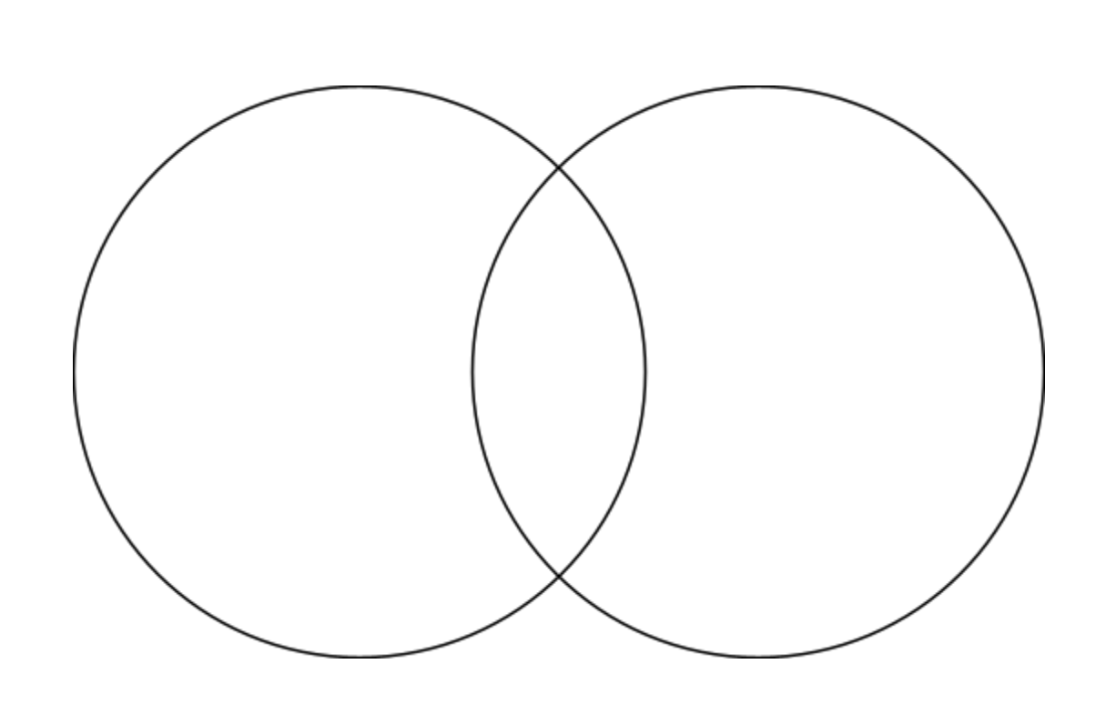
Optimistic Closure
Function
Academic Press
Personalization

Slide 21
Questions & Comments
Raven Cleveland
ENL Coordinator of K-12 Academics & Instruction
Hamilton County Schools
Cleveland_C@hcde.org
423.498.7342

Slide 22
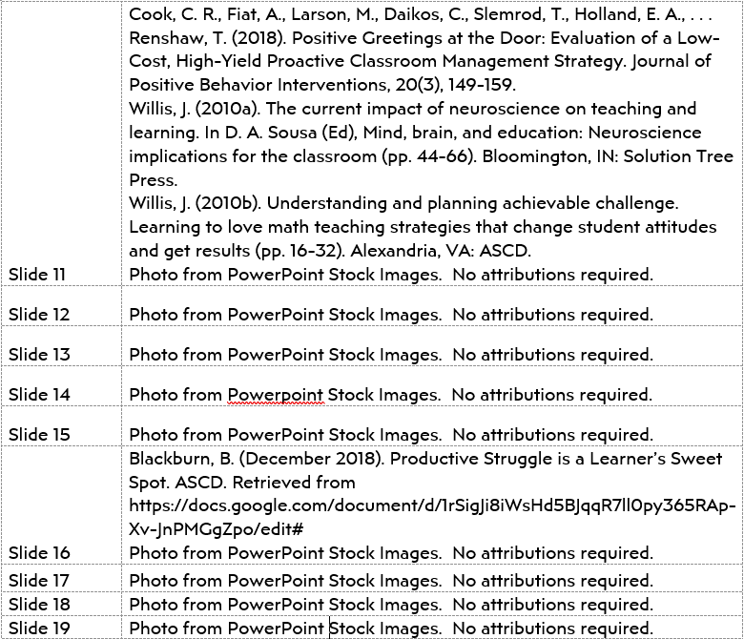
References & Attributions

