Slide 1
Circle/Sphere of Influence
Leah Simpson & Brent Simpson, WCHS

Slide 2
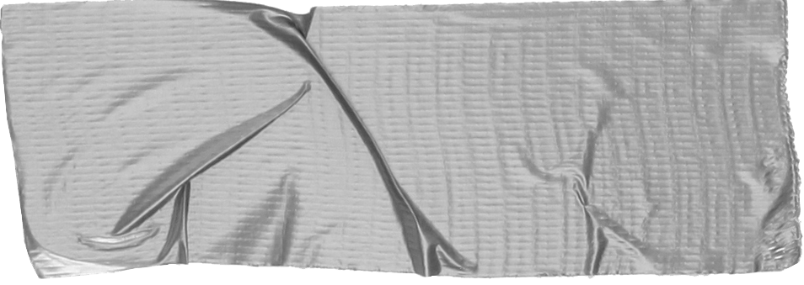
Intro
Scholarships
Alli
Community
Notes:
This presentation will be mostly conversational style, but we will address:

Slide 3
Scholarships
Golden Door
Equal Chance for Education
The Dream
simpsonl@warrenschools.com
Notes:
Ask for emails to send document
Goal setting theory

Slide 4
Alli
Multicultural Club
Relationship Based/Support
Adult ESL Classes

Slide 5
Community
Family Resource Center
Legal
Career

Slide 6
Good luck!
Send ? simpsonl@warrenschools.com
THANK YOU!

