Slide 1
Child Fatality Review Data, Data Dashboard and Prematurity Data
5-12-2021

Slide 2
Data from 2020 CFR Report

Slide 3
Child Mortality, Tennessee
Non-significant decrease from 2017 to 2019
28% higher than 2019 national rate
Data source: Tennessee Department of Health, Office of Vital Records and Statistics; CDC Wonder.

Slide 4
Child Mortality by Race, Tennessee
Black children had approximately 2.2 times the mortality rate of white children in 2019
Data source: Tennessee Department of Health, Office of Vital Records and Statistics.

Slide 5
Infant Mortality, Tennessee
Non-significant decrease from 2017 to 2019
25% higher than 2019 national rate
Data source: Tennessee Department of Health, Office of Vital Records and Statistics; CDC Wonder.

Slide 6
Infant Mortality by Race, Tennessee
Black infants had 2.5 times the mortality rate of White infants in 2019
Data source: Tennessee Department of Health, Office of Vital Records and Statistics.

Slide 7
Summary of Child Mortality Data, 2019
By Age Group
By Sex
By Race
Data source: Tennessee Department of Health, Child Fatality Review.

Slide 8
Manner of Death Summary, 2019
Data source: Tennessee Department of Health, Child Fatality Review.

Slide 9
Cause of Death Summary, 2019
Data source: Tennessee Department of Health, Child Fatality Review.

Slide 10
Medical Cause of Death Ranking, 2019
Medical Cause | Total
Prematurity | 140
Congenital Anomaly | 97
Other Medical Condition | 59
Cardiovascular | 47
Cancer | 36
Asthma | 26
Other Infection | 26
Other Perinatal Condition | 22
Pneumonia | 16
Neurological/Seizure Disorder | 16
Influenza | 3
Diabetes | 2
Low Birth weight | 2
Undetermined Medical Cause | 1
Total | 493
Data source: Tennessee Department of Health, Child Fatality Review.

Slide 11
External Cause of Death Ranking, 2019
Injuries | Total
Motor vehicle and other transport | 75
Assault and weapon-related | 67
Unintentional asphyxia | 39
Drowning | 16
Poisoning, overdose, or acute intoxication | 11
Fire, burn, or electrocution | 7
Fall or crush | 3
Other/Unknown | 7
Undetermined | 4
Total | 229
Data source: Tennessee Department of Health, Child Fatality Review.

Slide 12
External Cause of Death by Age Group, 2019
Injuries | Total | Percent of Reviewed Deaths (%) | Age Group
 |  |  | < 1 year | 1-4 years | 5-9 years | 10-14 years | 15-17 years
Motor vehicle and other transport | 75 | 9.3 | 3 | 16 | 16 | 10 | 30
Assault and weapon-related | 67 | 8.3 | 5 | 5 | 4 | 18 | 35
Unintentional Asphyxia | 39 | 4.8 | 34 | 3 | 0 | 1 | 1
Drowning | 16 | 2 | 0 | 5 | 5 | 2 | 4
Poisoning, overdose, or acute intoxication | 11 | 1.4 | 3 | 3 | 0 | 1 | 4
Fire, burn, or electrocution | 7 | 0.9 | 1 | 5 | 1 | 0 | 0
Other | 5 | 0.6 | 0 | 1 | 1 | 1 | 2
Undetermined | 4 | 0.5 | 2 | 2 | 0 | 0 | 0
Fall or crush | 3 | 0.4 | 0 | 0 | 0 | 0 | 3
Unknown | 2 | 0.2 | 1 | 0 | 0 | 1 | 0
Total | 229 | 28.3 | 49 | 40 | 27 | 34 | 79
Data source: Tennessee Department of Health, Child Fatality Review.

Slide 13
Number of Deaths by Cause for 2018 vs. 2019
 | 2018 | 2019 | 2018 | 2019
Categories showing improvement | Number of Deaths |  | Rate
Sleep-Related | 128 | 103 | 1.8 | 1.3
Congenital Anomaly | 107 | 97 | 1.6 | 1.2
Suicide | 39 | 32 | 3.4 | 2.1
Homicide | 55 | 40 | 3.7 | 2.7
Drowning | 31 | 16 | 1.3 | 1.1
Unintentional Asphyxia | 56 | 39 | 3.4 | 2.6
Categories showing small change
Prematurity | 140 | 140 | 8.8 | 9.3
Cancer | 32 | 36 | 2.2 | 2.4
Categories showing worsening outcome
Motor Vehicle Related | 62 | 75 | 4.3 | 5.0
Data source: Tennessee Department of Health, Child Fatality Review.

Slide 14
Cause of Death in Tennessee, 2015-2019
The mortality rate due to medical conditions 2.2 times the mortality rate due to external cause
2019 rates for external, medical and undetermined causes did not differ significantly from 2018 rates
Data source: Tennessee Department of Health, Child Fatality Review.

Slide 15
Prevention Analysis, 2019
CFR teams determined that 306 of the 808 (38%) deaths reviewed could probably have been prevented.
$$\frac{306}{808}$$
Data source: Tennessee Department of Health, Child Fatality Review.

Slide 16
Prevention Analysis, 2019
External Cause
Medical Condition
$$210 preventable deaths$$
$$30 preventable deaths$$
Data source: Tennessee Department of Health, Child Fatality Review.

Slide 17
Sleep-Related Infant Deaths, 2015-2019
23% of all infant fatalities
Approximately 1 of every 4 infant deaths was sleep-related
Decrease from 2018 to 2019, not statistically significant.
34 of 103 deaths confirmed as asphyxia in the sleep environment
Data source: Tennessee Department of Health, Child Fatality Review; Office of Vital Records and Statistics.

Slide 18
Sleep-Related Infant Deaths, 2015-2019
Black infants had 3.8 times the sleep-related mortality rate of white infants in 2019
Data source: Tennessee Department of Health, Child Fatality Review; Office of Vital Records and Statistics.

Slide 19
Contributing Factors in Sleep-Related Infant Deaths, 2019
*Includes comforter, blanket, pillow, bumper pads, toys, plastic bags and other.
Data source: Tennessee Department of Health, Child Fatality Review.

Slide 20
Contributing Factors in Sleep-Related Infant Deaths, 2017-2019
Circumstance | 2017 Percent of Sleep-Related Infant Deaths | 2018 Percent of Sleep-Related Infant Deaths | 2019 Percent of Sleep-Related Infant Deaths
Unsafe bedding or toys in sleeping area* | 84% | 82% | 86%
Infant found not sleeping in crib or bassinet | 72% | 62% | 80%
Infant sleeping with other people | 57% | 47% | 67%
Infant found not sleeping on back | 49% | 55% | 44%
Infant sleeping with obese adult | 10% | 11% | 16%
Drug-impaired adult sleeping with infant | 8% | 10% | 7%
Alcohol-impaired adult sleeping with infant | 4% | 2% | 2%
Adult fell asleep while bottle feeding infant | 2% | 5% | 2%
Adult fell asleep while breast feeding infant | 3% | 3% | 0%
*Includes comforter, blanket, pillow, bumper pads, toys, plastic bags and other.
Data source: Tennessee Department of Health, Child Fatality Review.

Slide 21
Sleep-Related Infant Deaths by Region 2018 vs 2019
Data source: Tennessee Department of Health, Child Fatality Review.

Slide 22
Asphyxia Deaths, 2015-2019
39 children died of unintentional asphyxia in 2019
1.4 times the 2019 national rate of unintentional asphyxia in children
Data source: Tennessee Department of Health, Child Fatality Review; CDC WONDER.

Slide 23
Motor Vehicle and Other Transportation Deaths, 2015-2019
75 deaths related to motor vehicles and other transportation among children ages 0 to 17
1.6 times the 2019 national rate of motor vehicle-related death in children
Of those that were passengers or drivers of motor vehicles, 52% were confirmed to not be using protective measures
Data source: Tennessee Department of Health, Child Fatality Review; CDC WONDER.

Slide 24
Drowning-Related Deaths, 2015-2019
16 children perished by drowning in 2019
48% decrease from unusually high 2018 rate
Data source: Tennessee Department of Health, Child Fatality Review; CDC WONDER.

Slide 25
Drowning-Related Deaths, 2019
Location
Activity
Data source: Tennessee Department of Health, Child Fatality Review.

Slide 26
Homicides, 2015-2019
There were 40 homicide deaths among children ages 0 to 17 in 2019
27% decrease from TN 2018 rate
Data source: Tennessee Department of Health, Child Fatality Review; CDC WONDER.

Slide 27
Homicides, 2019
Weapon Type
Victim’s Location
Data source: Tennessee Department of Health, Child Fatality Review.

Slide 28
Suicides, 2015-2019
32 suicide deaths among children under 18
38% decrease in rate compared to peak in 2017
Data source: Tennessee Department of Health, Child Fatality Review; CDC WONDER.

Slide 29
Suicides, 2019
Method of Suicide
Victim’s Location
Data source: Tennessee Department of Health, Child Fatality Review.

Slide 30
Firearm-Related Deaths, 2015-2019
47 children died as a result of firearm-related injuries in 2019
34% decrease in rate from peak in 2017
Data source: Tennessee Department of Health, Child Fatality Review; CDC WONDER.

Slide 31
Firearm-related deaths, 2019
Weapon Type
Manner of Death
Data source: Tennessee Department of Health, Child Fatality Review.

Slide 32
Fire/Burn Deaths, 2015-2019
7 fire/burn deaths in 2019
53% decrease in number of fire/burn deaths compared to 2018
Data source: Tennessee Department of Health, Child Fatality Review; CDC WONDER.

Slide 33
Fire/Burn Deaths, 2019
Fire Source
Structure Type
Data source: Tennessee Department of Health, Child Fatality Review.

Slide 34
Poisoning Deaths, 2015-2019
11 children died as the result of a poison-related incident in 2019
6 of the 11 fatalities involved prescription drugs
Due to small annual numbers of cases, Tennessee rates represent three-year rolling averages.
Data source: Tennessee Department of Health, Child Fatality Review; CDC WONDER.

Slide 35
Data Dashboard

Slide 36
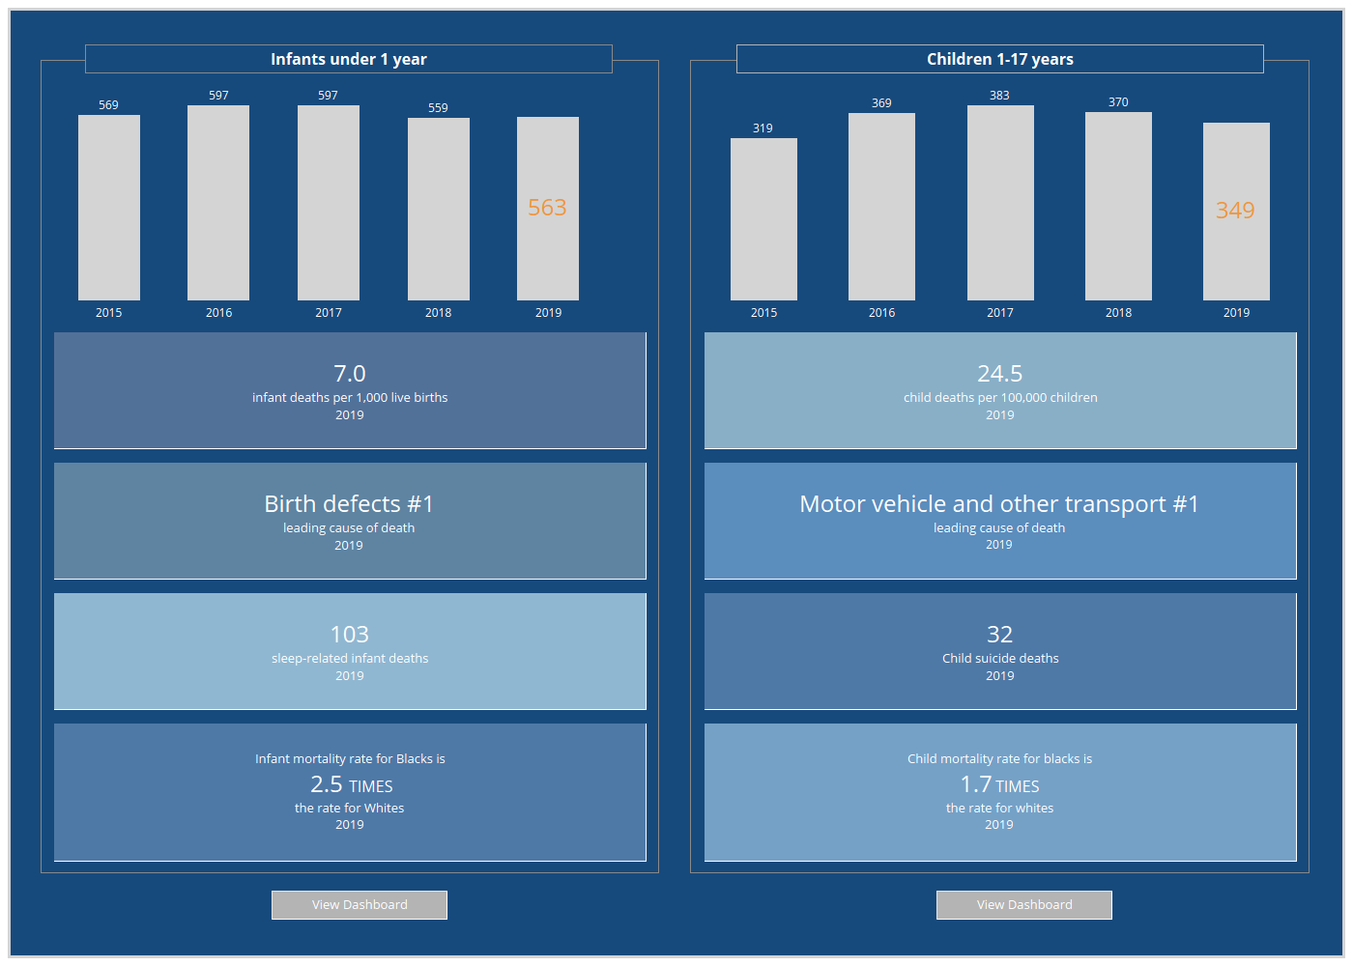

Slide 37
Prematurity Data

Slide 38
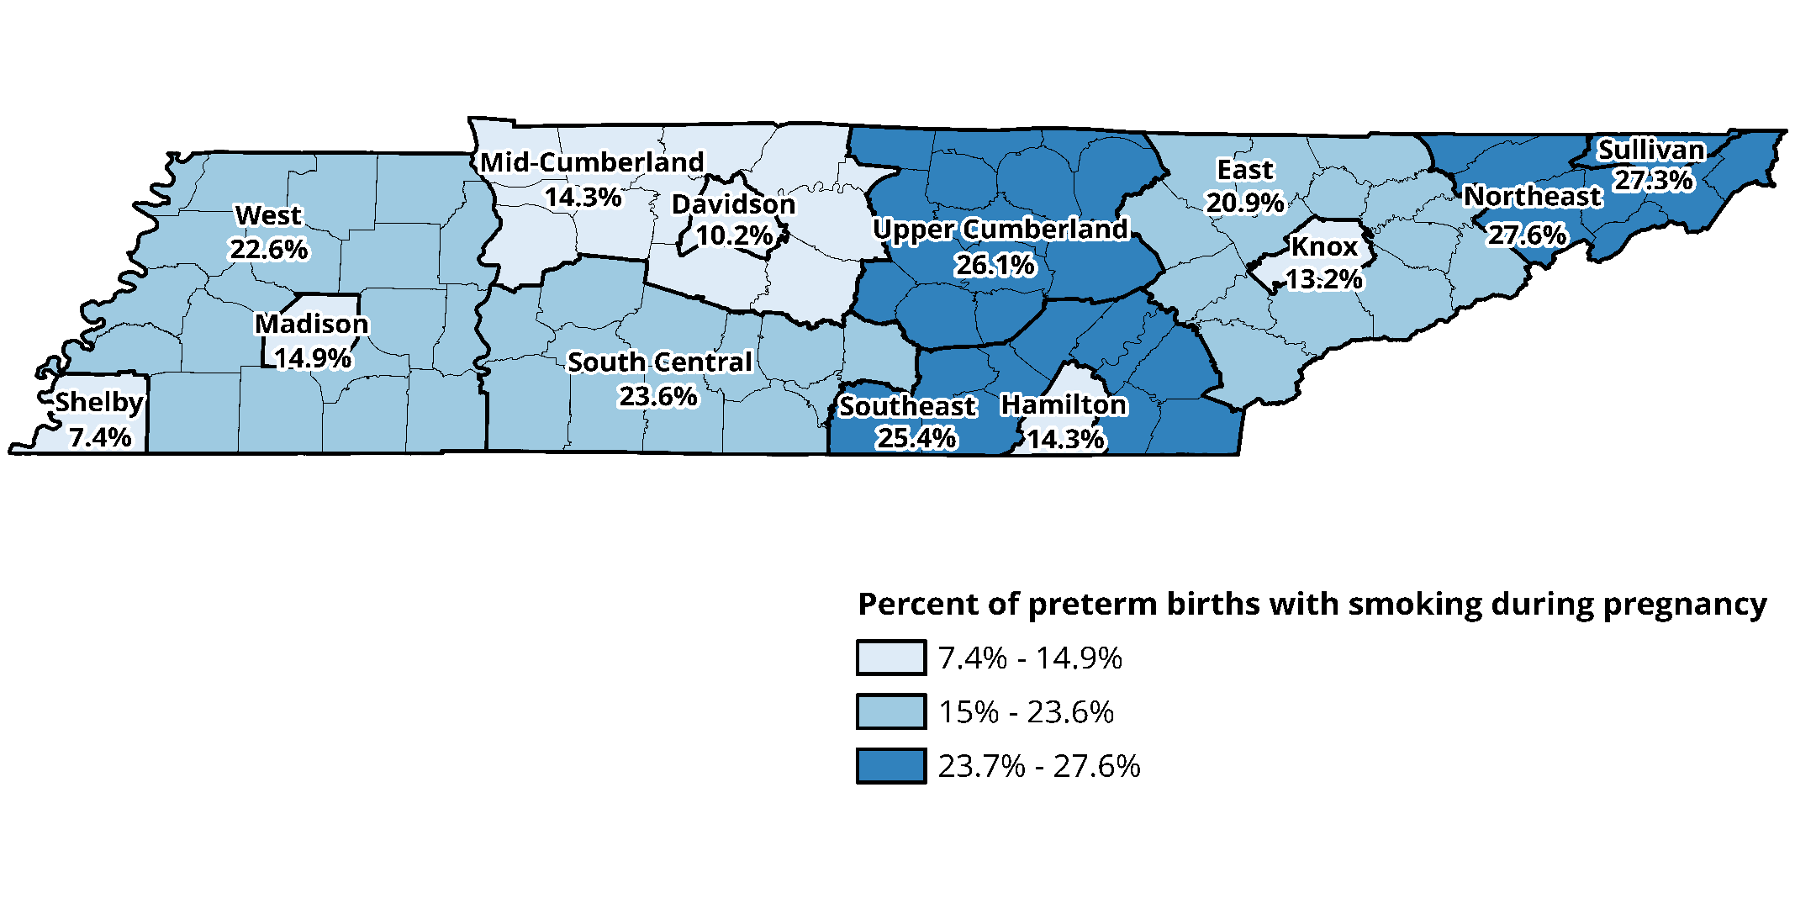
Percentage of preterm births with maternal smoking during pregnancy by region, 2015-2019

Slide 39
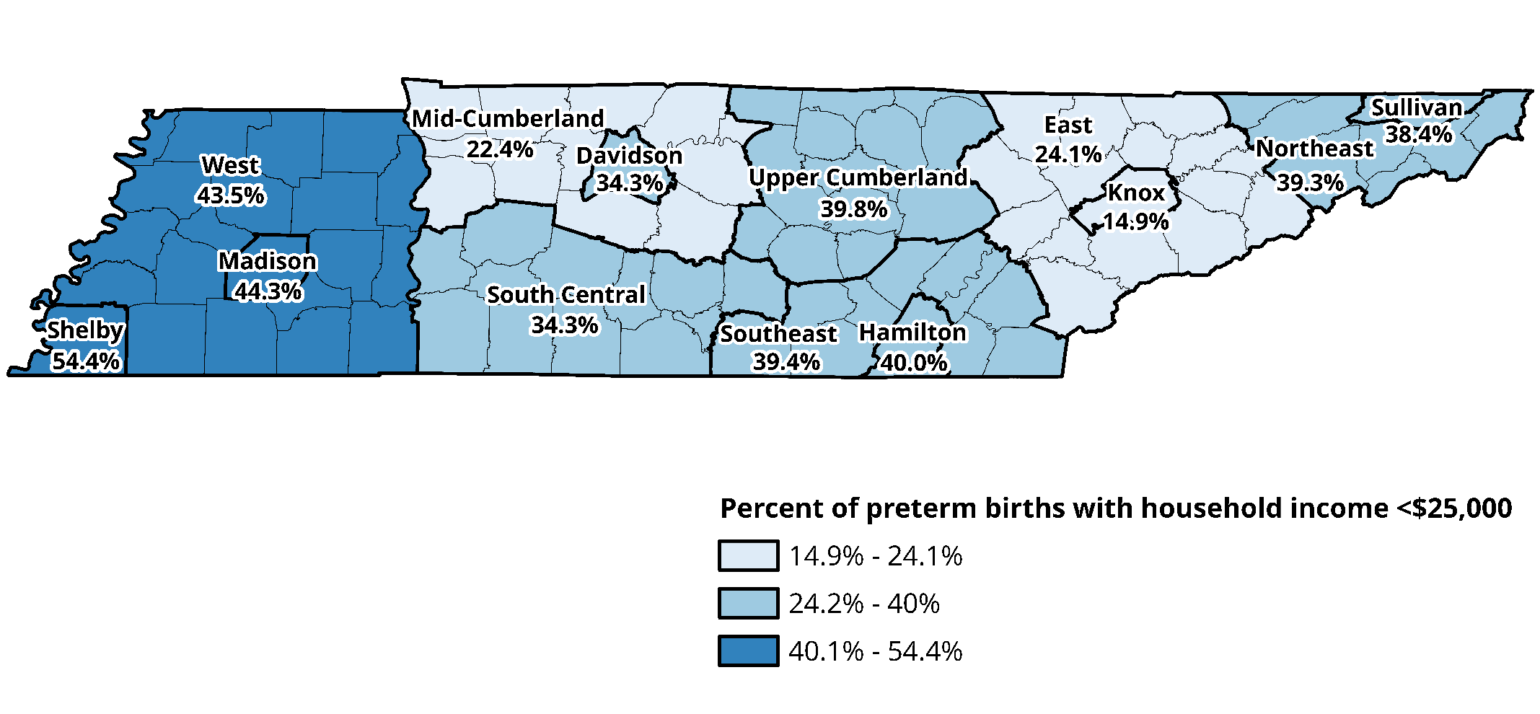
Percentage of preterm births with household income <$25,000 by region, 2015-2019

Slide 40
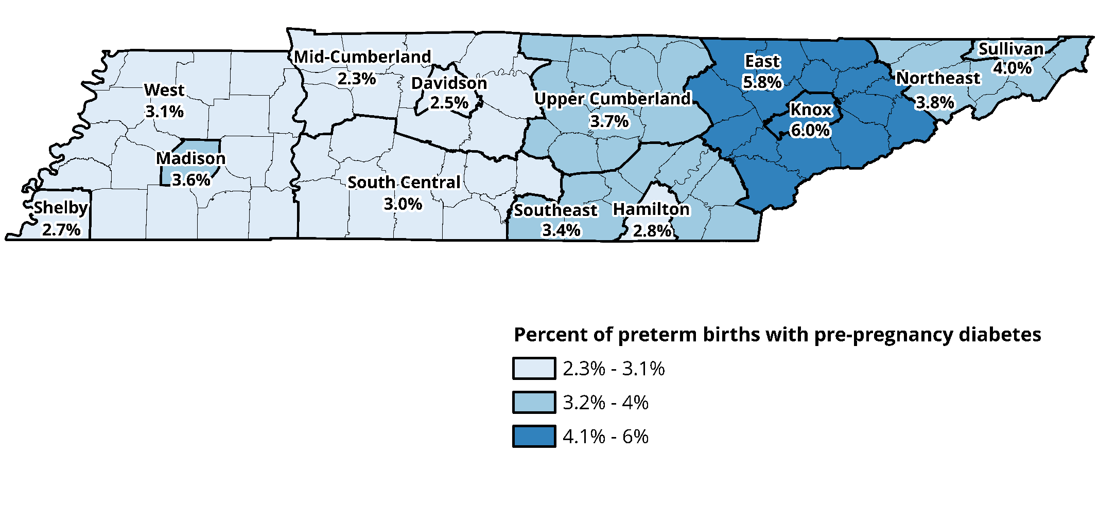
Percentage of preterm births with maternal pre-pregnancy diabetes by region, 2015-2019

Slide 41
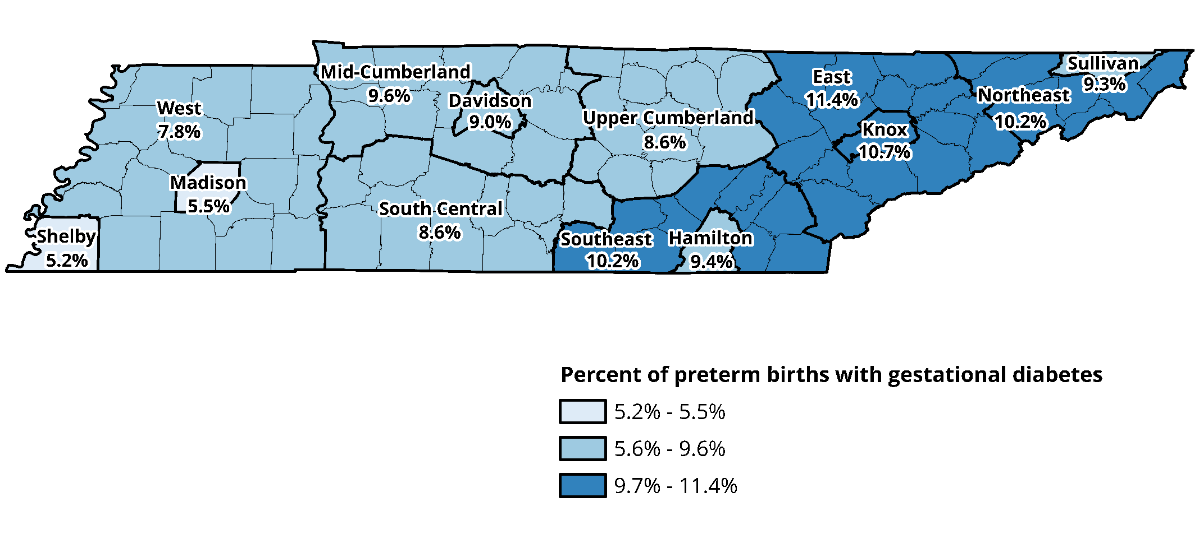
Percentage of preterm births with maternal gestational diabetes by region, 2015-2019

Slide 42
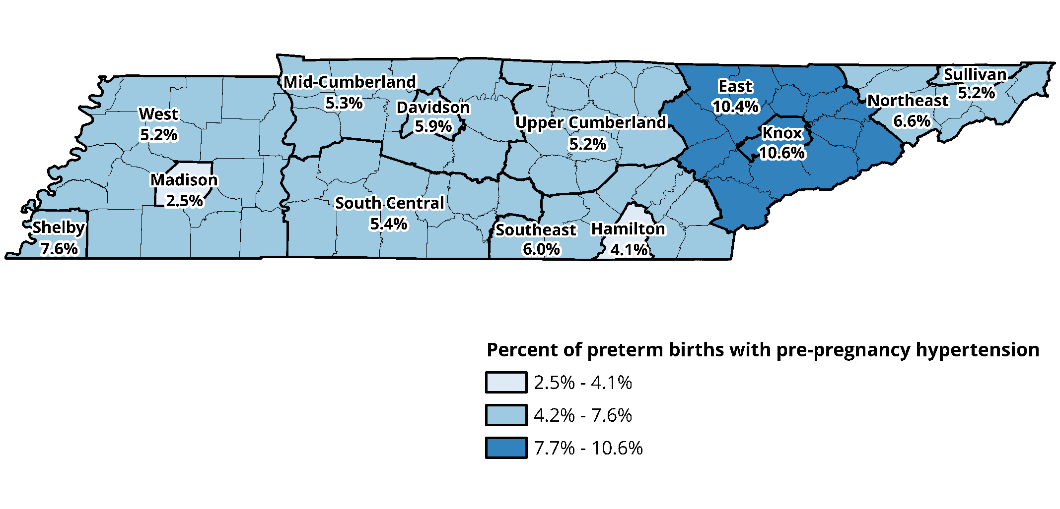
Percentage of preterm births with pre-pregnancy hypertension by region, 2015-2019

Slide 43
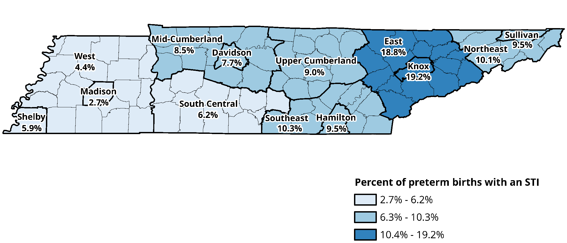
Percentage of preterm births with sexually transmitted infection by region, 2015-2019

Slide 44
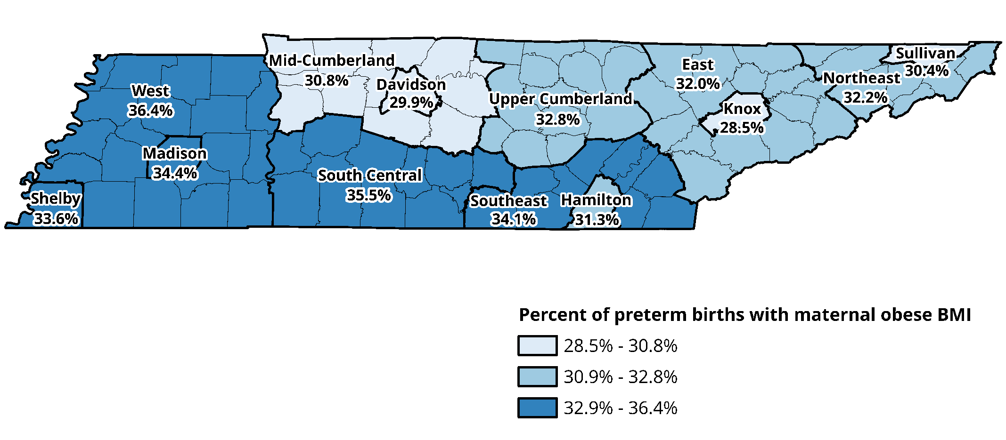
Percentage of preterm births with pre-pregnancy obese BMI by region, 2015-2019

Slide 45
Contact Information
Erin Hodson, MPH, Epidemiologist
Erin.Hodson@tn.gov
615-253-2802
Ibitola Asaolu, DrPH, MPH, Epidemiologist
ibitola.asaolu@tn.gov
615-253-0374

