Slide 2
Alphabet Soup!
Exploring the concepts of brands, companies, publically traded companies, and privately held companies.

Slide 3
Notes:
All – laundry detergent Brand owned by Unilever – not traded on a major U.S. market

Slide 4
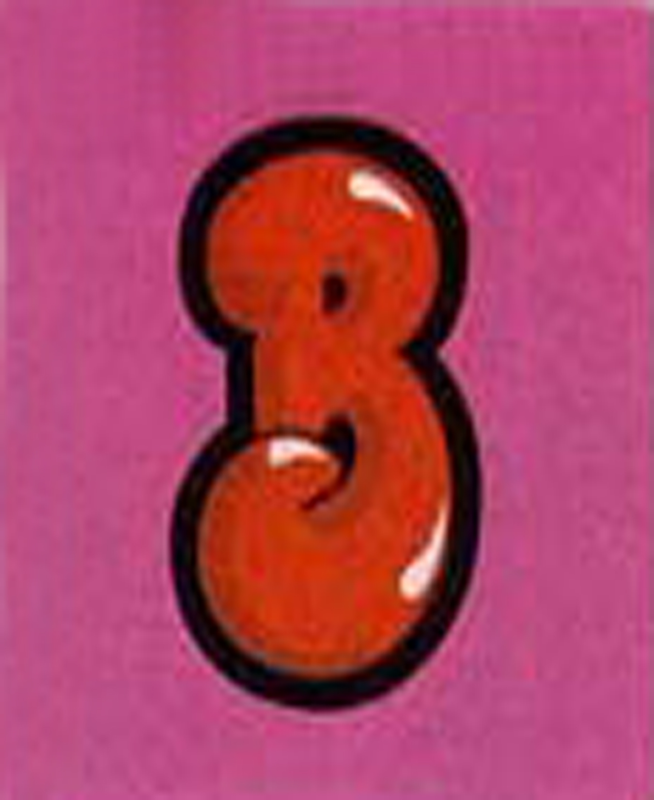
Notes:
Bubblicious – a brand owned by Cadbury - ticker symbol – CBY – traded on NYSE

Slide 5
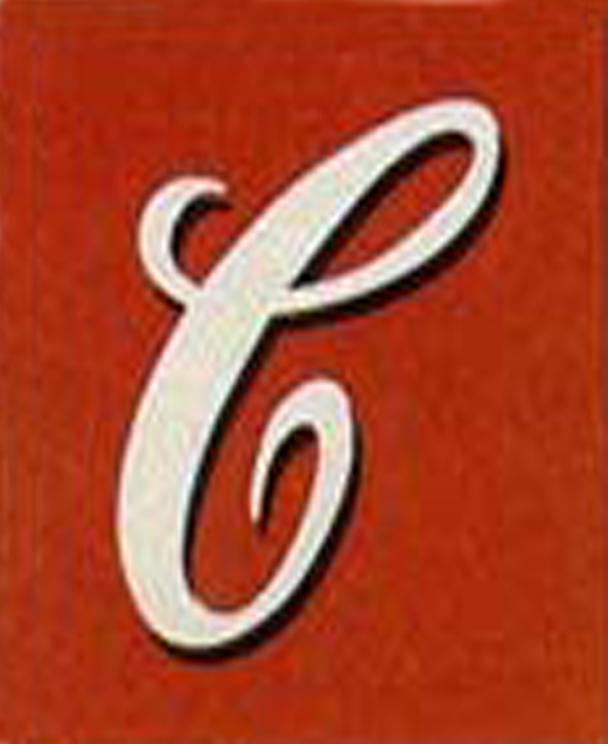
Notes:
Campbell Soup Company – Campbell’s brand – ticker symbol CPB – traded on NYSE

Slide 6
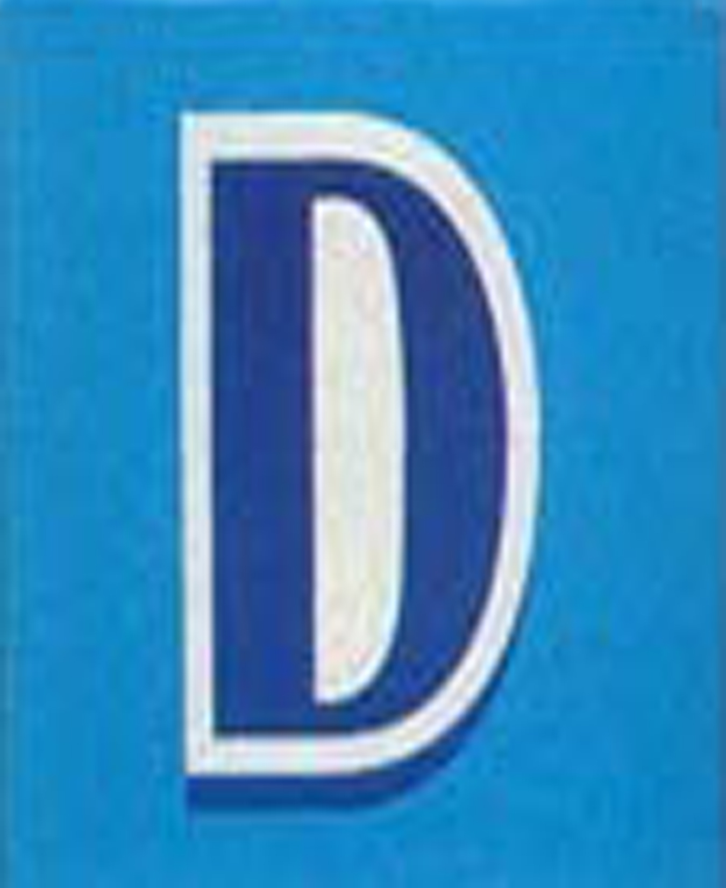
Notes:
Dawn – brand made by Proctor and Gamble – ticker symbol PG – traded on the NYSE

Slide 7
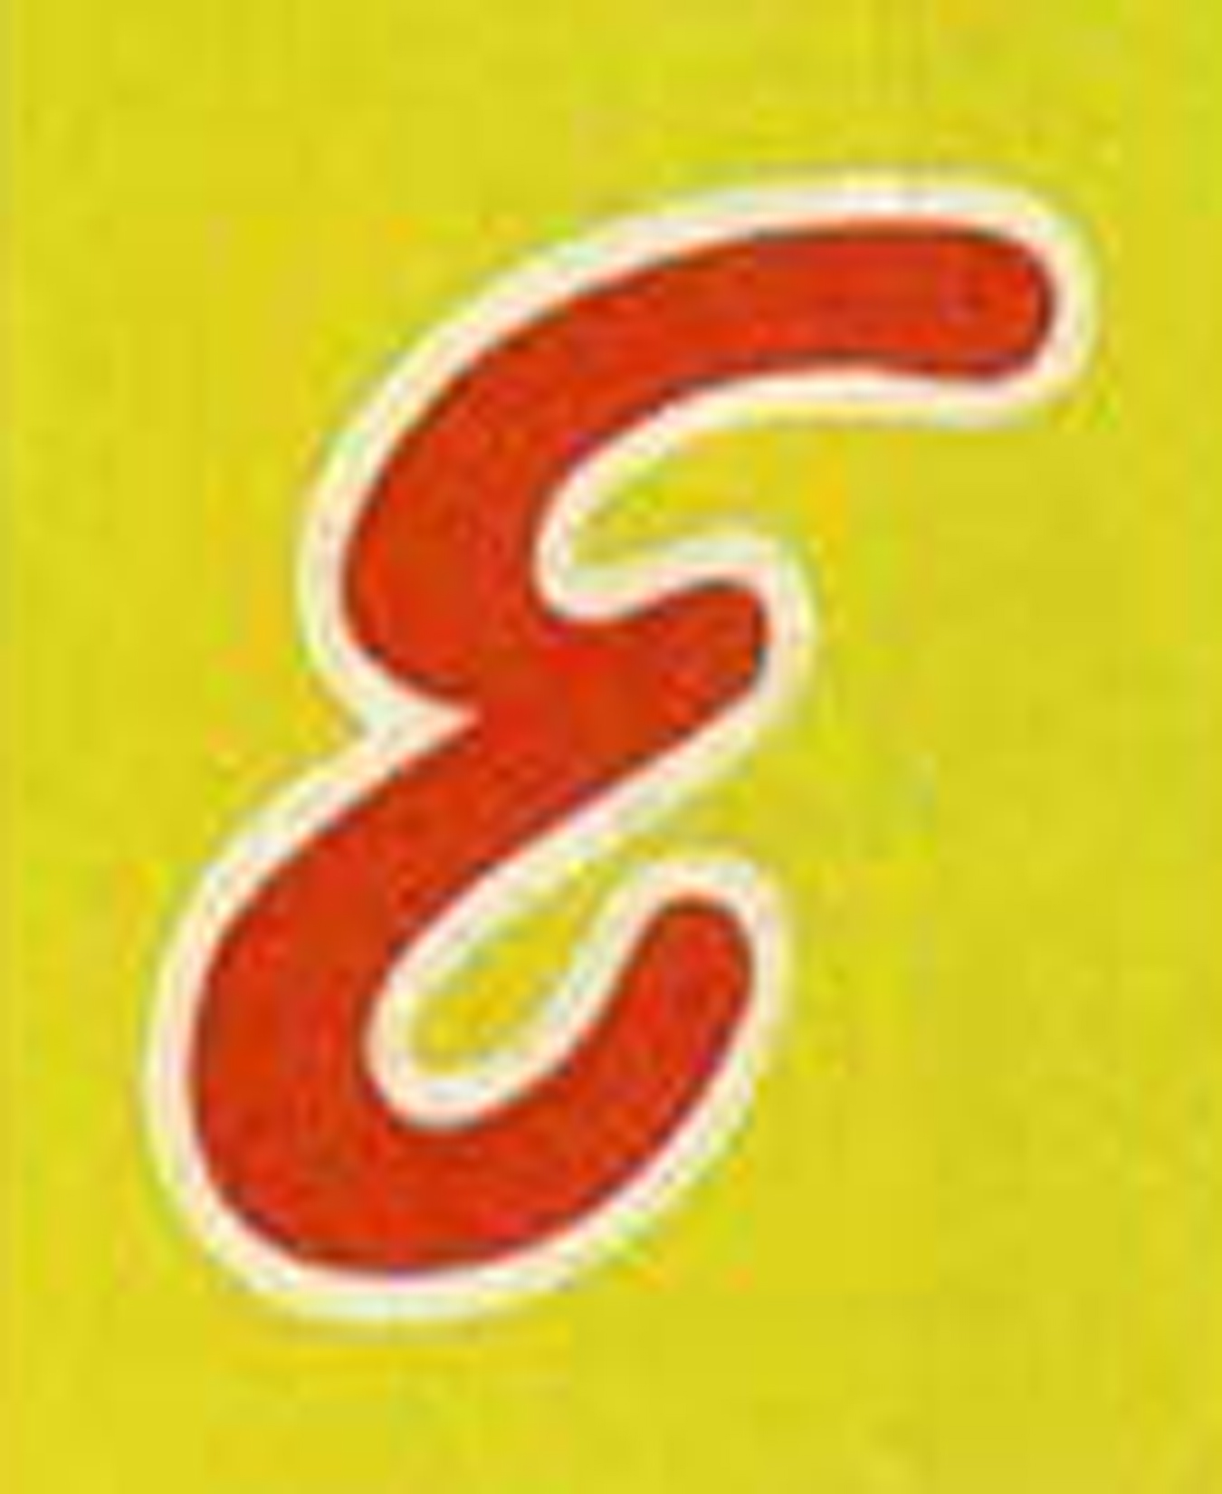
Notes:
Eggo - brand owned by Kellogg Company – ticker symbol is K – traded on NYSE

Slide 8
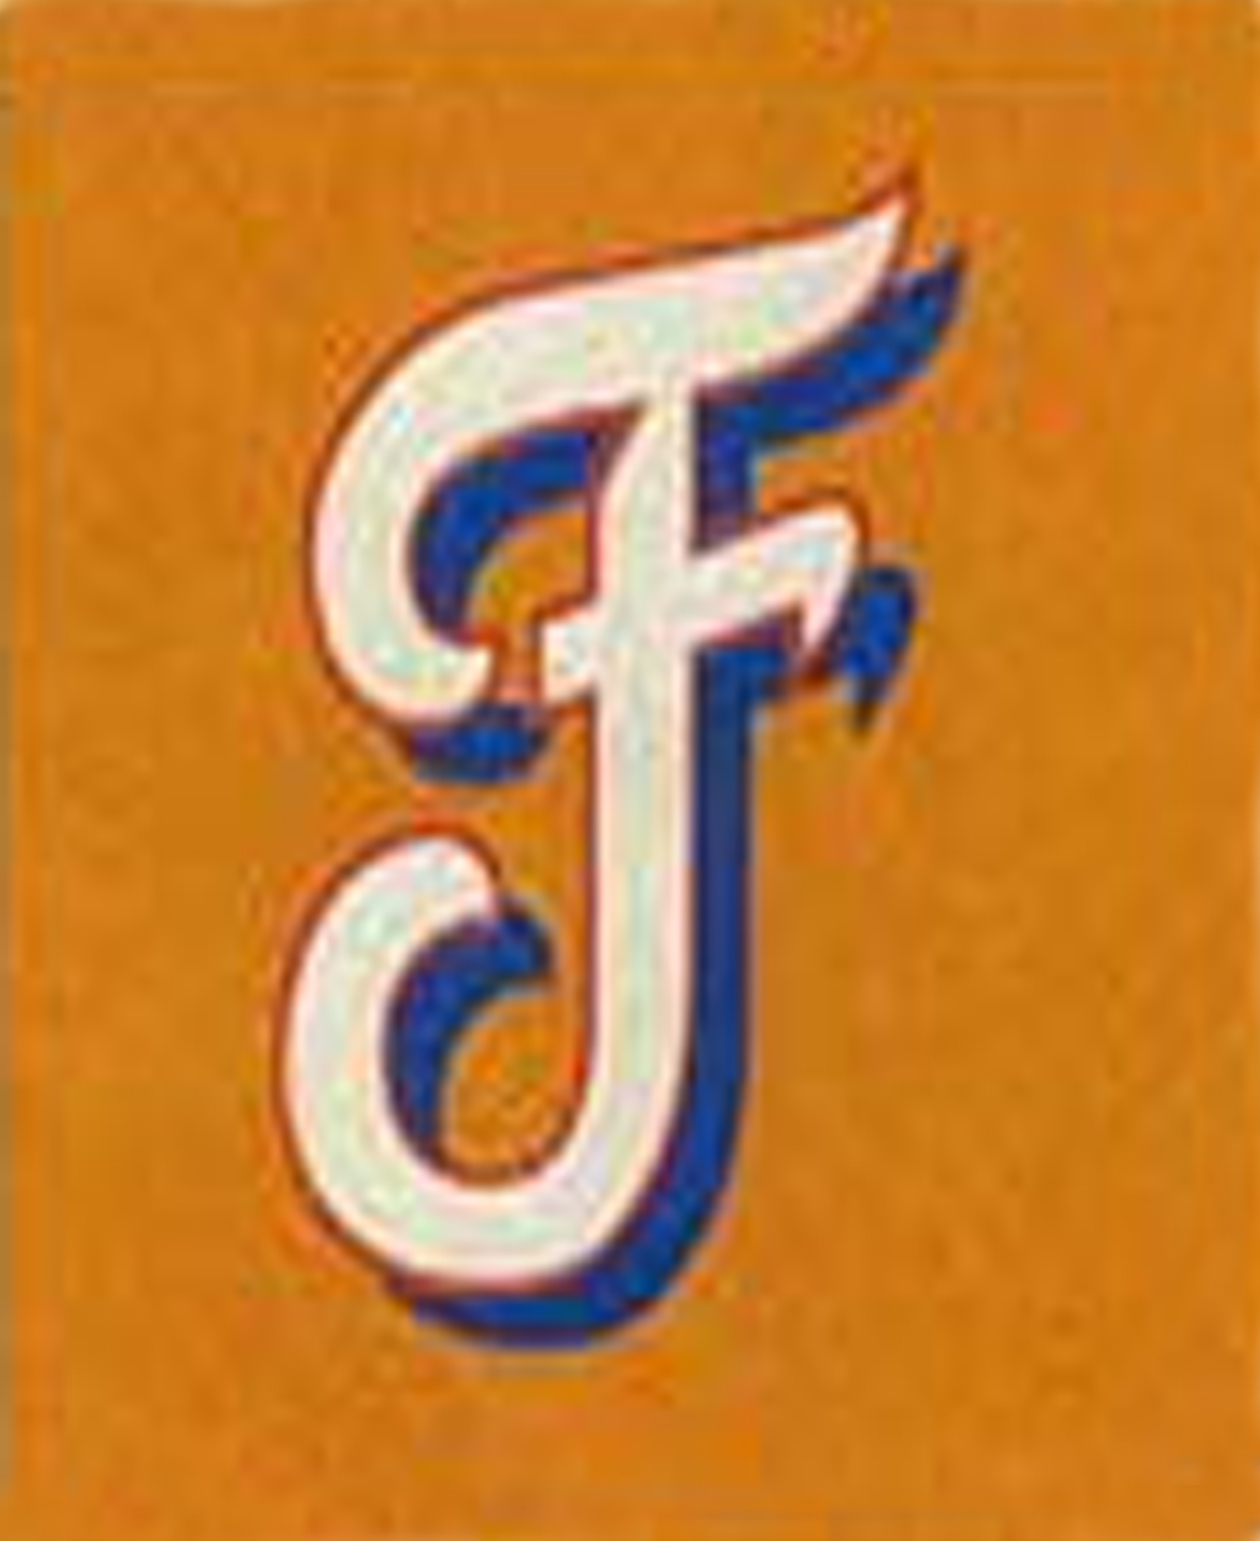
Notes:
Frito Lay – a brand owned by PepsiCo Inc.– ticker symbol – PEP – traded on the NYSE

Slide 9
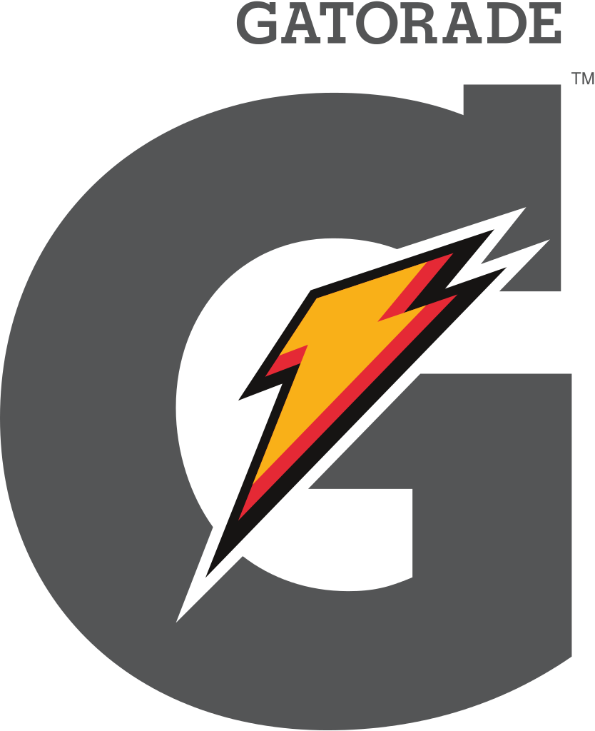
Notes:
Gatorade – a brand manufactured by the Quaker Oats company – now a division of PepsiCo Inc. – ticker symbol PEP – traded on NYSE

Slide 10
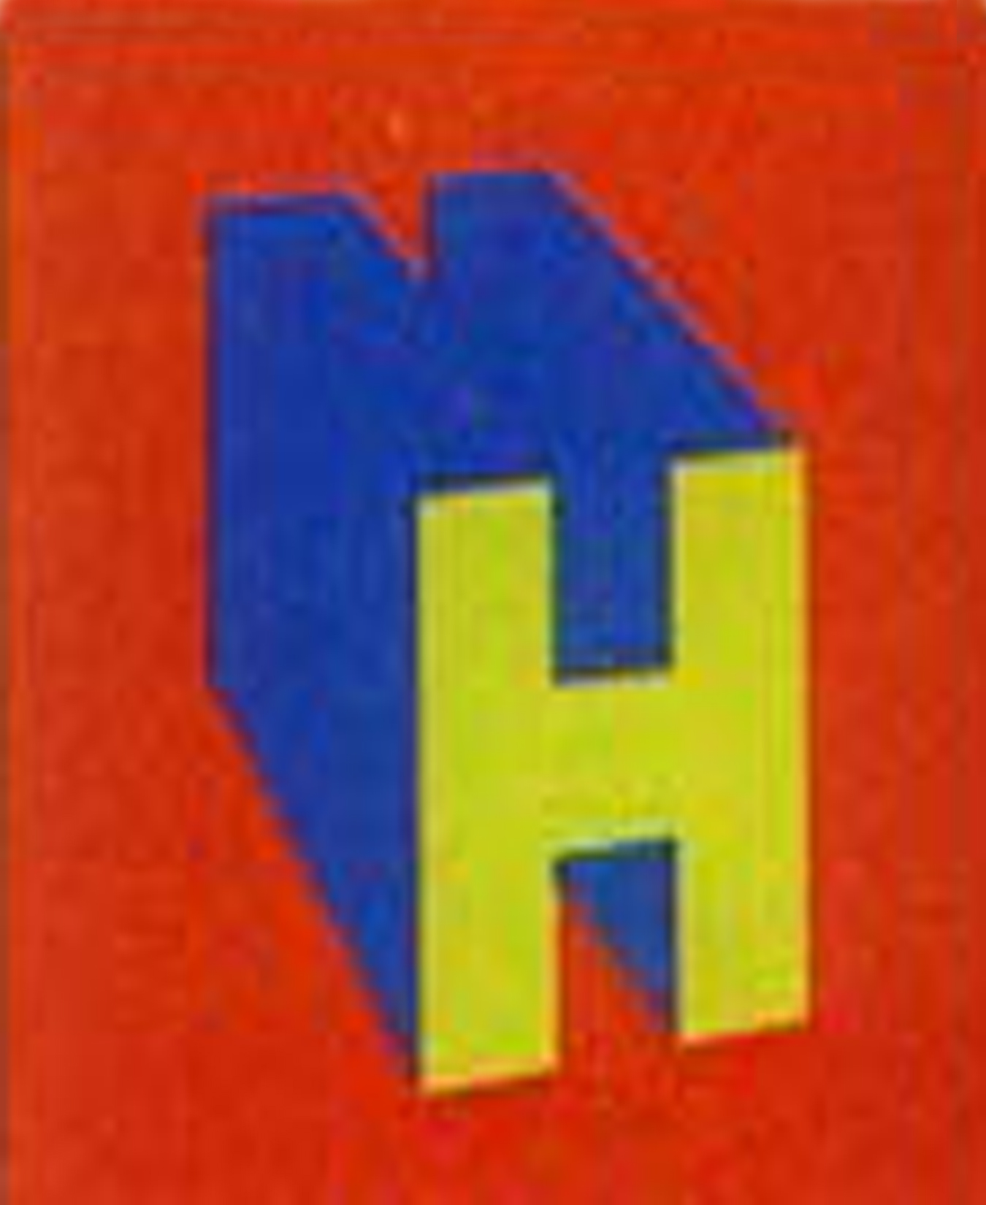
Notes:
Hebrew National – a brand distributed by ConAgra Foods, Inc. – ticker symbol – CAG – traded on NYSE

Slide 11
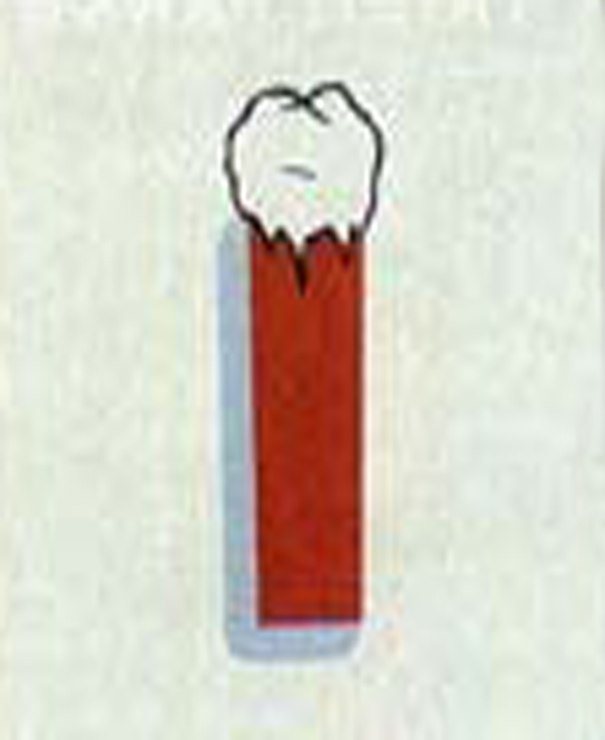
Notes:
Icee - subsidiary of J & J Snack Foods. traded on the over-the-counter market on the NASDAQ National Market System with the symbol JJSF – cannot be purchased during the SMG because it is not traded on the major NASDAQ market

Slide 12
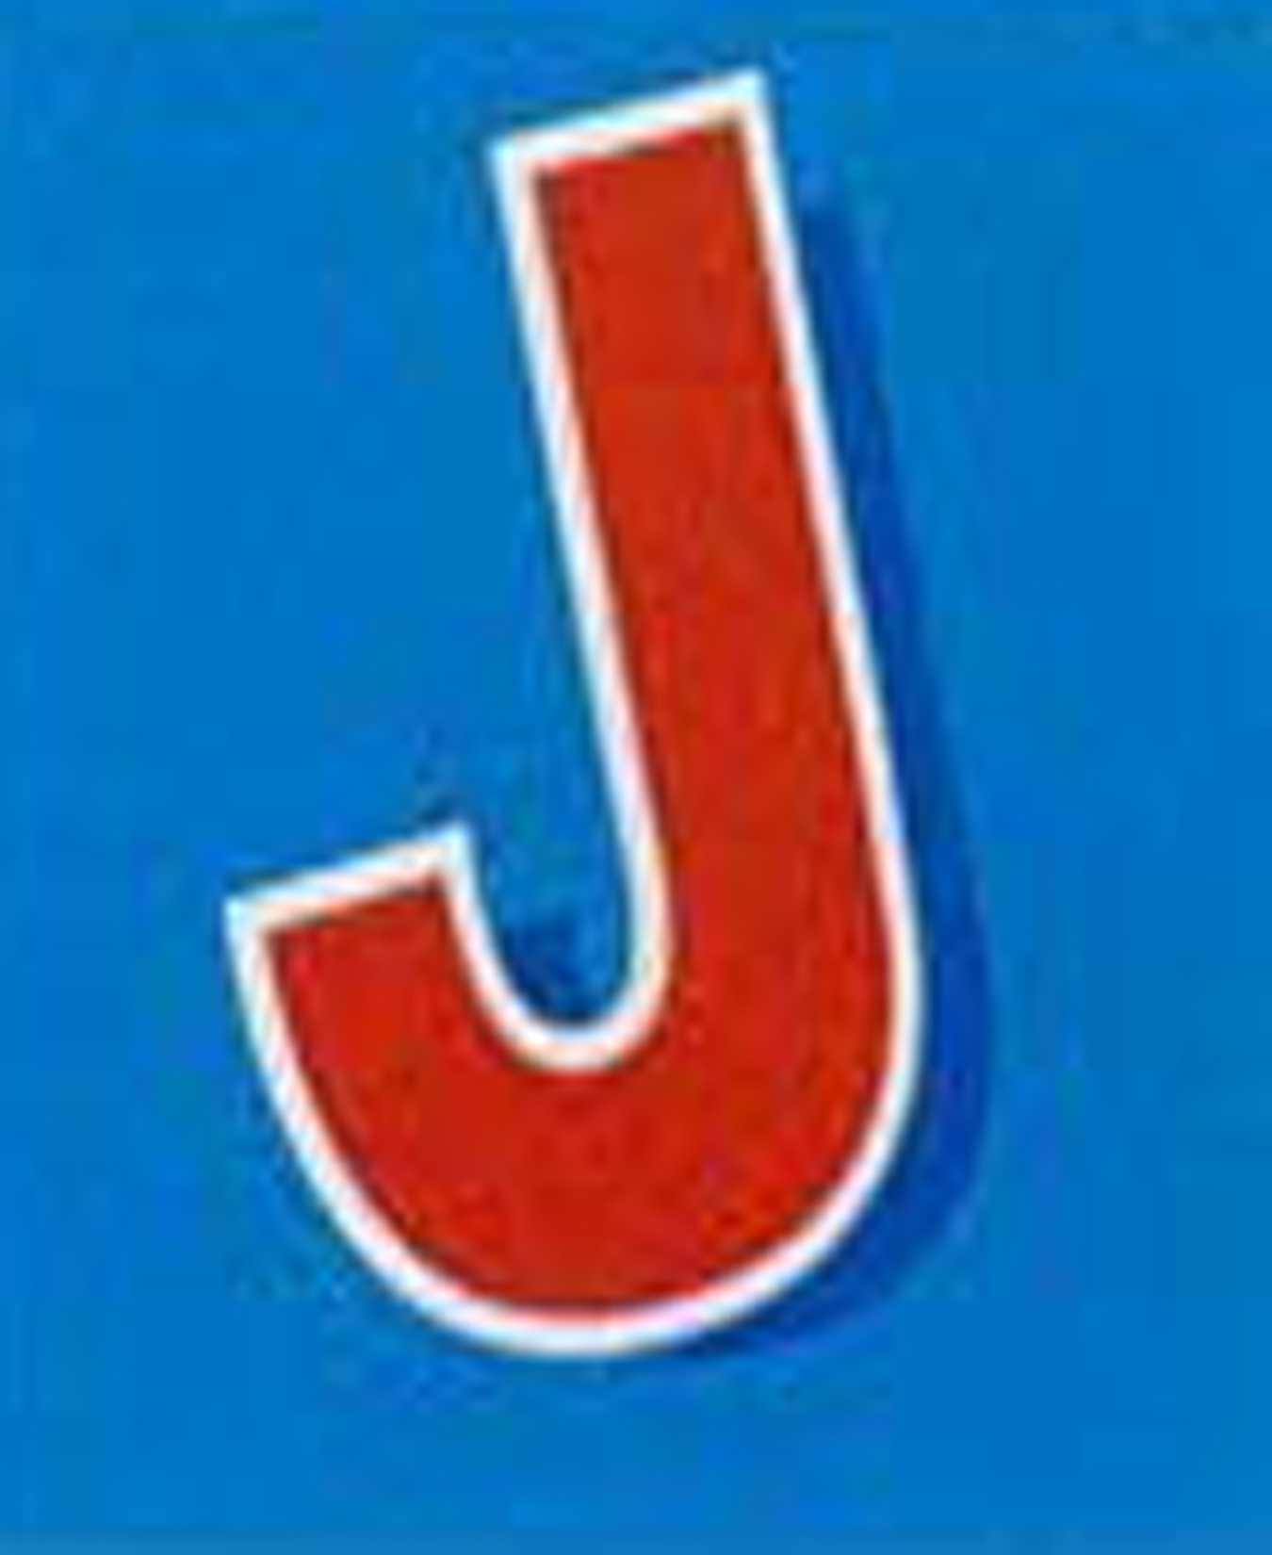
Notes:
Jello – a brand of Kraft Foods - ticker symbol KFT – traded on the NYSE

Slide 13
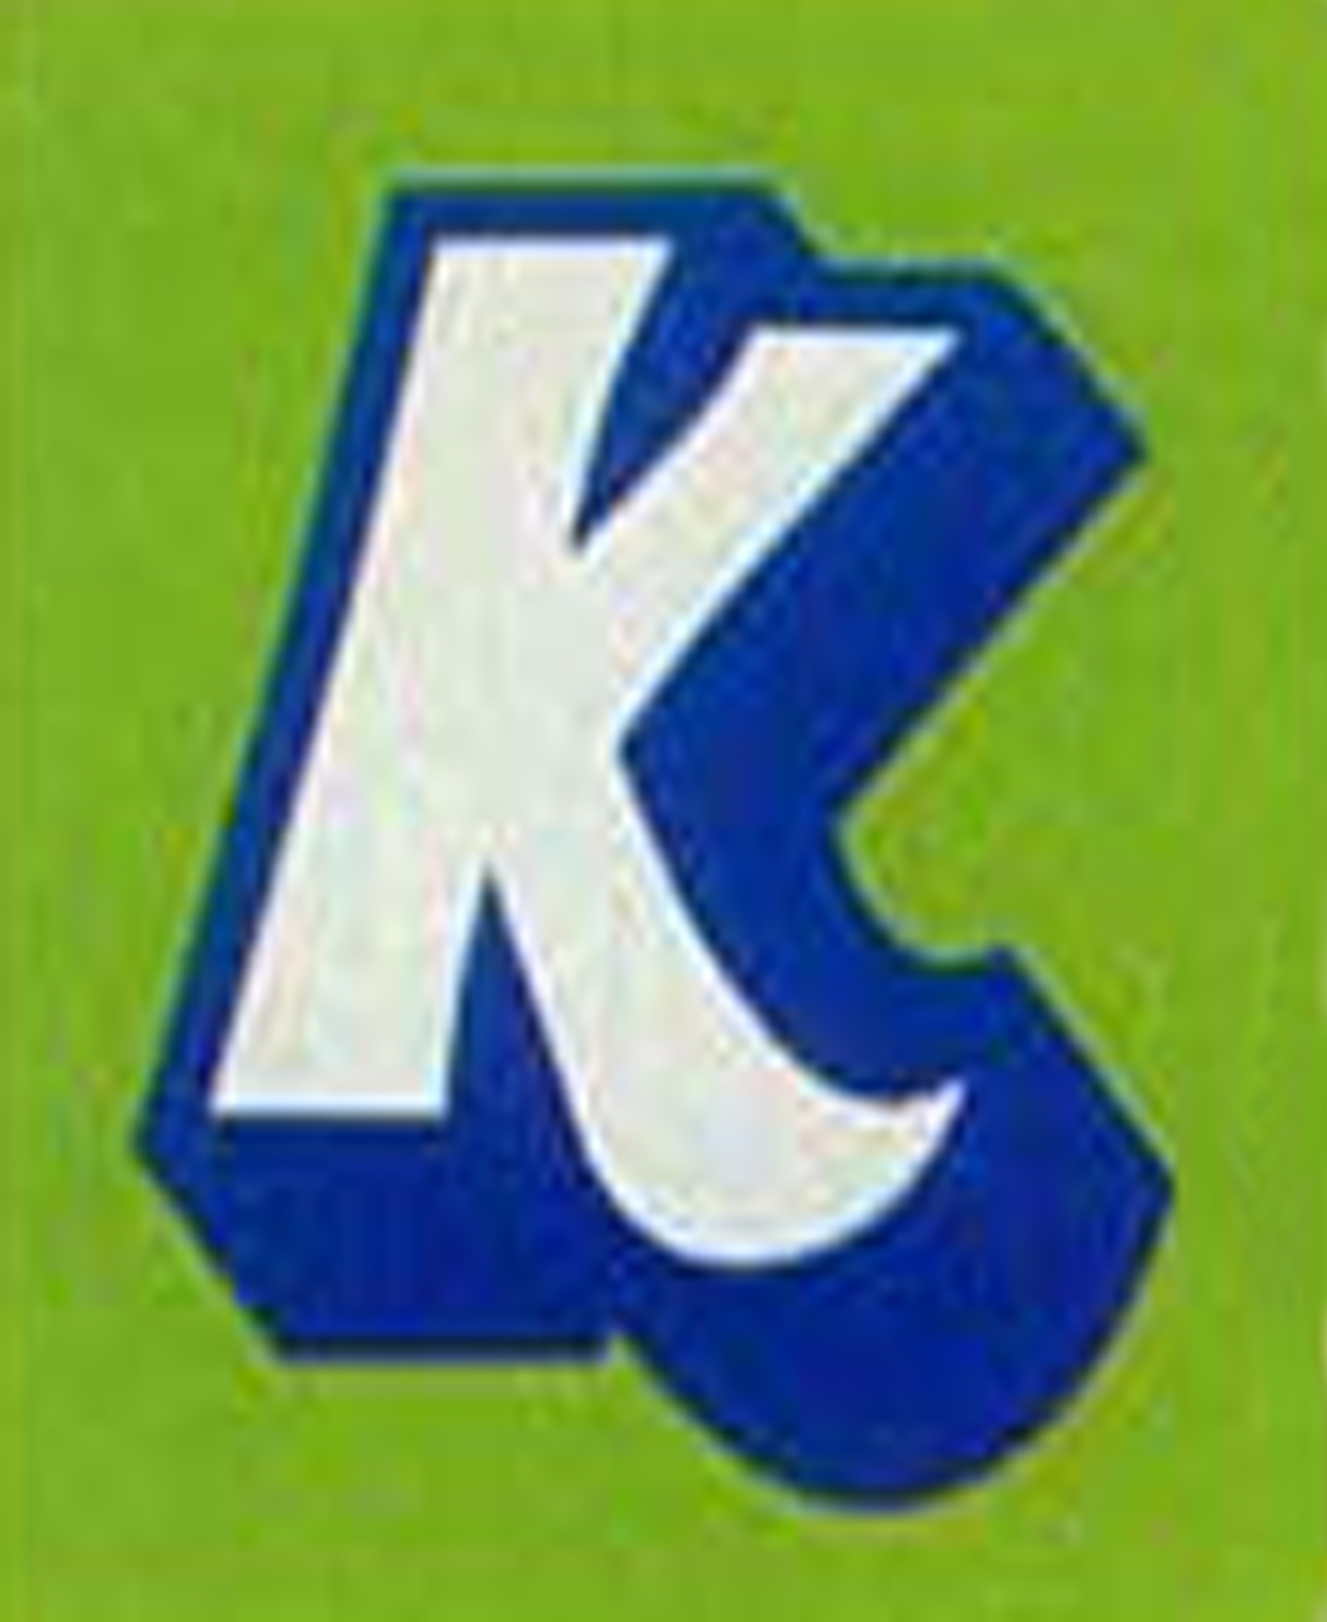
Notes:
Kool-aid – a brand of Kraft Foods – ticker symbol KFT – traded on the NYSE

Slide 14
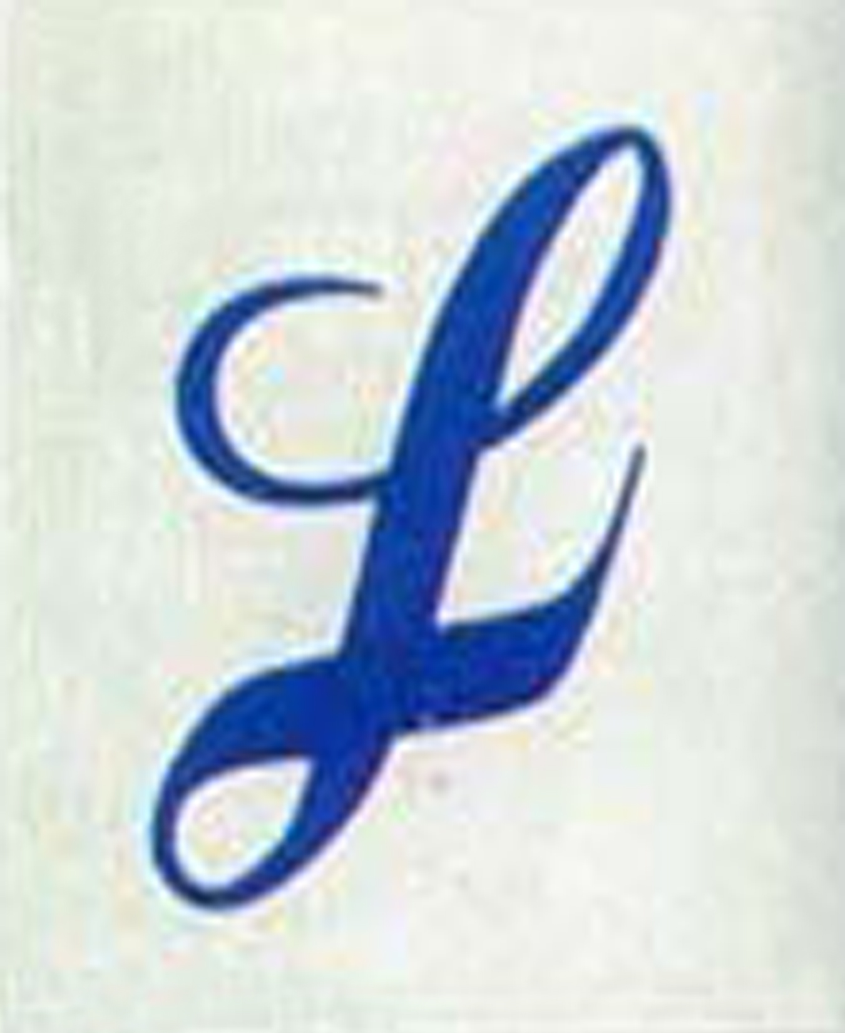
Notes:
Lysol – a brand owned by Reckitt Benckiser – a pink slip company traded on the European markets -

Slide 15
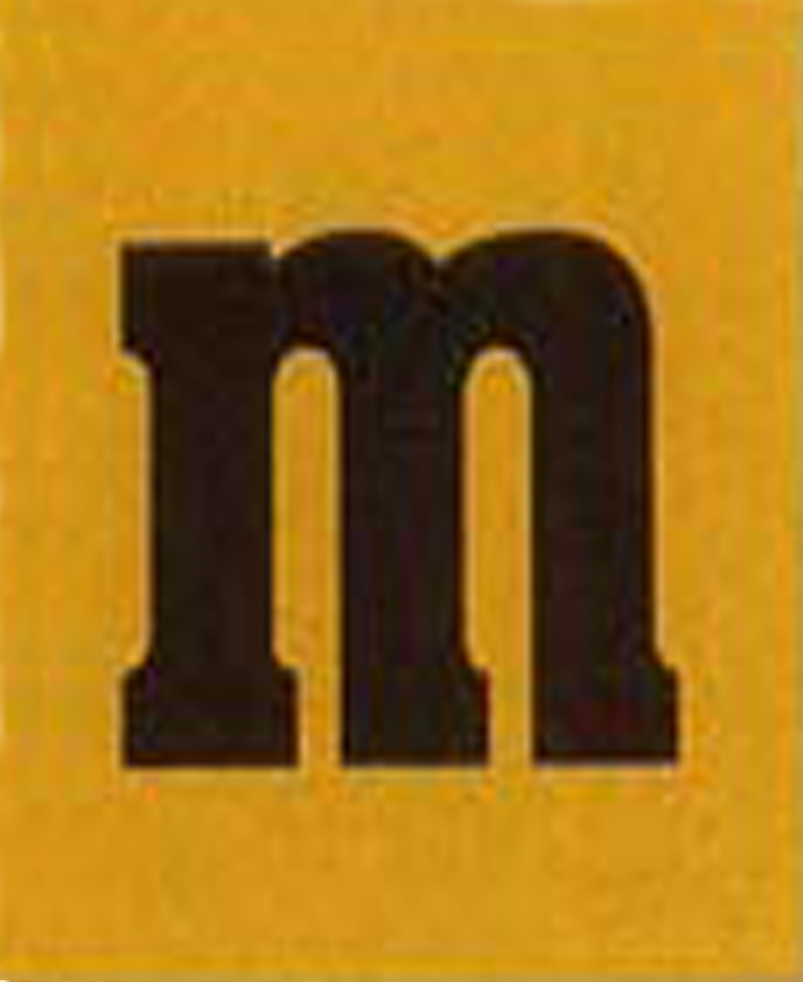
Notes:
M&Ms – a brand owned by Mars, Inc. – a private company

Slide 16
Notes:
Nilla – a brand owned by Nabisco – now a subsidiary of Kraft Foods – ticker symbol KFT – traded on the NYSE

Slide 17
Notes:
Oreo – a brand owned by the Nabisco Division of Kraft Foods – ticker symbol KFT – traded on NYSE

Slide 18
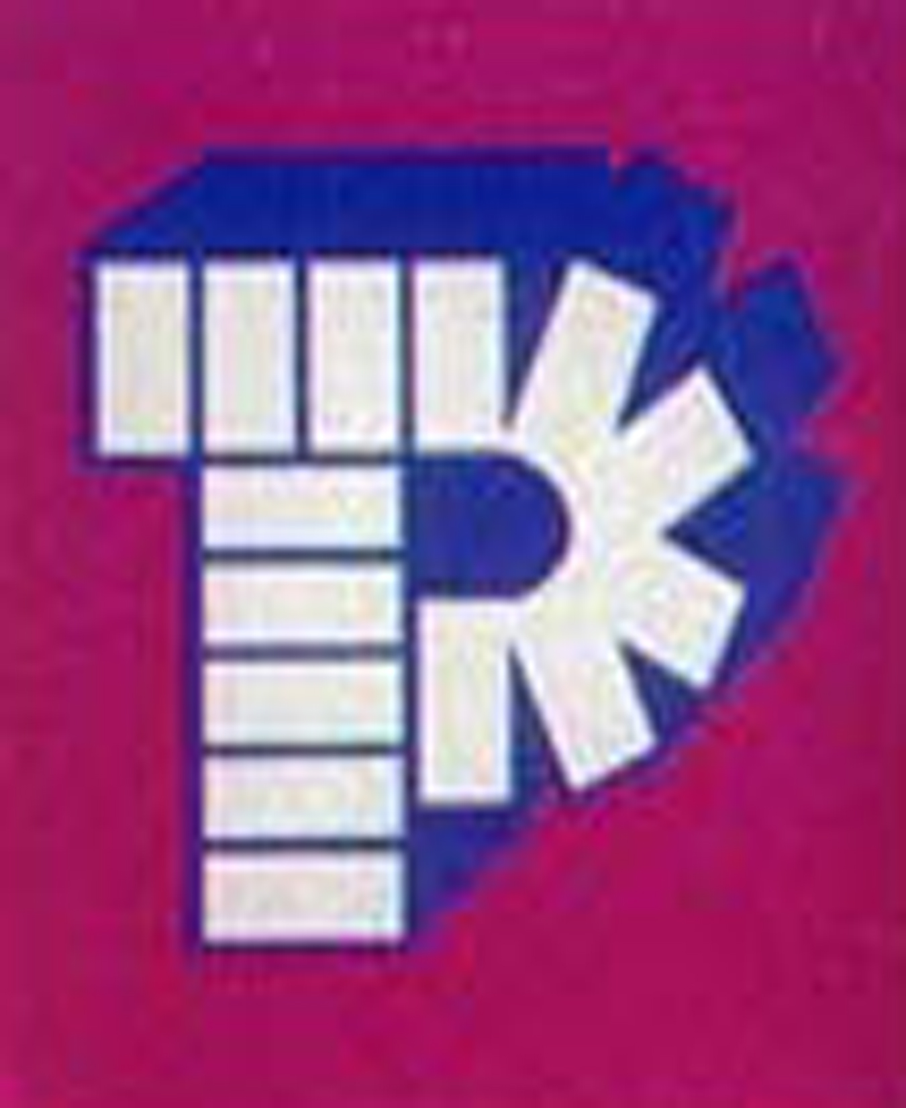
Notes:
PEZ – a private company

Slide 19
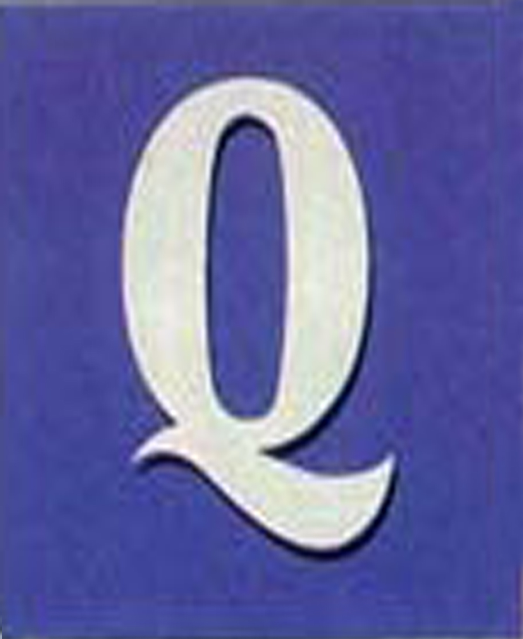
Notes:
Q-tip – a brand owned by Unilever - not traded on a major U.S. market

Slide 20
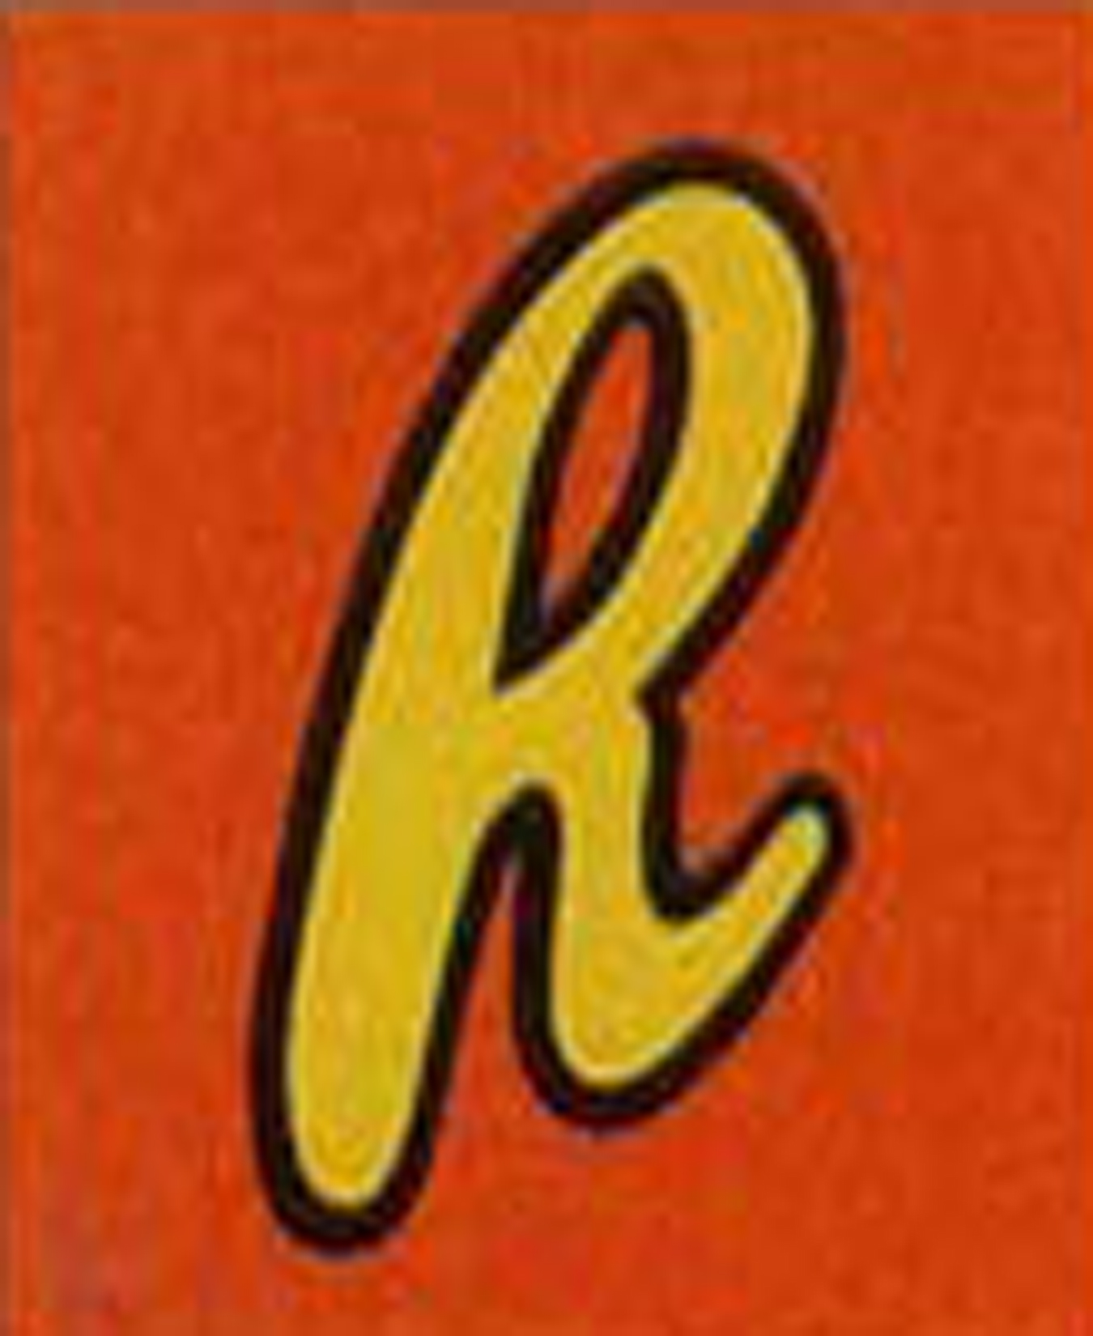
Notes:
Reeces – brand owned by Hershey Company – ticker symbol HSY – traded on NYSE

Slide 21
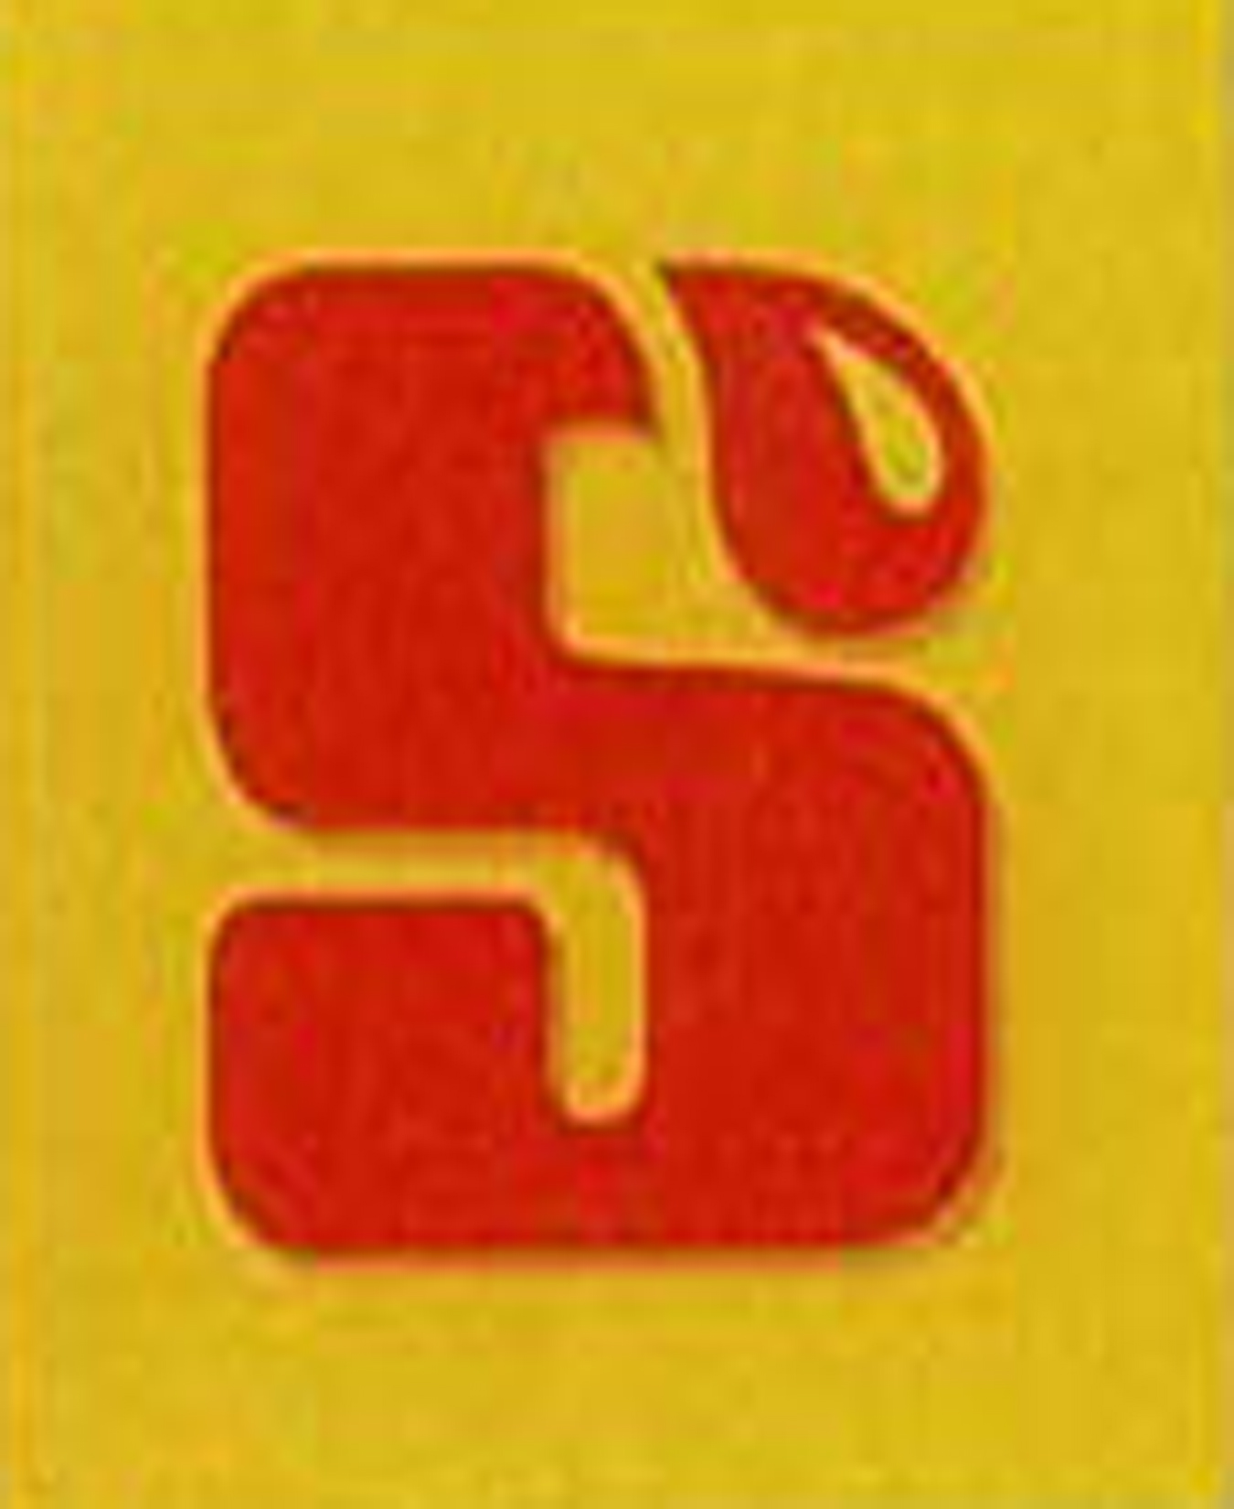
Notes:
Starburst – brand owned by Mars – a private company

Slide 22
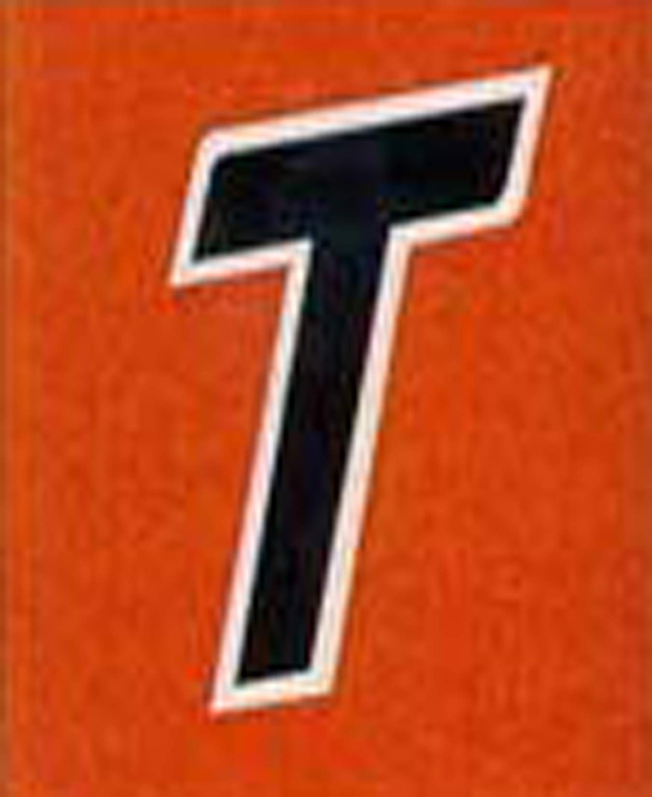
Notes:
Tide – brand owned by Proctor & Gamble – ticker symbol PG – traded on NYSE

Slide 23
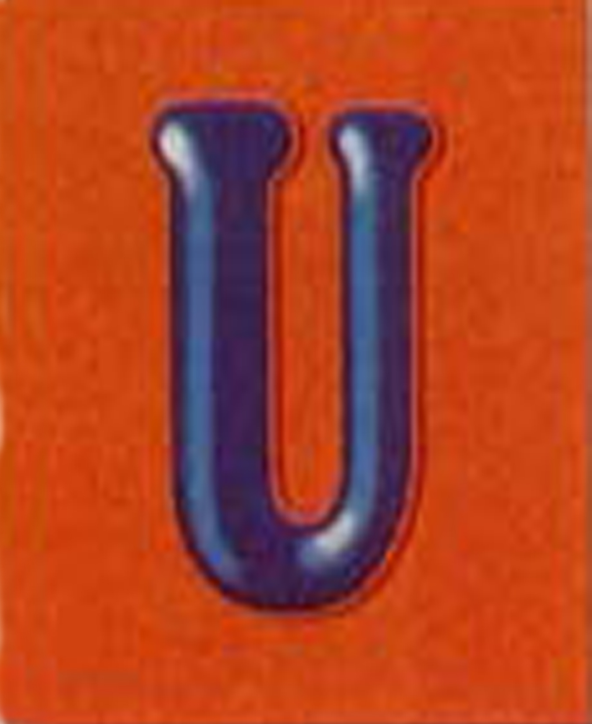
Notes:
Uncle Ben’s – a brand owned by Mars – a private company

Slide 24
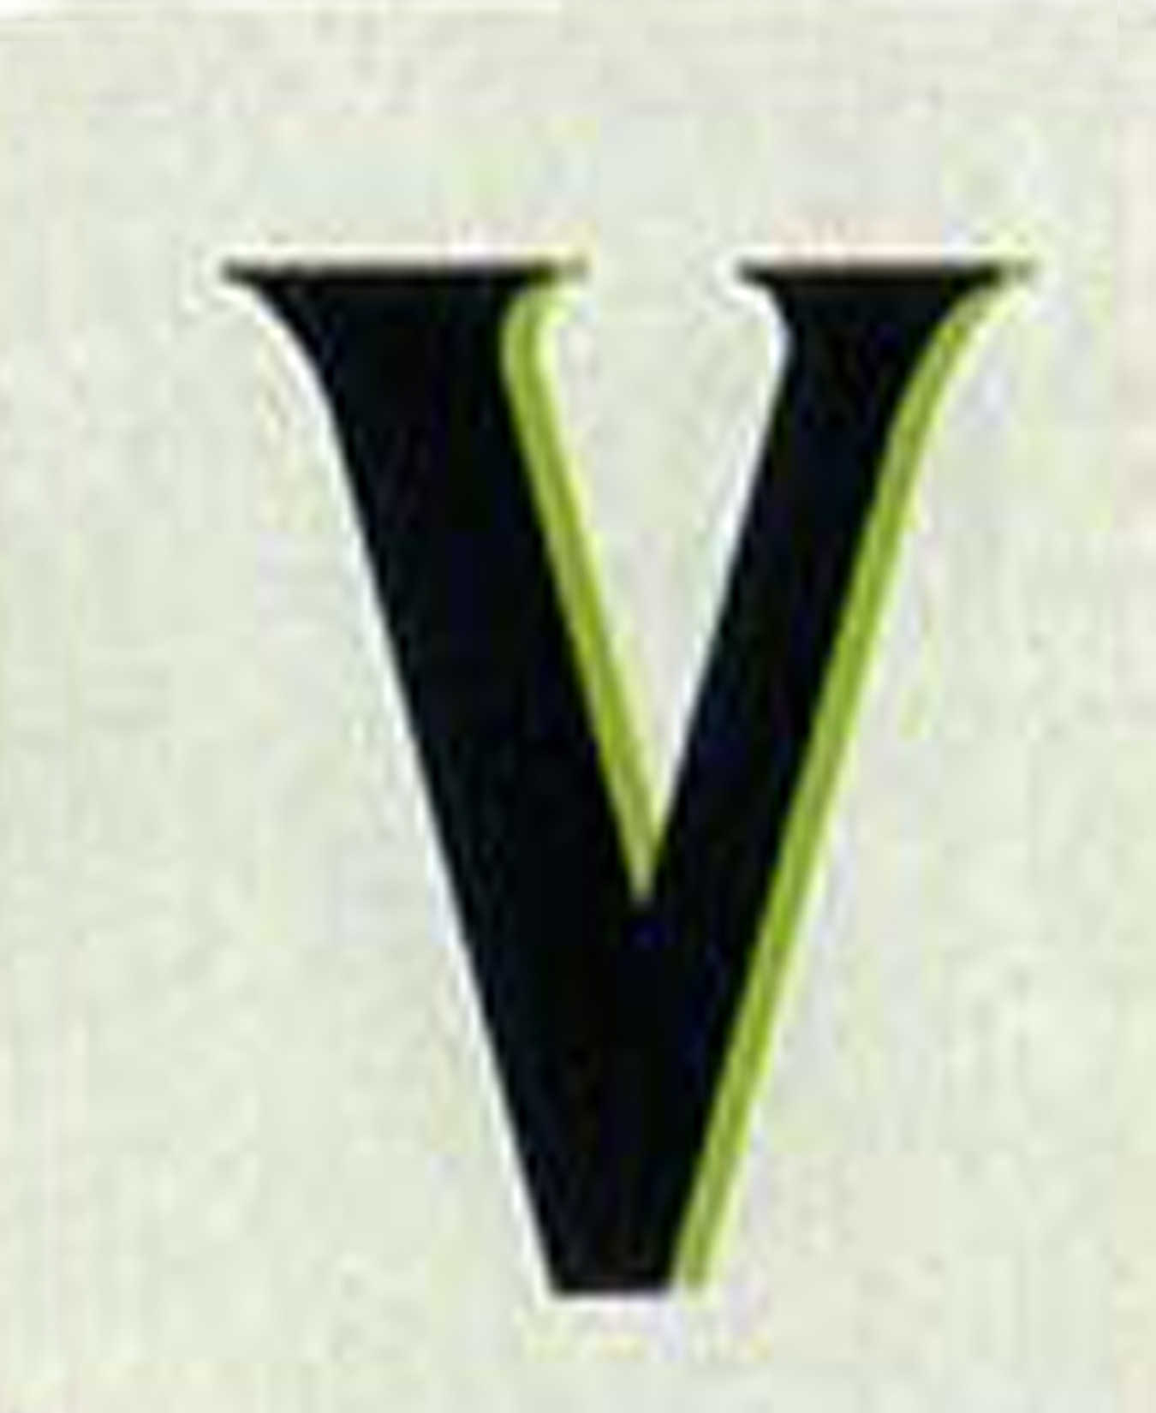
Notes:
V-8 – a brand owned by Campbell’s Soup Company – ticker symbol – CPB – traded on NYSE

Slide 25
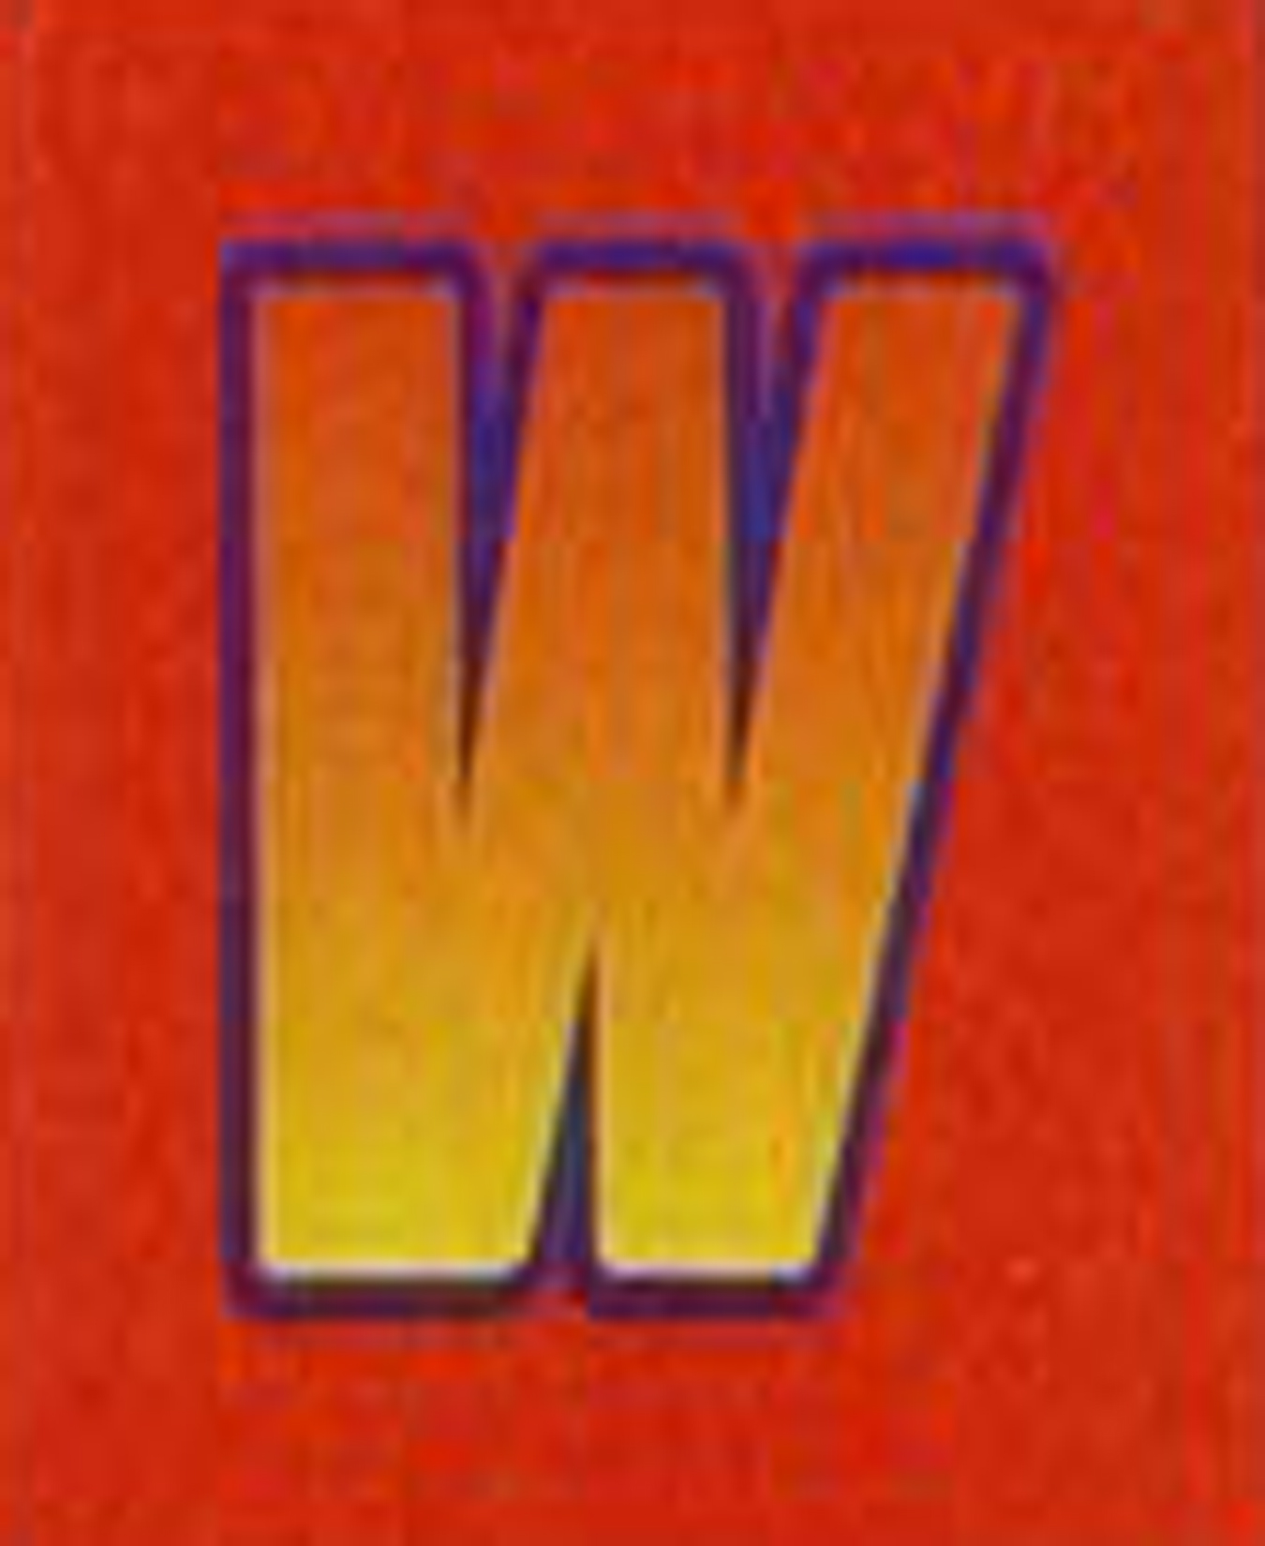
Notes:
Wisk – a brand distributed by Unilever – not traded on a major U.S. market

Slide 26
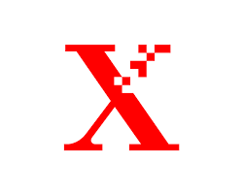
Notes:
X-tra – a brand of Trident Gum – a subsidiary of Cadbury PLC – ticker symbol CBY – traded on the NYSE –
CAUTION – if students search “Xtra” or “X-tra” rather than “Trident X-tra” some objectionable websites have the potential of being found

Slide 27
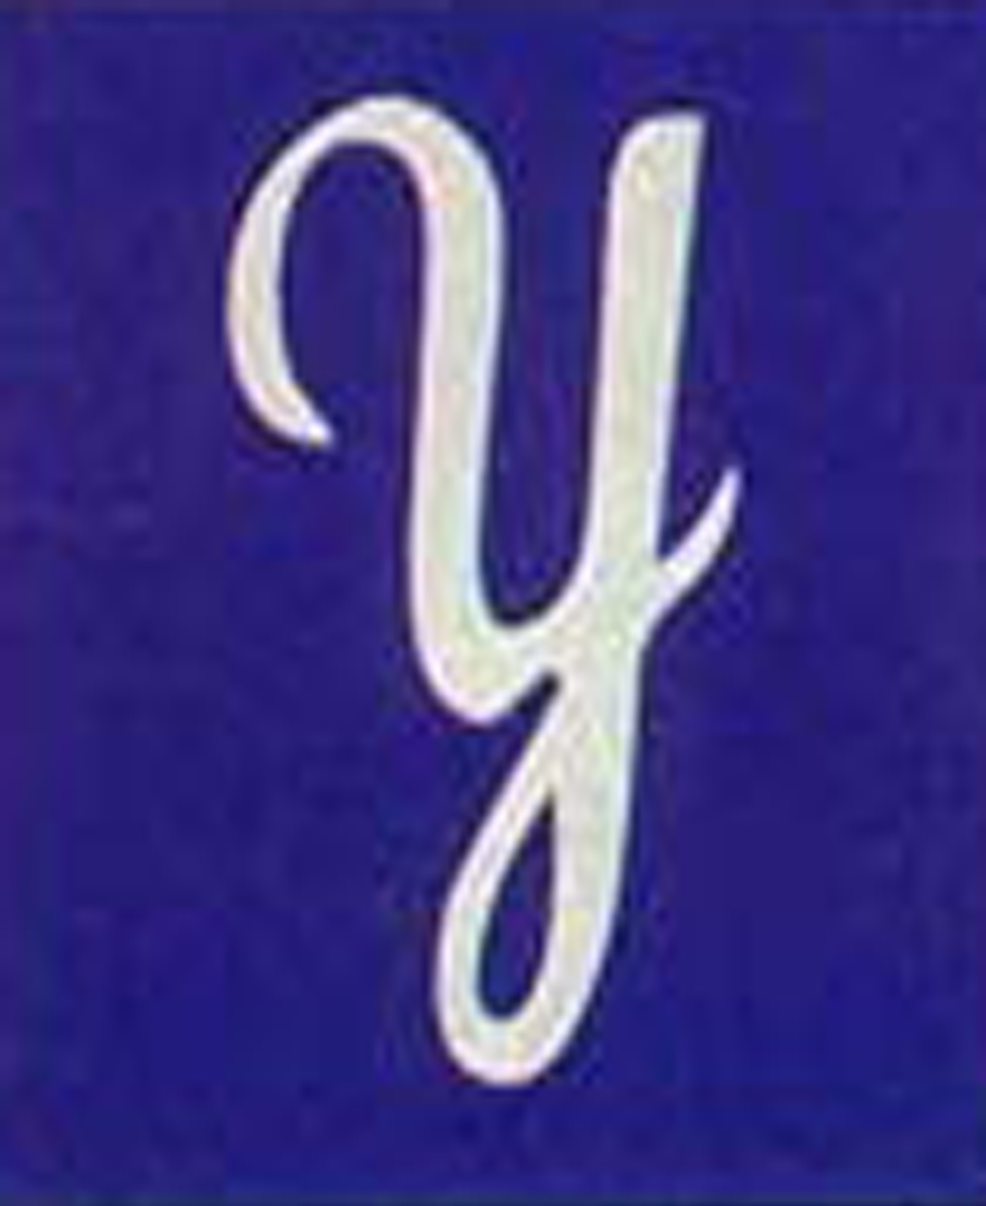
Notes:
York (peppermint patties) – a brand of Hershey’s – ticker symbol – HSY – traded on NYSE

Slide 28
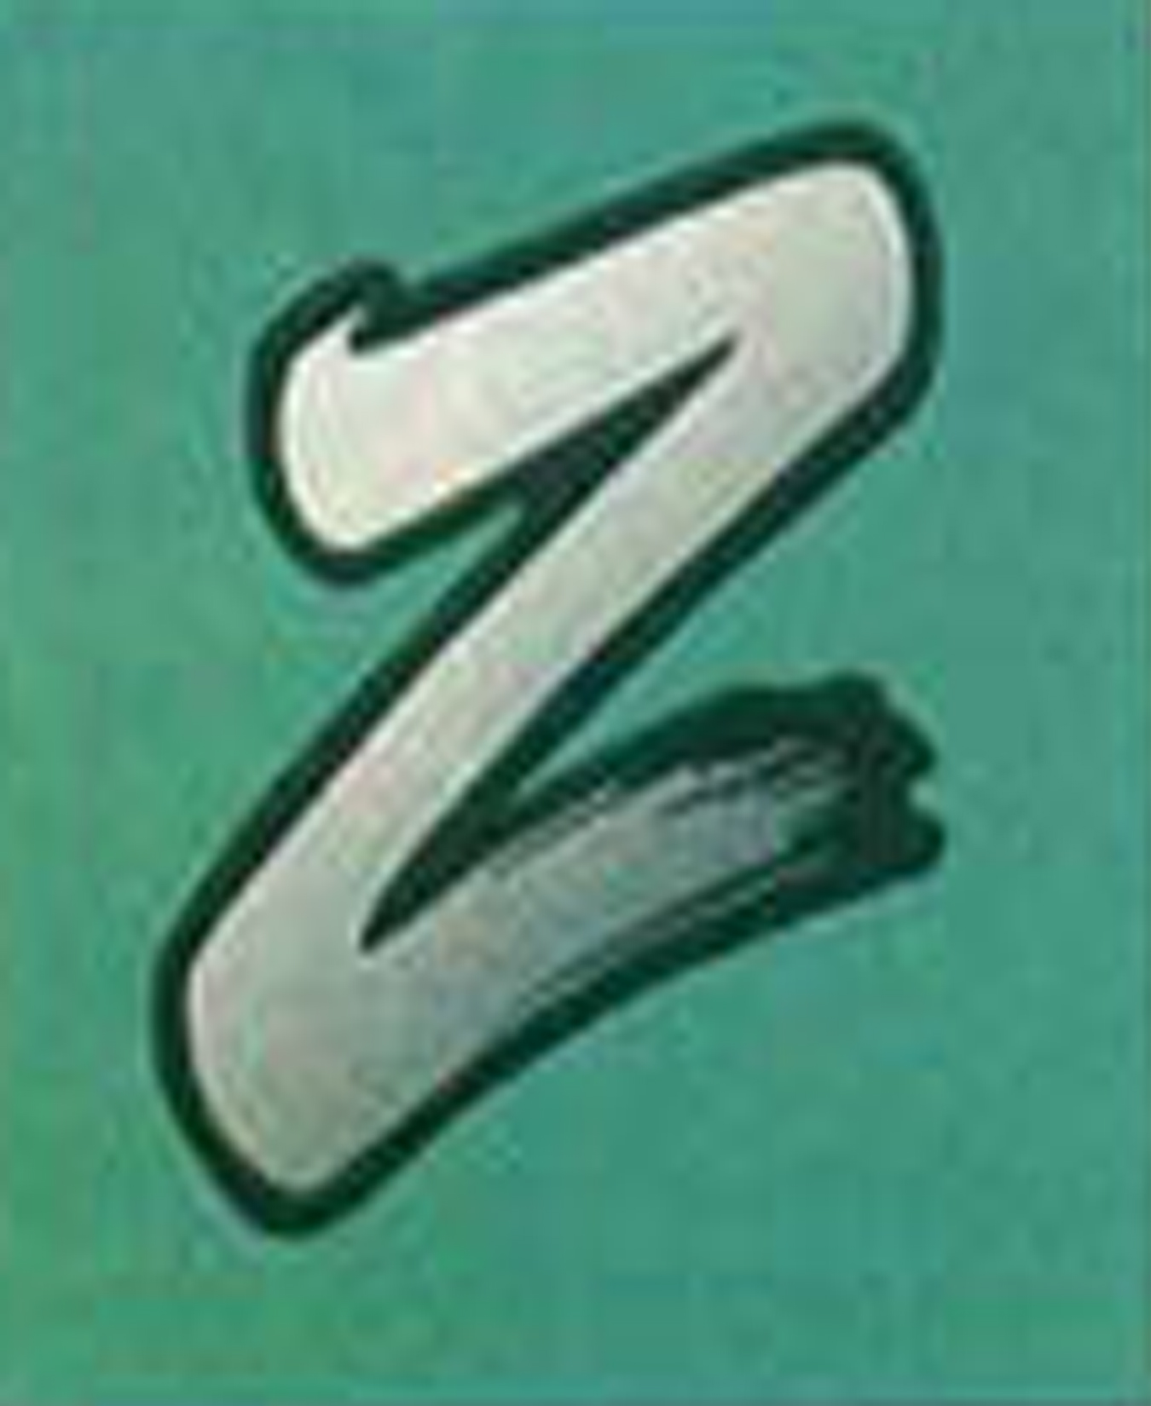
Notes:
Zest – a brand of Proctor & Gamble – ticker symbol – PG – traded on NYSE

