Slide 1
Contents
Immigration
Insurance

Slide 2
IMMIGRATION BRIEFING
Middle Tennessee State University
August 17th, 2021
Office of International Affairs

Slide 3
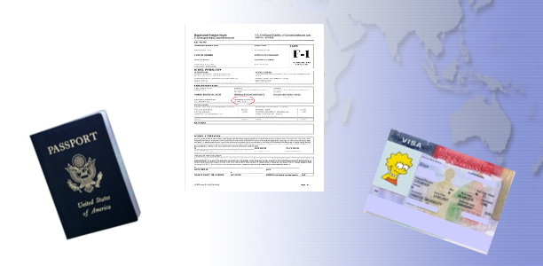
Immigration & Documents

Slide 4
SEVIS and USCIS
1. SEVIS- Student and Exchange Visitor Information System. An online database that allows USCIS and the Department of Homeland Security (DHS) to assist all international students.
2. USCIS-United States Citizenship and Immigration Services. Approves VISA status and changes, OPT, and Economic Hardship.

Slide 5
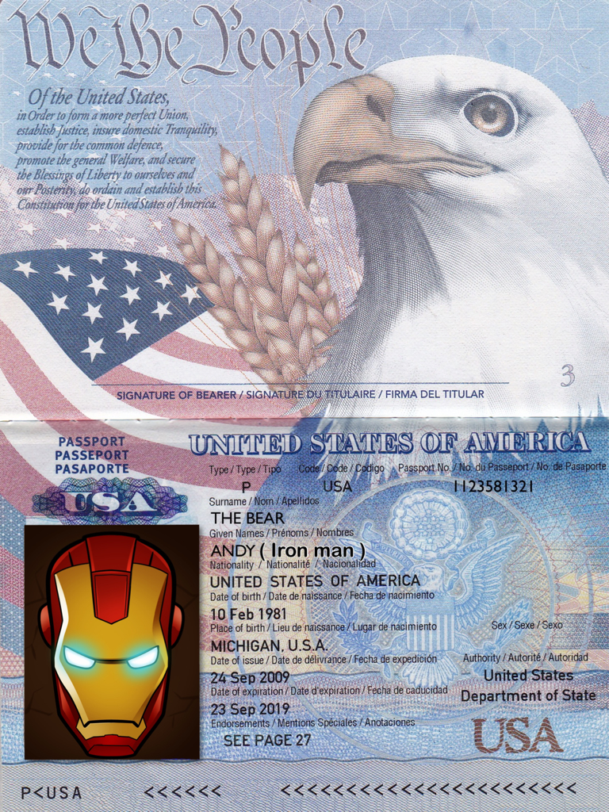
Passport
Maintain a valid passport at all times while in the U.S.
Know your expiration date.
Renew prior to expiration (6 months ahead).
Contact your home country consulate or embassy in the U.S. for renewal information.

Slide 6
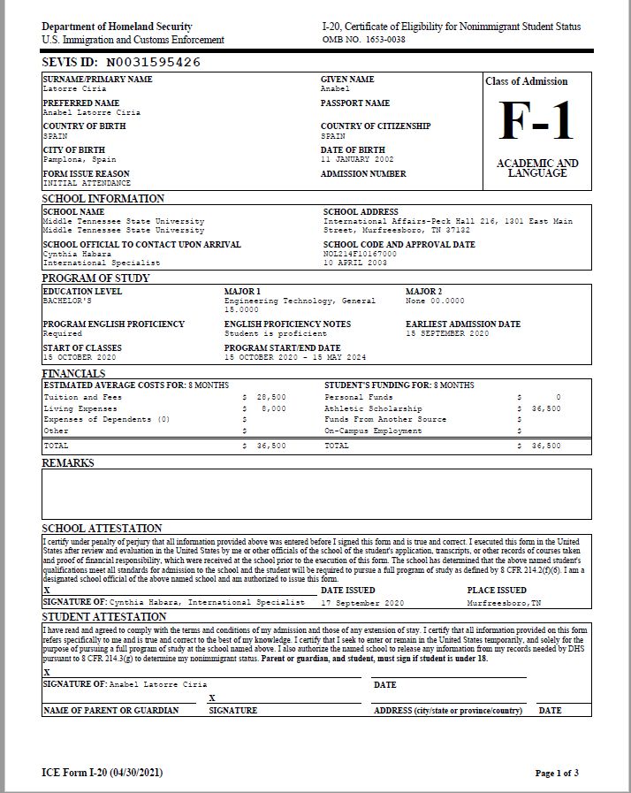
I-20 and DS-2019s
Know your Program End Date.
Renew prior to expiration (at least three months ahead).
Must reflect current and accurate information.
Have it endorsed for travel outside of US.
Your Name Here

Slide 7
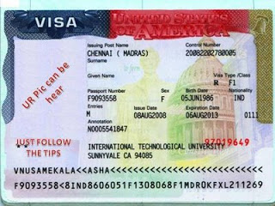
Visa
A visa is only a permit to enter the United States.
May expire while in the U.S. as long as you are maintaining status.
You must make sure that your visa is valid for your entry or re-entry.

Slide 8
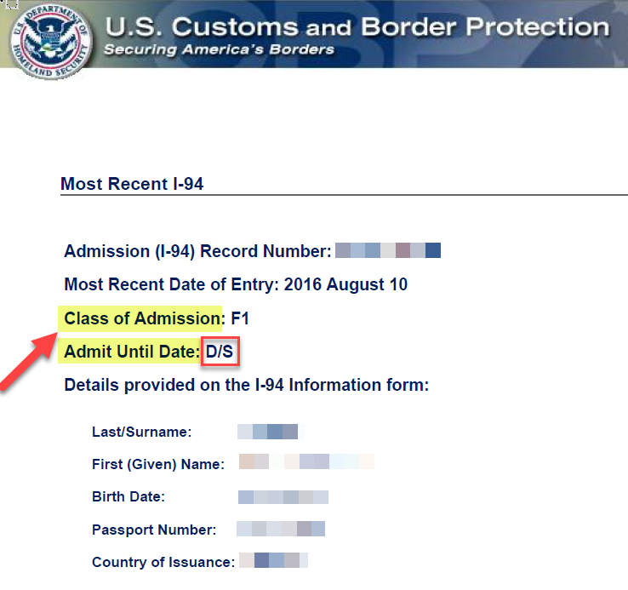
I-94 Card
Your Arrival – Departure Record.
D/S which means “Duration of Status” (including 60 days grace period).
The old I-94 card
The I-94 can now be obtained at:
https://i94.cbp.dhs.gov/I94/request.html

Slide 9
Maintaining Legal Status 1
Be enrolled full-time every semester.
Undergraduate Students-
12 minimum credit hours each semester
Nine (9) credit hours on campus
One three-hour course may count to the 12 total.
2. Graduate Students-
1. Nine (9) minimum credit hours each semester
2. Six (6) must be on campus
3. One three-hour course may count to the 9 total

Slide 10
Maintaining Legal Status 2
Make certain your I-20 or DS-2019 does not expire and is issued for your current academic program.
If you will not be able to finish your academic program by the program end date, you must tell your DSO BEFORE the end date.
If you change your major, you must tell your DSO. The code on your I-20 will change also.
Travel with valid IA “travel signature” on I-20.
The travel signature is valid for one year.
Have your I-20 signed BEFORE you travel

Slide 11
Maintaining Legal Status 3
Work only with the required permission and never more hours than regulations permit.
(Discussed later)
Timely depart the U.S. when your program is completed.
If you finish your program, you have a 60-day grace
period.
Leave the Country
Transfer to a different university
Apply for OPT
Apply for a new VISA type-USCIS

Slide 12
Maintaining Legal Status 4
1. Documents should always be valid. Renew prior to expiration.
Passport (6 months ahead) (expired visa- important for re-entry)
I-20 (2 months ahead)
2. Maintain academic progress
Undergraduate: 12 credits per semester
2.0 GPA
b) Graduate Students: 9 credits (6 credits if you have a GTA)
1. 3.0 GPA for Graduate
2. 3.25 GPA for Doctorate

Slide 13
Full-Time Enrollment
All F-1 students are required to maintain full time
enrollment throughout the semester. (SEVIS)
The exception to the full-time study rule is called
Reduced Course Load.
You must always obtain advance permission from a DSO prior to reducing your course load.

Slide 14
Exceptions
Reduced Course Load is allowed in special cases
1. Medical- documentation required(limited)
2. First semester-language problems/Improper
course level placement.
Only once- Must be enrolled ½ course load.
3. Last semester-remaining coursework permission from Academic Advisor
??What if classes are full or not offered?
Always Get Authorization

Slide 15
Exceptions
A leave of absence
If taking a leave for personal reasons you must depart the US
and return to home country.
I-20 will be terminated, and a new I-20 issued for return.
Exception: You may remain in the U.S. for medical reasons for one
semester if a doctor supports your request.
Your visa will be terminated if you fail to enroll full time in classes.

Slide 16
Changes to your U.S. Address and U.S. Phone Number
All F-1 and J-1 students are required to report their U.S. address and U.S. phone number to the government.
You can update your information in Pipeline and the IA office will pass this information to SEVIS on your behalf.
Any change to your address or phone number must be reported to the IA office within 10 days of the change.
This is required as a condition of your F-1 Status.

Slide 17
Employment 1
On Campus Employment
You may work anywhere on MTSU campus.
20 hours/week during spring and fall semester.
40 hours/week during semester breaks.
Hours are set by SEVIS
Do not violate these rules!
2. Attend the OPT/CPT workshop

Slide 18
Employment 2
On Campus Employment
1. It is up to you to find a job.
Library
MT Dining Services/Aramark
Academic Departments/Tutoring
MTSU Bookstore
Begin with the dynamic form on the I.A. home page, to get your Social Security Number

Slide 19
Employment 3
Off Campus Employment
1. OPT – Optional Practical Training
After one year of full-time enrollment
2. CPT – Curricular Practical Training
After one year of full-time enrollment
3. Economic Hardship Status
Request application from international office
Provide documentation of hardship e.g.: proof of currency
devaluation
Mail application to USCIS
Illegal without proper authorization

Slide 20
Employment 4
Optional Practical Training (Pre/Post)
1. Work done before or after graduation that is directly
related to your major.
2. Request application from international office.
3. Start working when USCIS approves application (usually takes 3-5 months).
4. You remain an F-1 student so requirements for health
insurance, travel signatures, etc. still apply
5. STEM programs eligible for a 1 time 24-month extension

Slide 21
Employment 5
Curricular Practical Training (CPT)
An internship or work
Must benefit your current academic program
Must have approval from your advisor
Must be enrolled in a class at the time CPT is done.
Requires approval from the DSO and a CPT I-20.
You may not work until you have the CPT I-20.

Slide 22
Completion of Degree Program
You complete all required coursework
Obtain your degree
You have 60 days to:
Transfer to another school
Return home
Change of Status
Apply for OPT

Slide 23
Conclusion:
What you should remember…
Remember, you are responsible for maintaining your immigration status.
Check the end date of your I-20 and notify the international office 2 months prior to ending date for approved extension.
You must enroll every semester.
You must maintain full-time enrollment of at least 12 credit hours throughout the semester.

Slide 24
Conclusion:
What you should remember (cont.)
Check travel documents often and keep valid.
Working off campus is illegal without the correct authorization.
Come to the international office for any questions or concern you may have.
7) Immigration regulations are serious but don’t panic.
Always remember, we are here to help you!

Slide 25
Suggestions:
What you should remember…
Always ask questions if you do not understand; there are no dumb questions
Don’t be afraid to ask for help.
Not knowing is not an acceptable excuse
Being international is not a reason for additional time on an examination
Be Brave!
Study, Learn and Enjoy!

Slide 26
Insurance
Purchasing Mandatory Health Insurance
All F-1 visa holders are required to purchase health insurance and maintain coverage for the duration of their stay in the U.S.
International students are required to have health insurance coverage at all times while in the United States to maintain their immigration status.
To assist you, the Middle Tennessee State University has partnered with Lewermark. A company that specializes in health insurance for international students. All MTSU international students not sponsored by their home government will automatically be enrolled in the MTSU international student insurance plan.

Slide 27
Insurance
Things to remember
You must maintain health insurance coverage while you are in the US, even if you are not taking classes, for example, during the summer;
Failure to maintain this coverage could subject you to be reported as out of status, which could result in deportation;
If you have dependents with you, you must provide coverage for them as long as they are in the US, as well;
You are responsible for the full costs of your medical expenses, including co-pays and deductibles;
You should visit Health Services on campus for all your medical needs. If you need medical attention they cannot provide, they can help you find the proper attention off campus. They can often ensure that you visit a doctor within your insurance policy's list of approved providers;
You should contact your insurance company prior to visits to doctors and hospitals off campus to ensure your insurance will cover those expenses.

Slide 28
INSURANCE ORIENTATION INFORMATION
Immigration regulations require that F1 & J1 visa holders be insured to maintain immigration status.
It is your responsibility to make sure that you maintain the required insurance coverage according to Immigration Regulations.
If you failed to maintain insurance coverage, you are subject to be reported to Immigration, which could cause deportation.

Slide 29
Print your insurance card from the recommended insurance company Lewermark.
You will need to visit the website of https://www.lewermark.com/mtsu for questions or concerns and print the brochure. The company name is Lewermark.
When you visit an off campus doctor, take the following:
Insurance Pamphlet
Insurance card
Passport and immigration documents for identification
MTSU photo ID card
Insurance cards will not be available until at least two weeks after the first day of class.

Slide 30
Doctor’s Office can demand payment in full or partial payment even if you are insured. The insurance company or doctor’s office will refund you if this occurs.
If you do not enroll in classes for the summer terms, you are not charged the MTSU insurance. You may purchase the insurance directly from Lewermark. You are required by law to maintain continual coverage.
It is a good idea to go to Health Services on campus all your medical needs. Some illnesses can be treated on campus with little or no cost to the student. If you need to see an off-campus physician, Health Services can refer you to one that is in the insurance’s group of physicians.

Slide 31
MOST IMPORTANT, CALL THE INSURANCE COMPANY FOR INFORMATION, IF POSSIBLE, BEFORE SEEING AN OFF CAMPUS DOCTOR OR IF YOU ARE IN DOUBT IF YOU ARE COVERED FOR A PARTICULAR ILLNESS OR PROCEDURE.
If you must go to a Doctor before the two-week waiting period, contact our office in order to have the insurance company confirm your coverage to the physician’s office or hospital before your appointment. Our office is not authorized to confirm insurance to anyone.
Visit the insurance web site of Lewermark following these instructions:
https://www.lewermark.com/mtsu
Set up your Student Login like available from the above website.
Insurance Cards can be printed from your computer.

Slide 32
Accessing your Lewermark account
Go to www.lewermark.com/mtsu and choose “Print your ID Card.”

Slide 33
Accessing your Lewermark account (cont.)
Follow the instructions on-screen to set up your account.

Slide 34
Insurance Processing for Option Coverages
Students can purchase coverage for more than one semester, such as annual or academic year coverage
THE PREMIUM FOR THESE OPTIONAL COVERAGES WILL APPEAR ON YOUR TUITION BILL. You will be responsible to purchase and pay those types of optional coverage premiums which will be included in your Fall 2021 tuition bill.
Please remember that we do not confirm your name to the insurance company until at least 14 days after the first day of class. Contact international@mtsu.edu if you should need to see a medical doctor or have visited an emergency room before this date.

