Slide 1
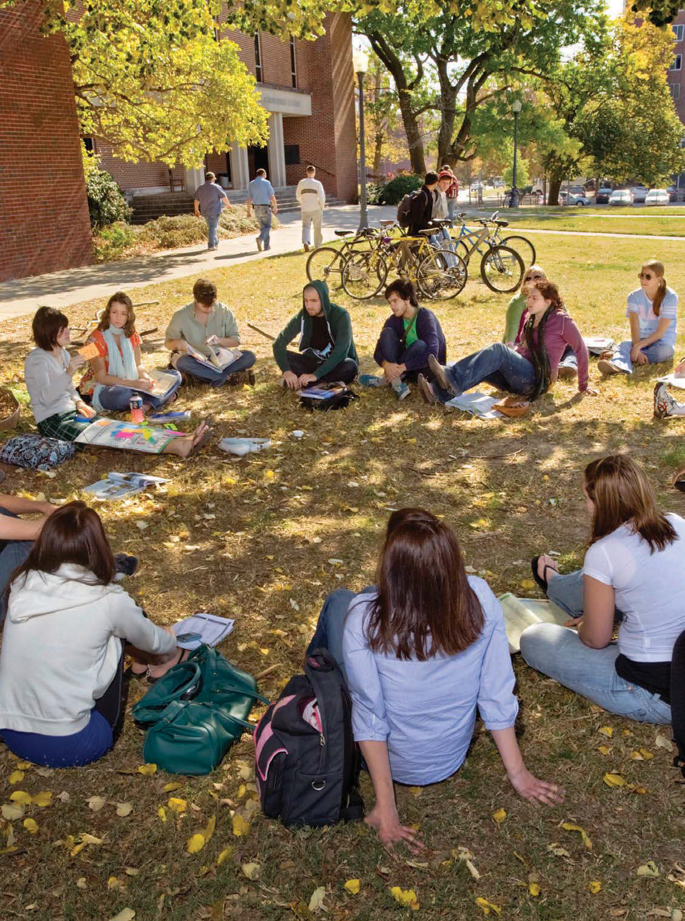

Town Hall Forum:
Quest for Student Success
Presentation and Open Dialogue on
MTSU’s Student Success Strategic Initiative
with
President Sidney A. McPhee
Dates:
April 15, 2014
April 16, 2014
April 17, 2014
TBA
New Student Union Building
Parliamentary Room

Slide 2

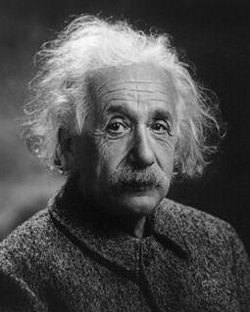
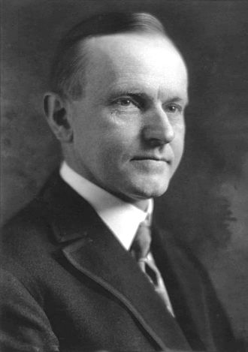
Town Hall Forum:
Quest for Student Success
Words of Wisdom
  “An intelligent man doesn’t answer every question he is
  asked.”
  Albert Einstein
  “You don’t have to explain something you never said.”
  Calvin Coolidge

Slide 3
Town Hall Forum:
Quest for Student Success
Higher Education Landscape
Source: Educational Advisory
Board Student Success Collaborative

Slide 4
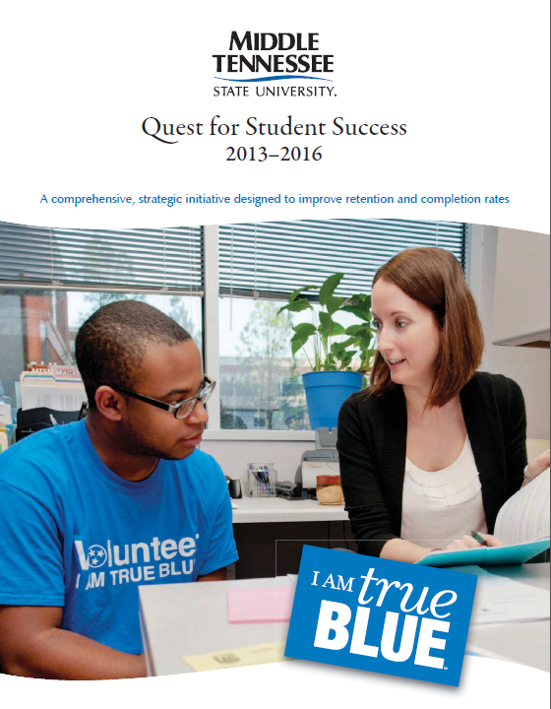
Town Hall Forum:
Quest for Student Success
MTSU’s Quest for Student Success
  Why?
  What?
  Whose initiative is it?
  It’s the right thing to do!!!
  Accountability mandated by local, state, and national policy officials!!!

Slide 5
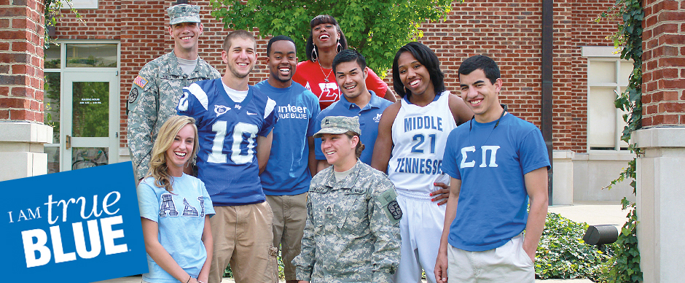
Town Hall Forum:
Quest for Student Success
“MTSU’s Quest for Student Success keeps the University focused on its primary purpose—educating students. It weaves student success and academic enhancement into the institutional core and emphasizes how best the University can engage and support students as they progress, achieve, and graduate.”
Source: Quest for Student
Success Strategic Initiative
“Success begins with the first interactions the student has with the University. From that initial encounter forward, the University must deliver to all students a clear and consistent message: Success is a partnership between the student and the University. This partnership requires the student’s commitment to academic and personal achievement and MTSU’s commitment to provide support and an outstanding academic experience.
This mutual commitment will ensure the highest probability of success for each student recruited and enrolled. Quality programs coupled with a thriving and supportive intellectual community attract success-oriented students and provide a clear path for academic achievement.”
Source: Quest for Student
Success Strategic Initiative

Slide 6
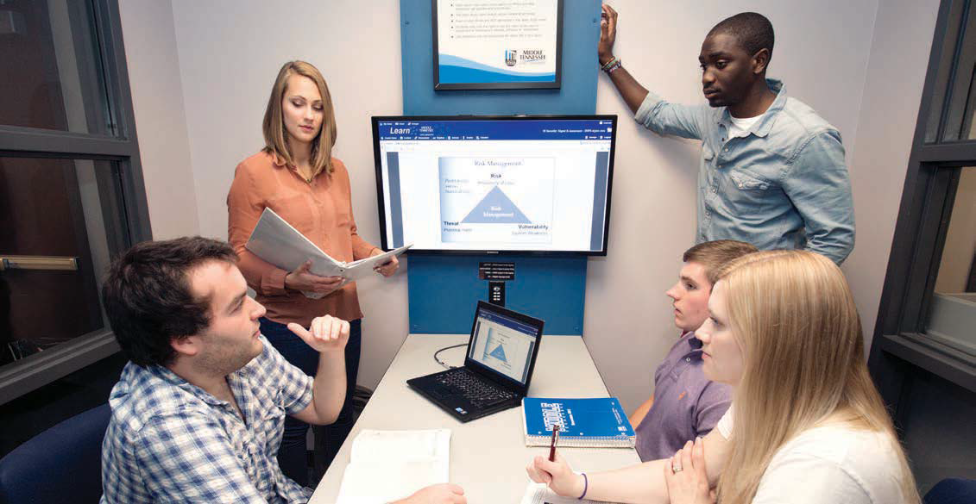
Town Hall Forum:
Quest for Student Success
Actionable goals of the initiative
  Recruit students who value academic success and have potential to succeed at a four year comprehensive university
  Seek to enhance the academic experiences for our students
  Facilitate student success through innovation, use of data, and informed best practices

Slide 7
Town Hall Forum:
Quest for Student Success
The initiative focuses on 5 specific strategic areas:
  Recruiting and enrolling students having the potential to be academically successful
  Enhancing academic advising
  Developing and supporting innovative instructional strategies and programs
  Breaking down administrative barriers to student success
  Employing the latest technology and best practices regarding data analytics and predictive modeling to support student success

Slide 8
Town Hall Forum:
Quest for Student Success
Enhancing advising
  Greater focus on improved advising on the campus
  The university is strengthening its shared model of academic advising
  This enhancement is intended to add resources and support so that students may access improved quality advising and mentoring from the professional and faculty advisor.

Slide 9



Town Hall Forum:
Quest for Student Success
Data informed decision making
  Education Advisory Board (EAB) Student Success Collaborative
  USA Funds and Rezolve Group pilot financial predictive analytics project

Slide 10
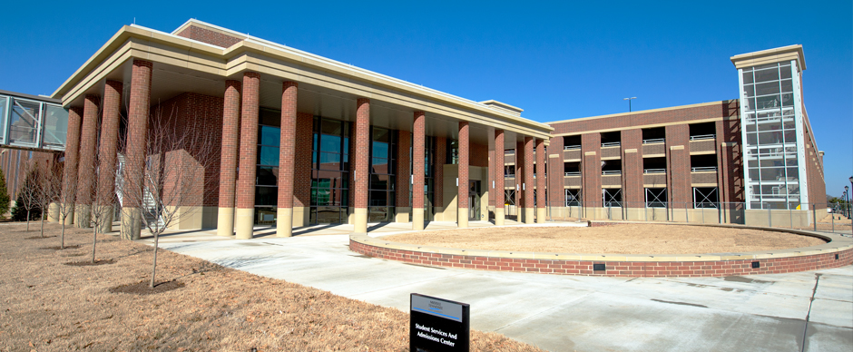
Town Hall Forum:
Quest for Student Success
Other components for the
Quest for Student Success initiative:
Breaking down barriers
  MT One-Stop
  Enrollment counselors
  Enrollment purge changes
  Financial aid support
Recruiting and enrolling students with the potential to be successful at a university
  Already implemented

Slide 11

Town Hall Forum:
Quest for Student Success
Supporting instructional innovation leading to improved student success
  Course redesign project
  Midterm grades
  Other initiatives

Slide 12

Town Hall Forum:
Quest for Student Success
Reminder: there is no silver bullet
  Our success is going to take a long-term, sustained effort
  We can be proud that we are making a collective effort to improve student success
  We are poised to be a leader in higher education

Slide 13
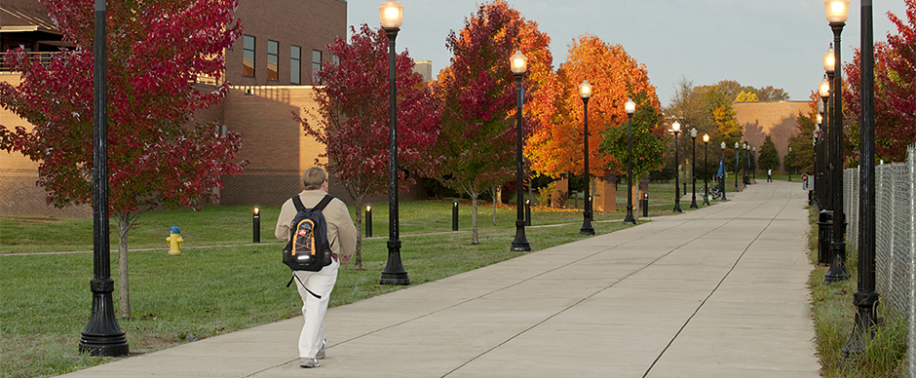
Town Hall Forum:
Quest for Student Success
Conclusion and Wrap Up

Slide 14

Town Hall Forum:
Quest for Student Success
Questions and Answers

Slide 15
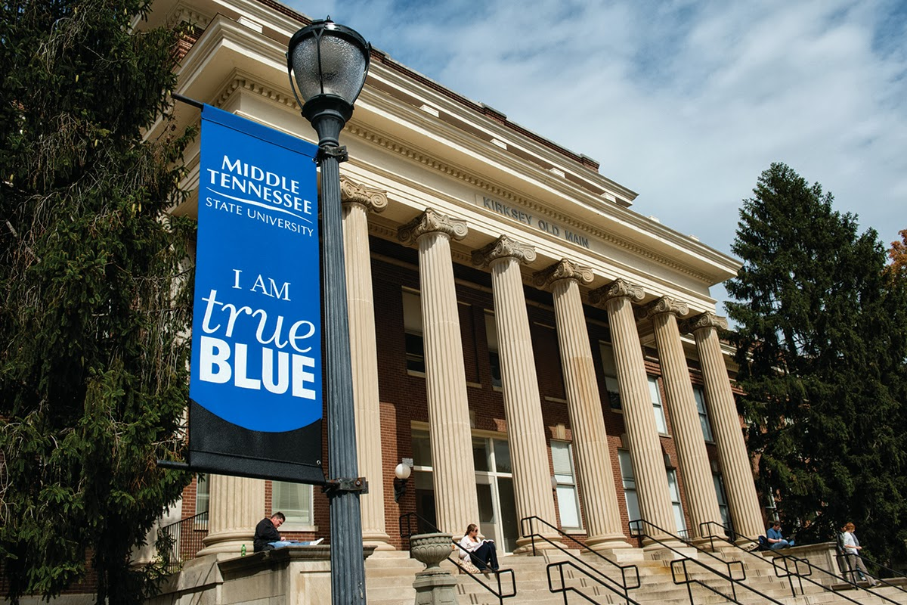
Town Hall Forum:
Quest for Student Success
Ten Key Points that guide our Quest for Student Success
1. Student Success is born and nurtured in the classroom
2. The results will take time but we cannot afford to take our time.
3. We will customize what worked elsewhere and shape it to fit our context
4. Our decisions are being data-informed and not necessarily data driven
5. We will employ both high tech and high touch strategies to maximize our reach
6. To maximize momentum and synergy, we are developing connective projects
7. We are proud of the students we have and are committed to serving them
8. Our Quest for Student Success includes all, involves all and invites all
9. Our most effective initiatives will affect the most of our students
10. In terms of success, in order to have something else we must do something else

